Slide 1
Session 1:
Efficient Processes
Andrzej Górak, Dorota Pawłucka
TU Dortmund University, Germany
SPIRE PPP Impact workshop
Brussels, 21-22 April 2015

Slide 2
Domain 1: Process Optimization
Projects:
COPIRIDE (COP) F3-Factory (F3)
INCAS (INC) POLYCAT (POL)
SYNFLOW (SYN) MAPSYN (MAP)
INNOREX (INN) ALTEREGO (ALT)

Slide 3
Aggregated technological impact
Highly selective catalysts
New synthesis routes
Modularisation of chemical production
Life cycle assesment
Process Intensification: integrated processes, new reactor concepts, batch to continuous, alternative enregy sources
Advanced design of integrated technologies
Industrial case studies

Slide 4
Aggregated technological impact
Highly selective catalysts
  High-end selectivities (>99 %) of advanced catalysts for hydrogenation of pharma molecules (MAP, SYN)
  Development of novel polymer-based nanoparticulate catalysts (POL)
  New synthesis routes (F3, SYN, MAP)
  Challenging hydrogenation
  Synthesis of API

Slide 5
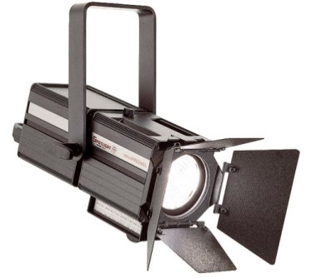
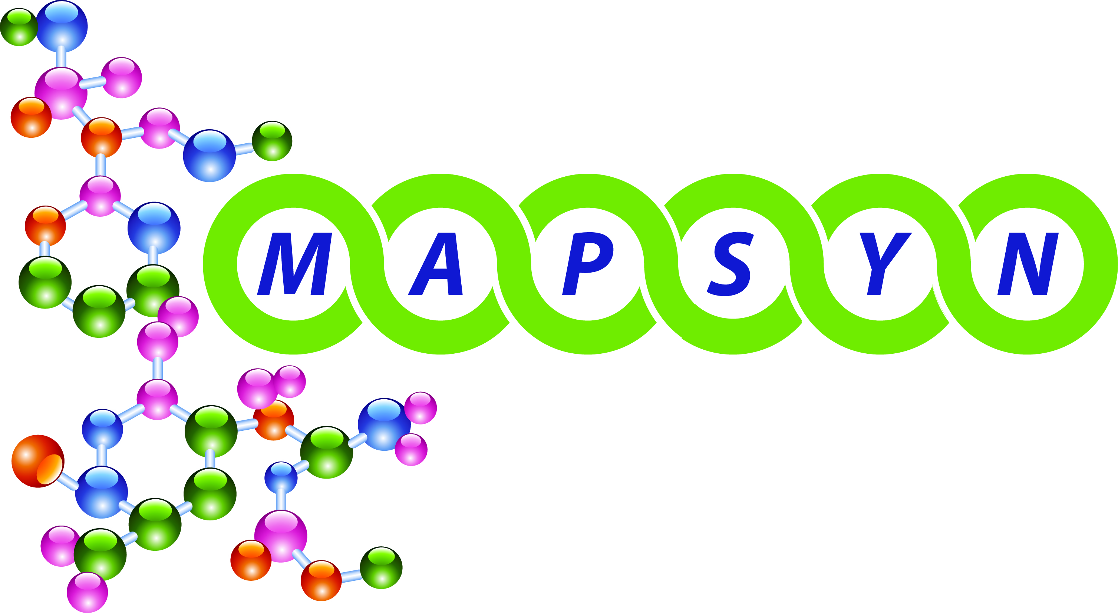
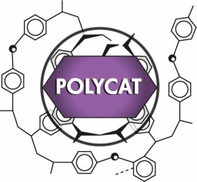
Innovation in fine chemical synthesis addressing especially pharmaceutical, crop protection and vitamin synthesis by novel catalysts and microflow conditions
Development of novel polymer-based nanoparticulate catalysts
Scaleable (micro) reactor concepts and a container based modular plant platform for the specific need e.g. of API synthesis
High-end selectivities (>99%) of advanced catalysts in hydrogenations to pay off in the manufacture of highly-valuable materials
Use of abundantly available resources such as air (N₂/O₂) in nitrogen fixation
Compete with very advanced technology (Haber-Bosch) through finding of new Windows of Opportunity (distributed production)
Novel polymer based catalysts and microflow conditions as key elements for innovation in fine chemical synthesis
Microwave, Acoustic and Plasma assisted SYNthese

Slide 6
Aggregated technological impact
Modularisation of chemical production
  Technologies for modules in prefabricated containers for flexible, efficient continuous production (F3)
  New modular production and factory concepts (mobile plant or miniplant) for chemical industry for flexible and adaptive production (COP, POL)
Life cycle assesment (MAP, COP, POL)
  Guidelines
  Ex-ante cost analysis

Slide 7
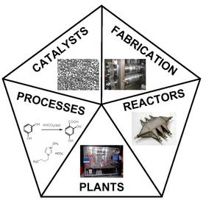
Flexibilisation of chemical production by novel plant concepts like a mobile plant in container formal for chemical production or a miniplant concept with focus on modular assembly and easy integration into existing facility infrastructures.
More focused development process by accompanying ex-ante cost analysis and Life Cycle Analysis.
More efficient chemical production processes and faster market implementation of chemical product ideas by above technologies and by broader uptake of PI, NPW, microreactor technology, and continuous processes.
Combining Process Intensification-driven Manufacture of Microstructured Reactors and Process Design regarding to Industrial Dimensions and Environment

Slide 8
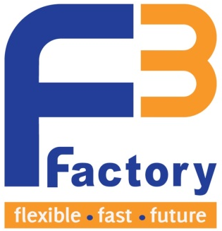
Define and demonstrate new modular, standardised, continuous production technology (F³ Factory) for low to medium scale production
Fast integration of novel (process intensification) technologies and concepts
Standardise processes and their interfaces
flexible
Lower CapEx and investment risk in entering new and volatile markets
Adjusted production volume to market demand
fast
Reduced industrialization time
Reduced time to market
Faster access to new geographic markets
future
New and advanced chemical & process solutions
Enhanced inherent safety for hazardous chemistry
Reduced working capital & cost of products sold

Slide 9
Aggregated technological impact
Process Intensification
  integrated processes
    Enzymatic reactive distillation (ALT)
    Reactive extrusion (INN)
    Reactive distillation (F3, COP, INC, SYN)
  new reactor concepts
    Membrane reactors (INC),plasma reactors (ALT)
    Scalable (micro)reactors (POL, COP)
    Automated reactors (SYN)
  batch to continuous (F3, COP, ALT, POL)
    Continuous polymerisation (INN)
    Continuos-flow reactions (SYN)

Slide 10
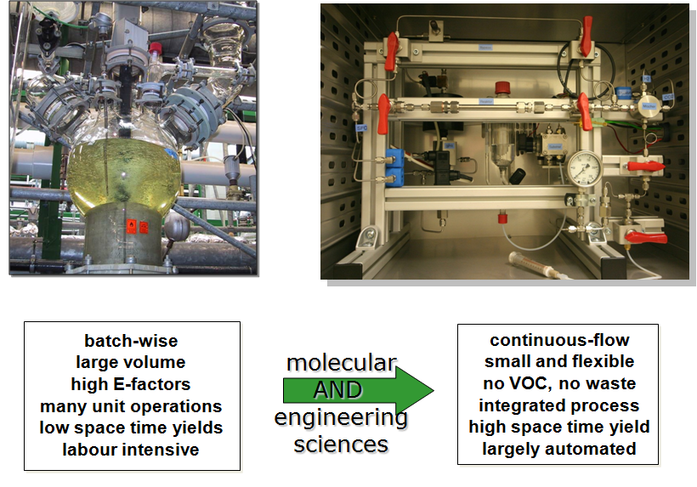

Innovative Synthesis in Continuous-Flow Processes for Sustainable Chemical Production

Slide 11
Aggregated technological impact
Advanced design of integrated technologies
  Advanced design of catalyst/membrane integrated systems (INC)
  Modelling of process with integrated alternative energy forms (ALT, INN)
  Process modelling and optimisation of combined reaction/separation processes (F3, COP, SYN, MAP, INN)

Slide 12
Aggregated economic/social impact
Cost reduction
Improved safety
Increased competitiveness of Europe´s industry
Increased sustainability

Slide 13
Aggregated economic/social impact
Cost reduction
  Enhanced resource efficiency (raw material savings) & energy efficiency – all
  Improvement in process efficiency - all
    increased selectivity
    increased separation efficiency
    time-to-market reduction
Improved safety
  Avoid storage of toxic intermediates/reactants (INC)
  Reduced metal contamination in isolated pharmaceutical products (SYN)

Slide 14
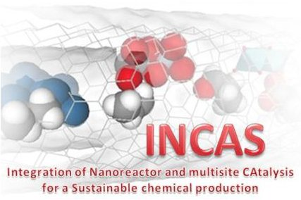
Improve safety of the process (avoid storage of toxic intermediate/reactants)
New reactor concepts for process intensification
Advanced design in multilayer catalytic membranes
Improved (more stable, higher productivity) catalysts
New nanomembranes
Alternative process design (competitive manufacturing)
Integration of Nanoreactor and multisite CAtalysis for a Sustainable chemical production

Slide 15
Aggregated economic/social impact
Increased competitiveness of Europe´s industry
  Cost-reduced and more resource & energy efficient processes (all)
  Flexible & adaptive production (COP, POL, F3, SYN)
  Novel concepts, alternative process design (competitive manufacturing) (all)
  Reduction of development time & faster market implementation (COP, POL, SYN)

Slide 16
Aggregated environmental impact
Use of alternative, green energy sources
Reduction in emissions
Reduction of fossil fuel use
Reduction in waste & water
reduction in environmental impact

Slide 17
Aggregated environmental impact
Use of alternative, green energy sources
  Microwaves, ultrasound, non-thermal plasma for improved reaction selectivity & separation efficiency in advanced pharmaceuticals synthesis as well as for green fuel and bulk chemical synthesis (ALT)
  Plasma, microwave, ultrasound for electrification of chemistry, selective hydrogenations & nitrogen fixation reactions (MAP)
  Microwaves, ultrasound, laser light for bioplastics (INN)
Reduction in emissions (all)

Slide 18
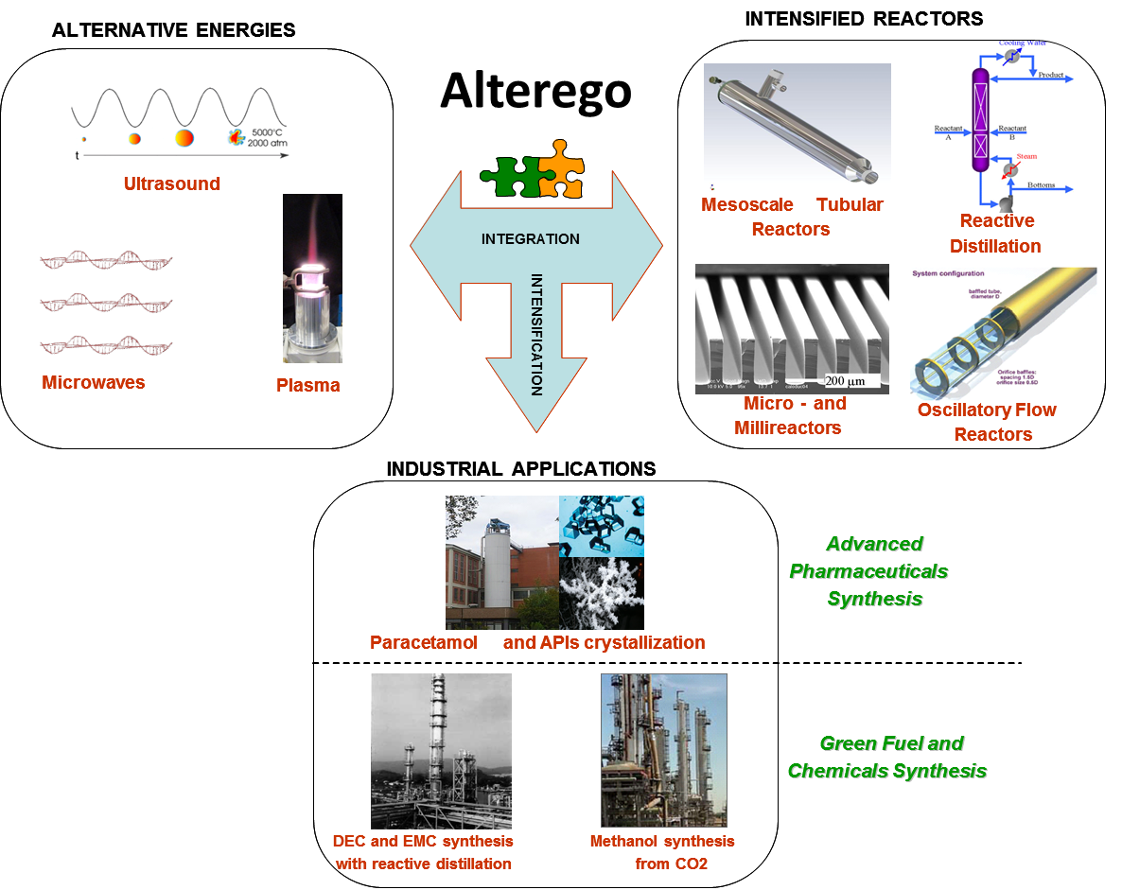
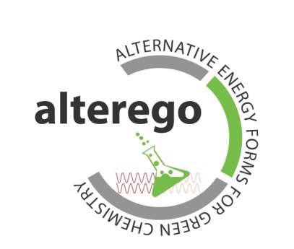
Advanced pharmaceuticals synthesis (paracetamol) using microwaves & ultrasound
  reduce lead time, increase selectivity & thus yield, switch to continuous production
Ultrasound enhanced enzymatic reactive distillation as novel reactor concept
  Improvement in reaction yield & selectivity, improvement in separation efficiency, shorter reaction times, smaller equipment

Slide 19
Aggregated environmental impact
Reduction of fossil fuel use
  Renewable raw materials (starch) for bioplastics: PLA (INN)
  Renewable raw materials like sugars, soybean oil, waste plant oils (COP)
Reduction in waste & water
  reduction of non-biodegradable waste via replacement of metal-containing catalysts (INN)
  Avoiding byproduct formation (INC)
  Reduction of waste & water by 15-50 % (SYN)

Slide 20
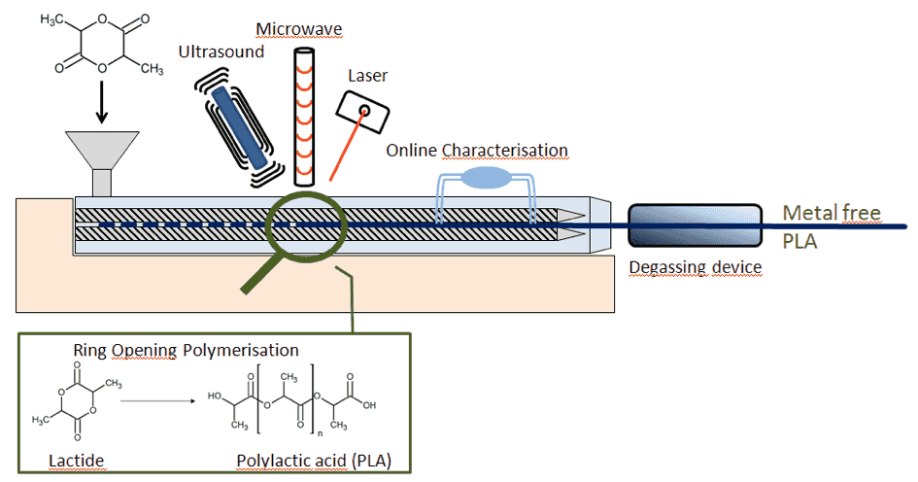

Resource and energy savings together with reduction of CO₂ emissions through using PLA as substitute of petrol-based polymers
70% reduction of fossil fuel use over traditional plastics
PLA comes from a renewable resource (starch)
PLA degrades completely within 3-4 weeks
Reduction of non-biodegradable waste
Continuous, highly precise, metal-free polymerisation of PLA using alternative energies for reactive extrusion

Slide 21
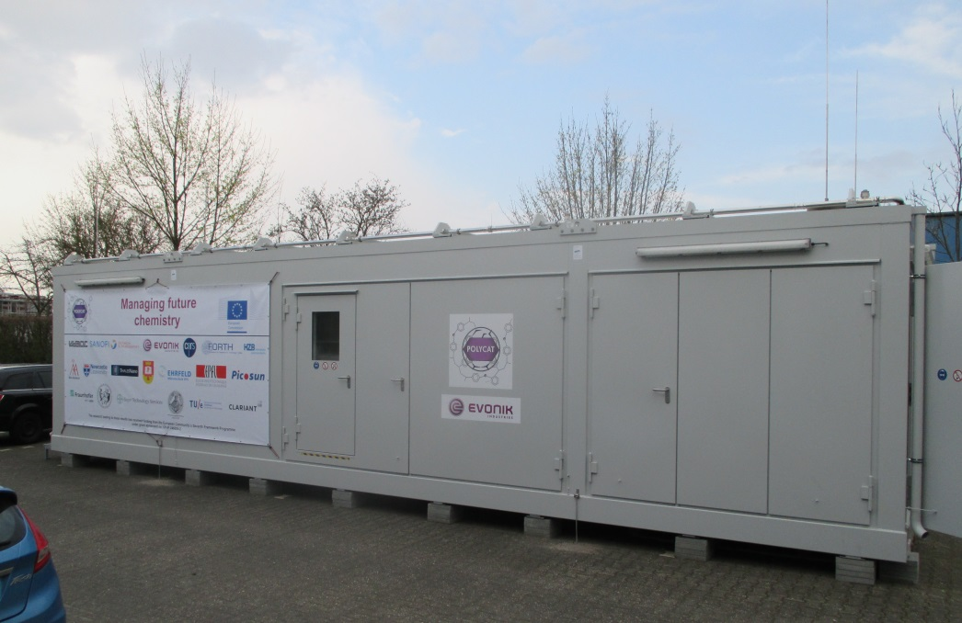
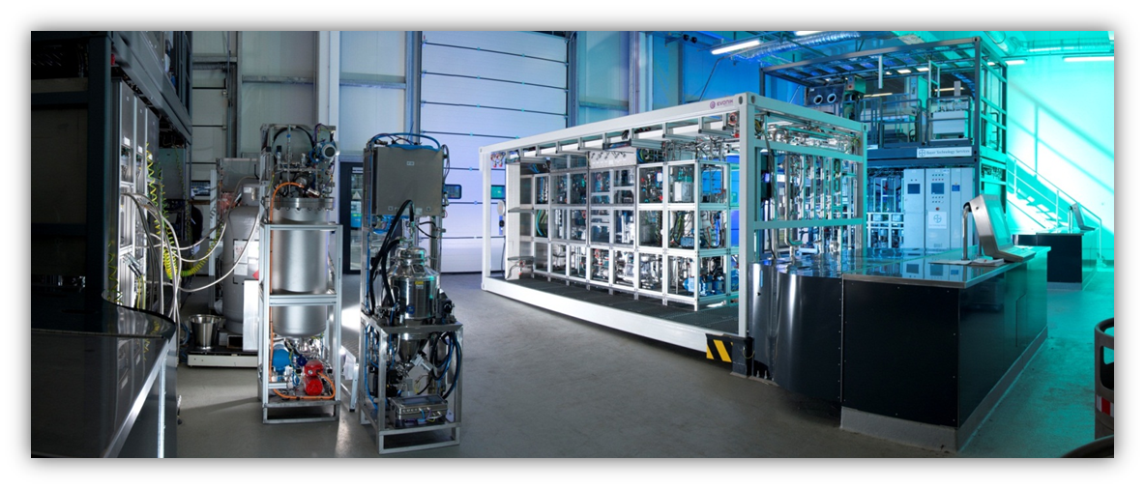
Technical cross-cutting issues
Standardisation
and demonstration
Modular Equipment:
  (F3, COP, POL)
Ecotrainer
New production/scale-up concepts
and process intensification
(F3, ALT, MAP, COP, POL)
Container at
INVITE

Slide 22
Non-technical cross-cutting issues
Clustering
Dissemination
Skills development
Business deployment
Strengthens collaboration

Slide 23
Non-technical cross-cutting issues
Clustering
Clustering within the domain:
  Plasma and hydrogenation cluster (MAP)
  Cluster on catalysis (INC)
Clustering with outside the domain:
  ISPT (NL)
  SusChemSys, CLIB²⁰²¹ (DE)
  MEPI (FR)
  SusChem (EU)
Confidentiality & trust in the context of IPR
Notes:
ZU Confidentiality: “Although the IEB members signed a NDA and their presence has been approved by the Consortium, they are external to the research, thus any information provided has to be evaluated properly”

Slide 24
Non-technical cross-cutting issues
Decision makers and knowledge brokerage
Regional/national research policy (North Rhine-Westphalia, DE, NL) (ALT, MAP, F3, COP)
Knowlegde brokerage (EUROPIC, 20 companies, 8 of them participating in workshop)
R4R concerted action
Workshop of Process Intensification in SPIRE community (first attempt failed)
KET activities (ALT, INC)

Slide 25
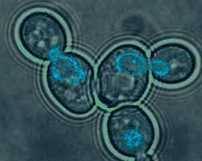

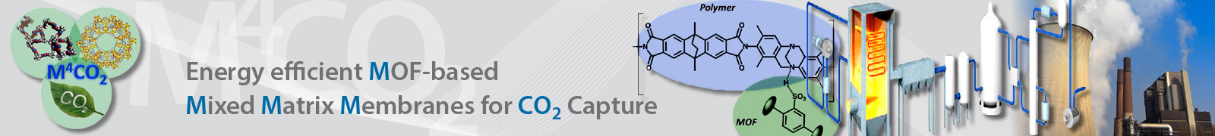
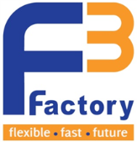


Non-technical cross-cutting issues
Strengthens collaboration
  Applications for new SPIRE calls (All)
  Applications outside SPIRE calls (see projects in Domain 2)
  New emerging projects e.g. at least 5 coordinators of SPIRE projects are holders of ERC Advanced Researcher Grants(!)
Novel
process
windows
Notes:
- Development of roadmaps

Slide 26

SPIRE: SUSTAINABLE PROCES INDUSTRY
Reduction in fossil energy intensity of up to 30% from current levels by 2030 through a combination of, for example cogeneration-heat-power, process intensification, introduction of novel energy-saving processes, and progressive introduction of alternative (renewable) energy sources within the process cycle.
By 2030, up to 20% reduction in non-renewable, primary raw material intensity versus current levels, by increasing chemical and physical transformation yields and/or using secondary (through optimised recycling processes) and renewable raw materials.
Improvement of resource and energy efficiency by new ways of utilising existing technologies/plants, as well as by implementing new and advanced process technologies
Synergies between sectors and value-chains are necessary
Scientific/Technical goals of the area

Slide 27
SPIRE: SUSTAINABLE PROCES INDUSTRY

Slide 28
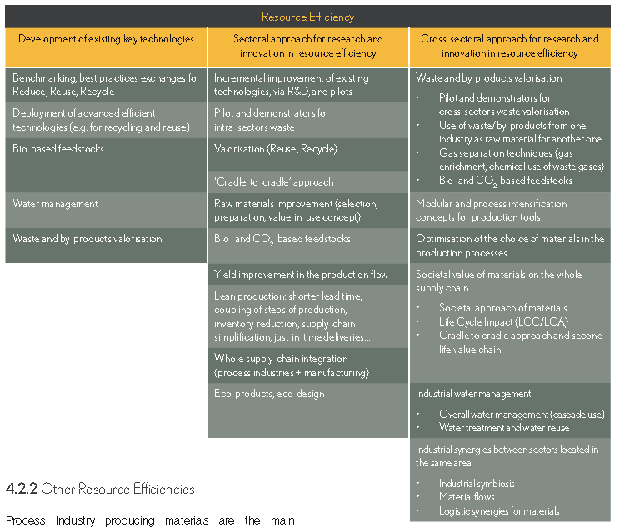
SPIRE: SUSTAINABLE PROCES INDUSTRY

Slide 29
Gap Analysis
Follow-up projects for bringing specific synthetic approaches to higher TRLs (SYN)
Scale-up is a major challenge (MAP)
Energy efficiency is the key to cost competitiveness and needs optimisation of the technology itself (MAP)
  Future challenges : process control/ automatisation, downstream integration, spread to other sectors aside broader uptake in chemical sector, new business models (COP, POL, F3)

Slide 30
Potential for further synergies and recommendations for follow-up
Room for improvement
Start-ups
Dissemination to other industry sectors
……
New research direction
Intensified equipment
New bussines models resulting from new processesing
Automation, novel IT solutions for chemical production
…….

