Slide 1
Session 2:
Process Control and Associated Parameters
Peter Singstad, Cybernetica AS,
Norway
SPIRE PPP Impact workshop
Brussels, 21-22 April 2015

Slide 2




Domain 2:
Integrated Process Control
Projects:

Slide 3
Integrated Control and Sensing for Sustainable Operation of Flexible Intensified Processes
CONSENS will remove obstacles for intensified continuous processes by:
online sensors with new capabilities (NMR, fouling, rheology)
closed-loop adaptive control concepts
monitoring and engineering tools
validation using 3 intensified continuous processes that cover the complete value chain of chemical production
(organic compounds, polymers, consumer products)

Slide 4
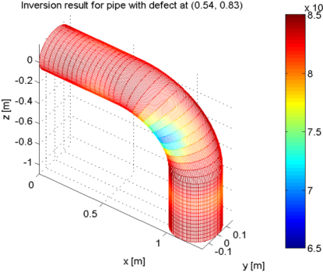
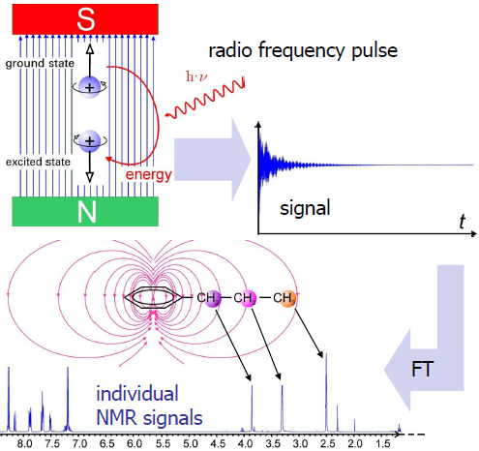
CONSENS
Ultrasound Online fouling sensor
  measure fouling layer thickness on inner surface
  detect best time to clean tube
  optimize process toward low fouling speed
  Increased capacity of plant
Ultrasound online rheology sensor
  measure viscosity versus sheer-rate function
  enables fast quality control for:
    polymer melts (T > 250°C)
    complex consumer care products
Online NMR sensor
  Measures compositions fast & accurately
  Enables new applications / features
  compared to NIR & Raman:
    Non-transparent media
    Can distinguish similar molecules
    Integral measurement over volume
    Calibration may not be required

Slide 5
CONSENS – expected impacts
Technological:
making processes resilient to variances in feed-stocks and to external disturbances
enabling the migration of batch processes to flexible continuous intensified processes
enhancing fast development of new products.
Economic:
> 130 M€/year in pharmaceutical & specialty industry
> 100 M€/year in consumer chemicals
> 35 M€/year in polymer
Environmental:
Reduction of CO2 emission
  230,000 t/year in polymer
  170,000 t/year in pharmaceutical & specialty industry
Less consumption of non-renewable raw materials
  176,000 t/year less use of solvents in pharmaceutical & specialty industry

Slide 6
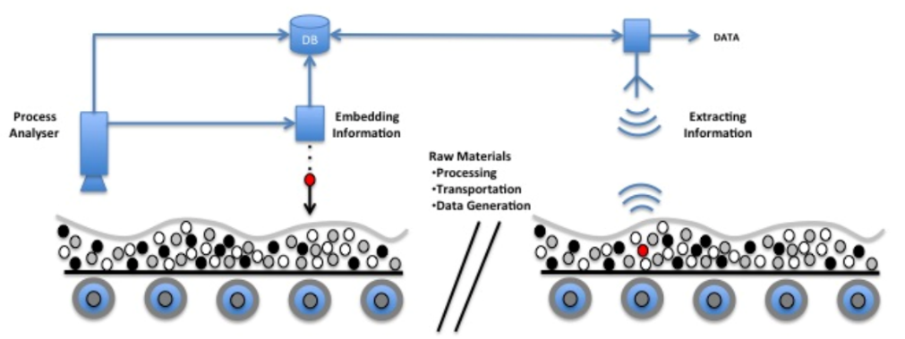
Integrated Process Control based on Distributed In-Situ Sensors in Raw Materials and Energy Feedstock
DISIRE will develop an optimisation scheme for belt conveyor transportation systems, which
eliminates idle running of conveyors
improves the reliability and availability of belt conveyors through novel condition based maintenance schemes
increases the efficiency by modernisation (belt, drive units, idlers)
http://spire2030.eu/disire/

Slide 7
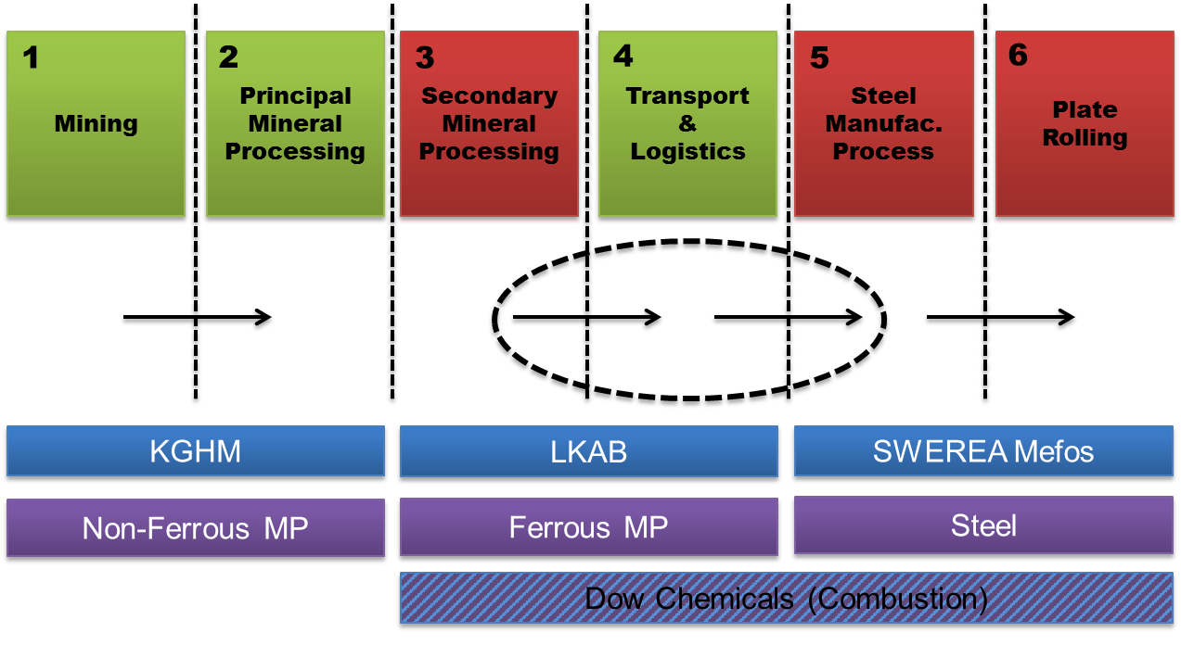
DISIRE
Mining and Mineral Processing
Industrial Combustion
Integrated Process Control
Integrating Value Chains
(from Iron ore to Steel)
Intelligent Raw Materials

Slide 8
DISIRE – expected impacts
STEEL
  Reduction of 3 kg of C from fossil fuels per ton hot metal
MINING
  2% energy savings of electricity and fossil fuel.
COMBUSTION
  Increased efficiency and continued optimization through detection and correction of operation drifts
  Greater operation flexibility, with different loads and combustibles
  Reduced pollutant emissions (including Nox)
  Introduce new combustibles to the energy market, enabling reliable and efficient combustion.

Slide 9

Robust and affordable process control tecnologies for improving standards and optimising industrial operations
GOALS:
To develop an INTEGRATED PROCESS CONTROL PLATFORM based on novel low cost real time on-line sensors and a versatile Global Control System Platform that acquires and processes the data
To develop models for individual sensors and methods for analysing multisensory inputs
To perform PAT and QbD implementation case studies in order to evaluate their impacts and demonstrate their advantages.

Slide 10
PROPAT – expected impacts
Technological
  To ensure a more efficient control of processes through on-line measurement and modelling critical quality attributes
  Implementation of PAT in the European process industry
  Improved and affordable measurement tools
Economic/Social
  Strengthening of the competitiveness of the European industry
  Retention and growth of jobs in process automation sectors
  Operator safety
Environmental
  More sustainable plant operations
  Significant decrease in greenhouse gas emissions
  Increased resource and energy efficiency in plant operations in the short to medium term

Slide 11
Cross-sectorial real-time sensing, advanced control and optimisation of batch processes saving energy and raw materials
Innovative sensor technique (Raman Spectroscopy, Acoustic sensors, TEM, Fibre-optic sensors)
Innovative process models with less parameters and equations to solve
More reliable and faster control and optimization methods
Case-studies on batch production in polymer, steel and silicon industries
http://spire2030.eu/recoba/

Slide 12
RECOBA – expected impacts
Technological
  Products have higher and more consistent quality
  Robust real-time control
Economic/Social
  Resource efficiency: depending on industrial sector
  raw material savings 1-5 %, up to 25 % for new products
  Energy efficiency
  Reduction of waste water
  employment opportunities along value chain
Environmental
  Reduced carbon footprint: 1.554 GWh/a = 932,500 t/a CO2

Slide 13
Aggregated technological impact
These four projects will adopt robust real-time control technology, new measurement techniques and mathematical modelling to:
  Enable products with higher and more consistent quality
  Yield processes that are resilient to variations in feed-stocks and to external disturbances
  Enable the migration of batch processes to flexible continuous intensified processes
  Enhance fast development of new products
They will in addition facilitate
  Implementation of PAT in the European process industry
  Improved and affordable measurement tools

Slide 14
Aggregated economic/social impact
These four projects will contribute to:
  Resource efficiency: depending on industrial sector
  raw material savings 1-5 %, up to 25 % for new products
  Improve traceability of raw materials
  Energy efficiency
  Reduction of waste water
  In sum: Improved profitability in the European industry and improved market share.
With these results we will:
  Create wealth and employment in Europe
  Make employment opportunities along value chain
  Retain and create new jobs in process automation sectors
  Enhance operator safety
  Improve turnover for European instrumentation vendors

Slide 15
Aggregated environmental impact
These four projects will contribute to:
  Reduced carbon footprint: The CO₂ emission is claimed to be reduced by 1.3 mill. tonnes/year (combined from the polymer, steel, silicon, pharmaceutical and speciality industries represented.)
  Less consumption of non-renewable raw materials: 176,000 tonnes/year in reduced consumption of solvents in pharmaceutical & specialty industry.
  Significant decrease in other greenhouse gas emissions.

Slide 16
Technical cross-cutting issues
Standardisation
ProPAT will contribute to the creation of a CEN Workshop Agreement as a best practise document.
New technologies
Several of the projects will contribute to improved technology for process control and optimization
New sensors for traceability of raw materials in the steel industry
New sensors for high temperature applications
New tools for sensor failure detection
Practical implementation of PAT and Quality by Design in the process industry (high transferability across sectors)
“Data cubes” which integrate control, process and design data facilitate efficient data analysis to improve the running processes.

Slide 17
Non-technical cross-cutting issues
Promoting the importance and opportunities in the European process industry
Creating awareness among the European energy-intensive (batch) process industry and related stakeholders
Stimulating the market uptake in the European manufacturing industry
CONSENS proposes a Cross-sectorial Advisory Board (CAB) to facilitate technology transfer. The industrial members should feed in the needs of their industrial sectors.

Slide 18
Potential for further synergies and recommendations for follow-up
Integrated process control is a key to enable the migration of batch processes to flexible intensified continuous processes. This will enable huge savings and environmental impacts.
Jointly set up new generic processing standards for batch processes
Adapt solutions of 3 industrial sectors (out of 8 SPIRE sectors) to various application sectors
Joint dissemination activities
Workshops and working group sessions in cross-thematic areas that could be of relevance to other projects

