Slide 1
Session 3:
Sustainability and Circular Economy
Anna Sager, SP Technical Research Institute of Sweden
SPIRE PPP Impact workshop
Brussels, 21-22 April 2015

Slide 2

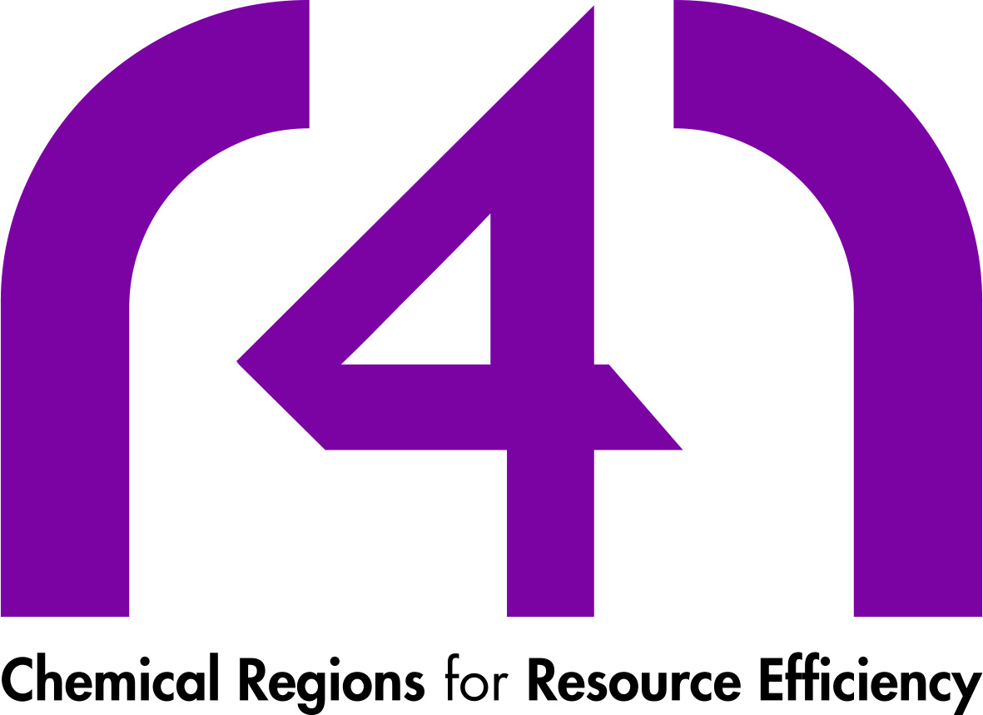


Domain 1: Integrated management of resources
Projects:
E4WATER R4R
MefCO₂ TASIO

Slide 3


Aggregated technological impact
Integrated Management of Resources
E4WATER
MefCO₂
R4R
TASIO
Develop, implement and validate new integrated approaches for a more efficient and sustainable management of water in Chemical Industry achieving solutions that are: eco-efficient (-20% water use, -30% wastewater production, -15% energy consumption), cost-effective (up to > 20% cost reduction) and industrially relevant
Mitigation of exhaust carbon dioxide and reduction of greenhouse gas emissions through the conversion of CO₂ into methanol (an extremely versatile chemical) through an efficient process supported by a non-noble metal catalyst
Overcoming the European fragmentation of ambitious and innovative regions, improving research and cooperation between chemical regions in the areas of resource and energy efficiency.
Demonstration of the potential for easy, compact and completely modular recovery of the process waste heat in the cement industry through a real installation
Proven capacity of the ORC plant to be operated in a flexible and modulated way following the overall plant work fluctuations and energy-heat demand dynamics
Proven complete integration with the industrial facilities selected and positive feedbacks from workforce on operation friendliness and performances control
R4R will be the major community to share best innovation practices and address the following needs and challenges

Slide 4
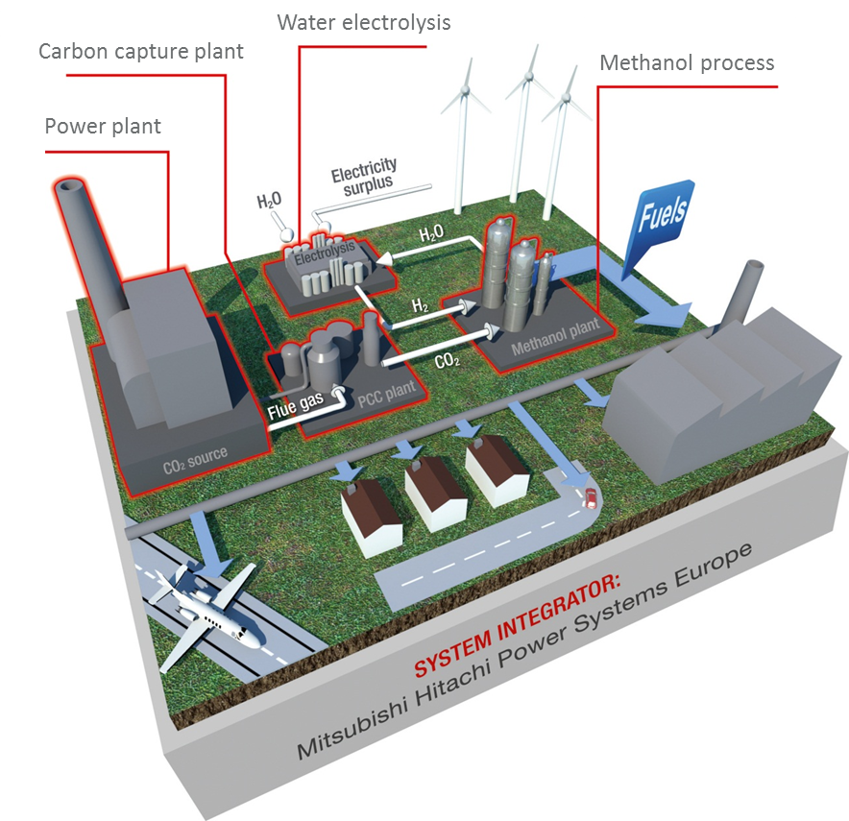
Examples from projects
MefCo₂:
  Utilisation of ordinarily emitted greenhouse gas carbon dioxide and hydrogen, produced from redundant electrical energy into a widely-useable platform chemical, methanol. The technology is being designed in a modular intermediate-scale, with the aim of being able to adapt it to varying plant sizes and gas composition.
  Construction of a pilot plant with a production capacity of 1,000 Kg of methanol per day through the conversion of 2.7 tonnes of CO₂ and with an energy consumption (for electrolysis) of 23,000 kWh.
  This process is envisaged to reach high efficiency
  Some of the chemicals that can be obtained from methanol are the following: formaldehyde (used in construction and wooden boarding), acetic acid, MTBE (fuel component), and the formation of methyl esters in the production of bio-diesel. In addition, methanol can be blended with other substances to produce fuels.
Notes:
The 1,000 kWel water electrolysis unit to be constructed will deliver around 200 m³_{i.N.} of hydrogen per hour for the methanol synthesis. It shall be powered by surplus electricity from renewable energy sources at energy production peaks, thus stabilising and buffering the oscillations of electric grid and its overloads.
In contrast to the conventional production from natural gas, the green hydrogen will be produced from water and renewable energy, which will reduce the net carbon footprint of the employed hydrogen.
Creation of catalytic materials for the synthesis of methanol directly from CO₂ and hydrogen using a variety of synthetic approaches. Testing of these materials will be carried out in two environments: i) thermal, using plug flow reactors, and ii) solar, using photocatalysis. Characterisation of these materials will be used as part of a feedback loop to catalyst improvement.
Development of the catalytic conversion process to methanol as a platform chemical, enabling methanol synthesis at high carbon dioxide/carbon monoxide ratios as opposed to the conventional low CO₂/CO ratios, pertinent to syngas, in economically viable manner (operating temperature and pressure not far from the ones employed in the conventional process, following the steam reforming of natural gas and consequent downstream).
This process is envisaged to reach high efficiency thanks to the development of:
the above-mentioned catalyst (essential from the global reaction engineering perspective since it will decrease the process’ activation energy significantly), and
the usage of energy surpluses stemming from renewable sources (aiding in the stabilisation of the electric grid).

Slide 5
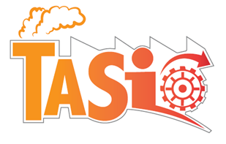
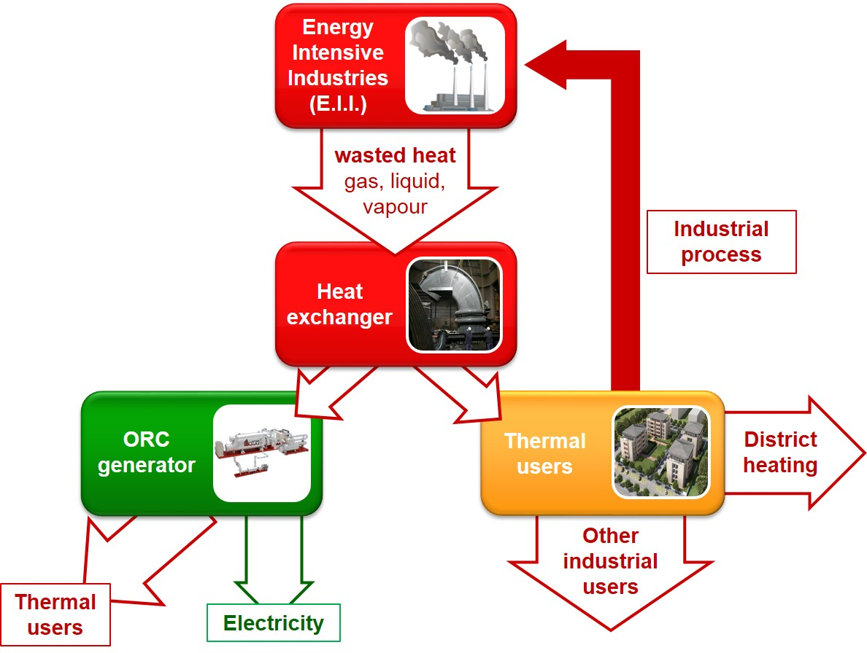

Examples from projects
TASIO:
Recovery of waste heat produced in energy intensive processes of industrial sectors such as cement, glass, steelmaking and petrochimical and consequent transformation into useful energy
Development of advanced Waste Heat Recovery Systems (WHRS) based on the Organic Rankine Cycle (ORC) technology, able to transform the thermal energy of the flue gases of E.I.I. into electric power for internal and external use
Cross sectoral applications in different E.I.I., increasing the overall efficiency and reducing investment costs
Application of new materials and coatings to improve heat transfer and avoid heat exchanger corrosion
Waste heat recovery diagram

Slide 6
Aggregated economic/social impact
Integrated Management of Resources
E4WATER
MefCO₂
R4R
TASIO
significant direct economic benefit up to 30 %
decreased dependency from fresh water resources
Main sources of revenues for the process shall come from commercialisation of methanol to bulk chemistry companies.
The envisaged process will allow the provision of certain services to grid operators.
Additional income sources, like emission rights selling (as a result of the CO₂ captured) have been initially discarded.
Identification and promotion of valuable and pragmatic resource efficiency opportunities for industry
Cross regional cooperation
Joint Action Plan for Resource Efficient Process Industry and chemical industries especially (33 initiated new actions)
Increase economic feasibility of WHRS with ORC through decreasing total investment costs and increasing heat exchangers efficiency
Proven capacity to recover installation costs in 4-5.5 years
Market replication
Boost industrial competitiveness through reducing the electric power taken from the grid
Development of a supply chain and job creation
Job creation

Slide 7
Examples from projects
E4WATER (economic)
Significant reduction of water uptake and waste water production due to the use of alternative water resources, reuse of water, water loop closure, industrial symbiosis, on site integrated water management:
up to ~ 45% in water use
up to ~ 65% in wastewater production

Slide 8
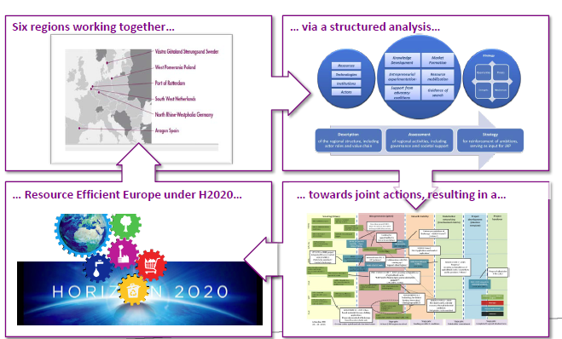
Examples from projects
R4R (social)

Slide 9
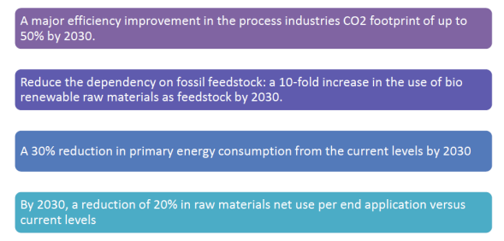
Aggregated environmental impact
Integrated Management of Resources
E4WATER
MefCO₂
15% reduction in energy use
capture of CO₂ at the facilities where is being produced, namely:
Thermal power plants.
Standard CO₂ capture facilities of biogas / gasification plants. The use of the technology in biogas plants shall enable the production of specific fuels and/or chemicals thanks to a process not competing with food crops since the feedstock is basically composed of organic, carbonaceous materials.
R4R
TASIO
Reduction of electric energy consumption
Reduction of primary energy consumption: every kWh of electricity generated by an ORC unit in a WHRS avoids 460 kg of CO2
Total CO2 savings across the sectors investigated: 1300 kton CO2/year corresponding to 0,27% of the EU27 overall CO2 industrial emissions
Cleaner and healthier environment

Slide 10
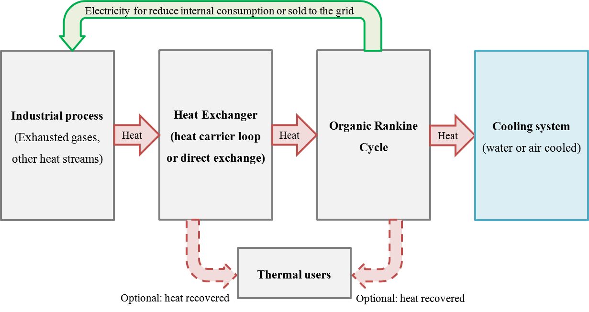
Examples from projects
TASIO:
Reduction of electric energy consumption
Reduction of primary energy consumption: every kWh of electricity generated by an ORC unit in a WHRS avoids 460 kg of CO2
Total CO2 savings across the sectors investigated: 1300 kton CO2/year corresponding to 0,27% of the EU27 overall CO2 industrial emissions
Cleaner and healthier environment
Waste heat to power typical schema

Slide 11
Technical cross-cutting issues
New technologies
E4WATER: Technical approaches for cost reduction in water treatment, Towards water loop closure, Integrated water management (process – plant – site), (Trans)industrial symbiosis
MefCO₂: cross-sectorial impact of the proposed technology is aligned with SPIRE’s Key Component FEED and, more precisely, with the Key Activity 1.2 “Optimal valorisation of waste, residue streams and recycled end-of-life materials as feed. Carbon dioxide sequestration and usage as a feedstock for methanol production has the potential to provide a significant reduction of CO₂ emissions
TASIO: Energy efficiency by filling the gap between unused surplus heat and its internal and external use; Energy sustainability of industrial processes through the design, implementation and testing of an innovative new energy recovery system
R4R: Identification of new technologies through cross-sectional/ stakeholder and over regional cooperation

Slide 12
Examples from projects
MefCO₂: For example, the cement sector (1) is a large producer of GHG emission, while the synergy of our project with this sector is straightforward utilising point sources of CO₂, pertinent to this industry (sequestration at power plant source, proposed in this project may be deemed as demonstrational). This approach can be easily transferred to other industrial sectors with a high GHG intensity such as steel, aluminium and ceramics which account for more than 10% of global CO₂ emissions.
E4WATER: Creating water loop interfaces and synergies: (I) in industry, (II) with urban & agricultural water management (trans industry); Overcome the bottleneck in recycling and reuse: Treating concentrates/complex wastewaters and Linking water- and production processes for process efficiency optimization

Slide 13
Non-technical cross-cutting issues
Cross sectional/stakeholder workshops
Exchange of Best Practices and Knowledge transfer/dissemination
Skills development
Business deployment
Different dissemination channels (website, twitter etc.)
Link with EU and national technology Platforms and Associations
Presentation of project results in scientific literature, international and national conferences and trade fairs

Slide 14
Examples from projects
MefCO₂: Knowledge transfer
“CO₂ capture and renewable energy sources as a business opportunity”.
“Combining applied research in several fields is an effective way of designing new innovative processes that will be the solution of European-level problems, as well as the source of a competitive edge for European industries”.
“CO₂ capture and its valorisation with the support of renewable energy sources surpluses is a way of accomplishing EU commitment with international protocols and regulations, leading to a more sustainable economy”.
R4R: Cooperation with other clusters and projects
Best practice workshops
Joined activities
Joined projects
TASIO: Synergies and benefits of clustering
TASIO invited to be part of a new cluster on Energy Efficiency with strong focus on heat recovery and oven technologies: exploitation of TASIO results through common ground, market segments and needs among the cluster projects
TASIO part of the Lombardy Energy Cleantech Cluster (LE2C): dissemination and promotion of the high replicability of TASIO outcomes across EU industries

Slide 15
Potential for further synergies and recommendations for follow-up
Get easier access to neighbourhood industrial sectors/application fields
Through synergies and common ground among the cluster projects, common market segments and needs
Standardization issues
Replication activities and support in the exploitation and operation of new technologies/processes in specific locations throughout Europe
Cross sectional and value chain cooperation, system approach

