Slide 1
Session 3:
Sustainability and Circular Economy
Jan Meneve
SPIRE PPP Impact workshop
Brussels, 21-22 April 2015

Slide 2



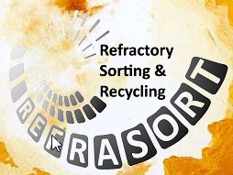





Domain 2: Recovery from Waste
RECLAIM
REMANENCE
HydroWEEE
RECYVAL-NANO
REEcover
RecycAl
ReFraSort
C2CA
BIOMETALdemo

Slide 3
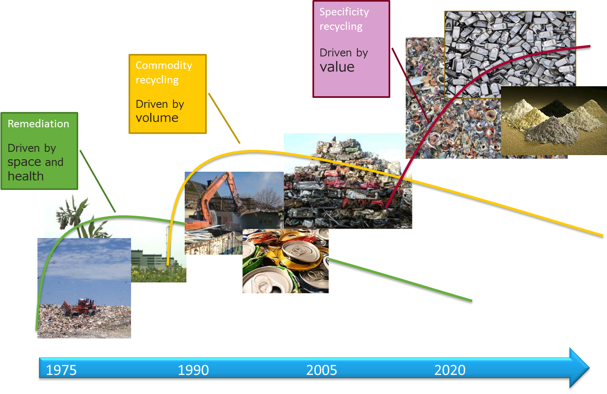
Waves of waste management

Slide 4
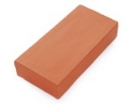
Zero waste concept metal recovery & matrix valorisation
Complex waste streams
ind
UM
EoL
Inventories
Physical treatment
Solvometallurgy
(critical)
metals
Pyrometallurgy
Residue valorisation

Slide 5
Aggregated technological impact
E-waste recycling:
Assessment of value chains, product life-cycles and market trends
New (automated) sorting, disassembly and separation concepts
Re-assessment and optimization of conventional recycling processes (KAIZEN)
Elaboration of new (hydrometallurgical) processes for highly efficient extraction and refinery of materials
Recovery of REE and other technology metals, for substituting mining of virgin raw materials
Innovative solutions for integrated treatments of liquid and solid wastes
Validation of re-mined elements from tailings
Industrial validation and scaling of stationary and mobile facilities

Slide 6
Aggregated technological impact
C&D-waste recycling:
Development of a 100% end-of-life (EoL) concrete separation process that produces:
  aggregates for use in new concrete production
  calcium rich feedstock for low-carbon cement production
Elaboration of new concrete type that uses recycled aggregates which is 30% stronger
Development of HSI and laser based sensors for quality assessments
Save costs by largely using conventional facilities for primary concrete
Deployment of the in-situ, multi-purpose new concrete recycling process

Slide 7
Aggregated technological impact
Refractory waste recycling:
  Innovative identification techniques for industrial residues with dust and slag contaminated layers
  New mechanical separation systems able to separate up to 8 classes of large, heavy bricks (up to 30 cm diameter, 20 kg weight)
  Industrially viable technology: high throughput, dust issues, ..
  Aiming at 20% (instead of current 5%) replacement of virgin critical raw materials incl. graphite, magnesite, bauxite

Slide 8
Aggregated technological impact
Metal Recycling:
Production of high quality raw material from Al scrap
Development and optimization of new casting process that produces high quality non-ferrous metal
Quantification of energy savings achieved during the development process
Produce and test components from the recycled material that are currently manufactured from virgin feedstock
Economic and logistics aspects for upscaling the High Shear Process for Al recycling, in view of the large quantities needed
More efficient heavy metal pollutant elimination in waste water treatment – 3200 tonnes discharged in EU-27

Slide 9

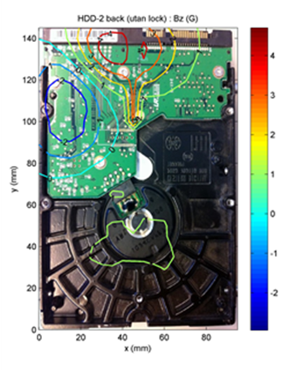
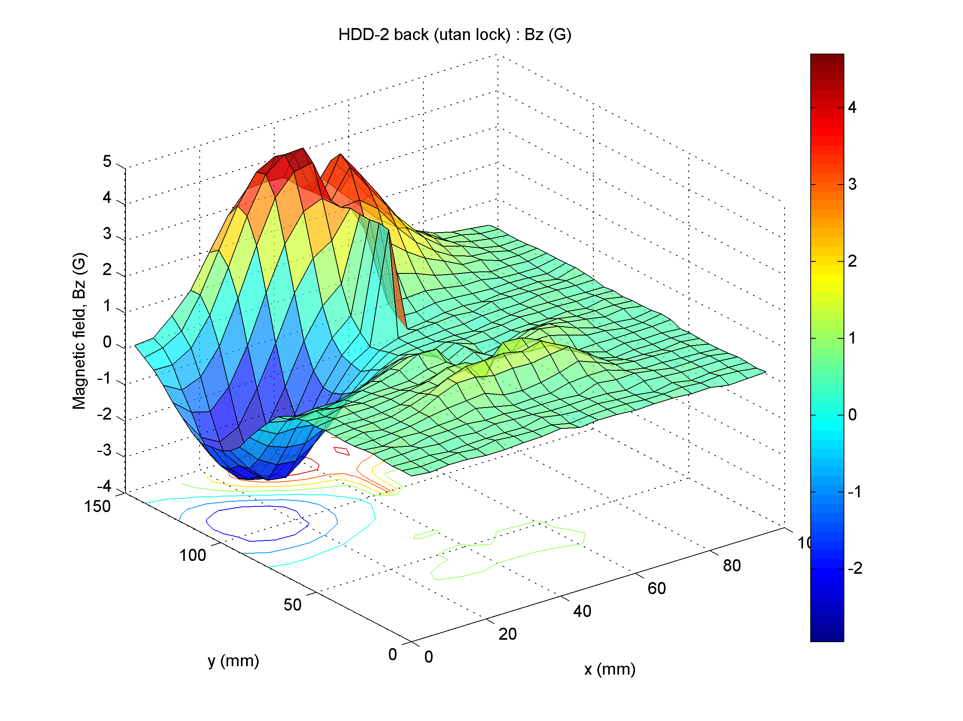
Examples from projects
E-waste recycling:
New detection equipment produced for detection of magnetic content in waste electrical equipment. Combination of magnetic and optical systems used
Recycling of low grade material: enhanced ionic liquid solvent extraction techniques and molten salt processing to recover rare earth materials to original virgin material specification

Slide 10
Examples from projects
E-waste recycling:
Develop a complete process for recuperation of key metals from Flat Panel Displays (FPDs) and their valorisation in the production of nanoparticles
Recovery of valuable indium, yttrium and neodymium included in the list of critical materials from one of the most growing electronic wastes which is FPDs
Recovery of other major (matrix) fractions such as PCBs, ferrous and aluminium based materials, polymers, etc. present in FPD wastes
Implementation of an upcycling process in which valuable compounds are reused in the production of high added value nanoparticles using the recovered materials as metal precursors for the flame spray pyrolysis synthesis process

Slide 11

Examples from projects
E-waste recycling:
Recovery of critical and precious metals from five WEEE waste fractions: CRT, lamps, LCDs, Li-batteries and printed circuit boards, by hydrometallurgical processes
Optimization of previously developed, conventional processes of extracting yttrium, indium, lithium, cobalt, zinc, copper, gold, silver, nickel, lead, and tin,
Development of new processes to recover additional metals: cerium, platinum, palladium, europium, lanthanum, terbium
Elaboration of flexible, mobile HydroWEEE plants

Slide 12
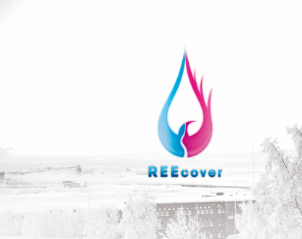
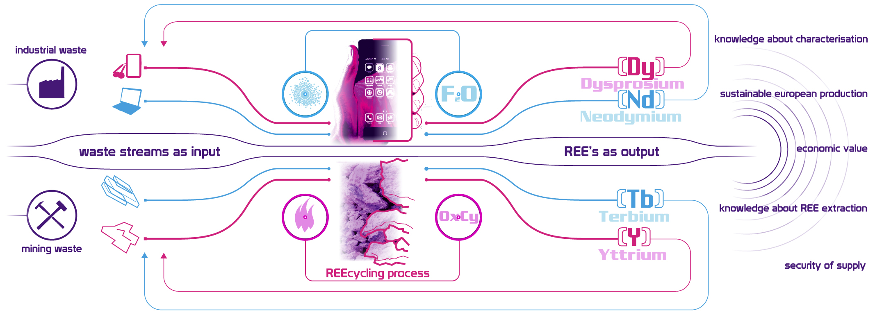
Examples from projects

Slide 13
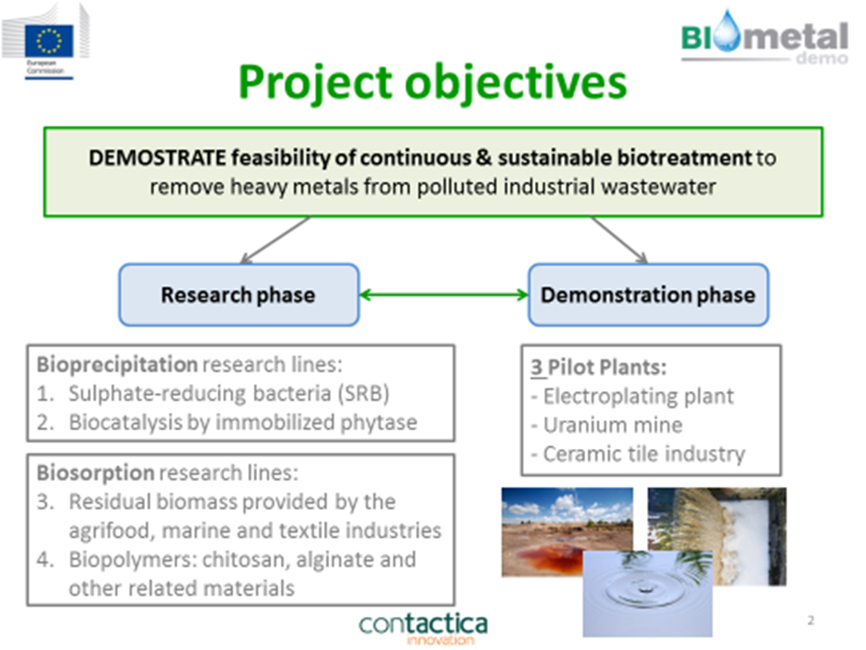
Examples from projects
Metal Recovery

Slide 14
Aggregated economic/social impact
Shift from primary production and waste storage to secondary resource production and reduced waste
Enhanced security of supply of (critical) resources
Reduce energy consumption, hence production costs
Increase competitiveness of Europe`s industry, thereby securing jobs
Raise SMEs involvement in urban-mining business solutions
Ensure sustainability vis-à-vis Material Criticality grand societal challenge

Slide 15

Examples from projects
New economically viable recycling technologies for PV, SSL and electronic waste, including upstream processing that are typical SME activities
Economic value of Ga, In and rare earth elements (REE) will be maintained with the help of new recycling business with additional employment in the regional economies
Reduction of overall waste and especially avoidance of losses of CRMs Ga, In and REE

Slide 16

Examples from projects
  Increased reuse of refractory waste as secondary raw material, thereby reducing EU import dependency for critical materials such as graphite, magnesite and refractory grade bauxite (dependency ranging from 40-95%, mostly from China)
Europe will be able to better utilise the 850kt (in 2008) of aluminium scrap currently exported to China. Improving the self-sufficiency of Europe in resource terms.
A low cost and efficient technology for producing the recycled alloys could boost jobs and the competitiveness of European recycling industry.
The reduced environmental and energy costs of recycled components are also likely to reduce production costs of recycled parts. This could make Europe more competitive.

Slide 17
Examples from projects
Overcome the European dependence in the supply of critical materials
Enabling the European market to promote the creation of new companies not only in the recycling, but also in the transformation of raw materials to manufacture electronic systems and devices
Based on predictions of 400 000 ktons of FPDs wastes by 2015, Europe reserves of key metals in FPDs would be around 3500 tons of indium and 4800 tons of yttrium
Recovery of indium, yttrium and neodymium streams can support the profitability of the recycling processes
Improve competitiveness of SMEs participating in the project related with mechanical and chemical recycling technologies

Slide 18
Aggregated environmental impact
Raise of sustainable and profitable, smart green technologies
Reduced waste generation while improved resource efficiency
Reduced environmental pressure:
    on earth`s crust i.e.: on water and raw material resources, on landscape and on the built environment;
    on waste storage and management systems
    on energy production and distribution infrastructures
    significantly less GHG emissions
    controlled hazardous substances in waste management

Slide 19

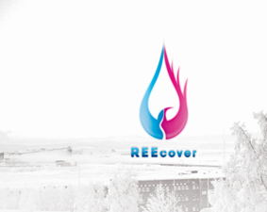
Examples from projects
Metal Recovery
Recent environmental awareness and legislative restrictions on uncontrolled discharges of waste water have highlighted the need for new technologies for the treatment of high volume, dilute liquid waste at source
Reduce global environmental pressure on raw materials by recovering valuable materials from industrial EoL & mining waste streams
Improved resource efficiency and reduced environmental impacts

Slide 20
Technical cross-cutting issues
Exchange and integration of knowledge and technologies from primary mining, metal & mineral processing, refractory production, waste recycling industry
Waste recycling companies as key players in the process industry, working together with technology provider research institutes to implement effective technology transfer
Waste valorisation in associated industries – industrial symbiosis

Slide 21
Examples from projects
Linking the demands of the end users of material e.g. Fiat with the technological limitations of producing an effective recycled alloy. In this project stakeholders at both ends of the value chain are working together to produce a recycled material fit for purpose
High level computer modelling has also been used to optimise the HSP, combing the skills and ‘on the job’ knowledge of experimentalists with the powerful predictions of complex computational models. All supporting the project goal of high performing recycled material.

Slide 22

Examples from projects
Waste2Resource: avoidance, valorisation and re-use of waste streams within and across sectors, including recycling of post-consumer waste streams and new business models with the ambition to closing the loop
Development of economically sound separation technologies for the optimal valorisation of waste, recovery of valuable materials and conversion of residue streams as feed for the production of high added-value products for the construction sector

Slide 23
Non-technical cross-cutting issues
Specific dissemination activities at international fairs and congresses
Cross-sector and industry-academia IPR activities for:
        integrated systems patents
        scaling-up activities
        spin-offs, start-ups
Exploitation of the recycling pilot lines and new products from recycled raw materials as well
Tailor made communication and training activities at regional level
Involvement of all relevant stakeholders incl SMEs for data mining, technology validation, supporting regulation and public awareness

Slide 24
Examples from projects
Analysis (and mass flows) of potential sources for recovery of rare earth materials. The current analysis shows that the amount that is potentially recoverable is much lower than expected - however, not all streams have been included
Exploitation meeting being held in May – process to identify exploitable results and assign lead partners is being developed with support from PTA. Use of simple 15 question template to generate a matrix of stakeholder interaction and exploitable results

Slide 25
Examples from projects
The HSP process developed in the process has been patented by Brunel University (a project partner). To maximise the impact of advancements made by the project a plan will need to be developed to commercialise this technology. This could including licencing the technology or a Brunel spin off company, this remains to be agreed.
A significant part of the project is a study on the economic and technical aspects of scaling up the HSP process. Which requires the input of companies, which produce scrap material through to the end user to determine the volume of scrap required at each stage together with the costs incurred. This is critical in determining the viability of the technology, particularly because, if adopted, large quantities of the recycled material will be needed. Calculations will need to be made on the quantity of unprocessed scrap that will be needed to meet this demand. Accurate determination of these figures can only be found by collaboration of industry at both ends of the scrap processing cycle.

Slide 26
Examples from projects
IPR/ Licencing- patents: 4 patents in Italy and Serbia
Business deployment: spin-off company to be founded, new business model development (recycling as a service based on mobile plant)
Skill development and technology transfer to SMEs, enabling the effective market intro
Outreach to all stakeholders: industry (especially SMEs), policy makers, investors and citizens to support the realisation of impact through awareness, stimulating societal responsible behaviour

Slide 27
Examples from projects
Business deployment (e.g. spin-off, start-up, new business models, patent, scaling up activities): because of the attractive business model, a spin-off company has been set up
Contribution to standards - cross-sectorial technology transfer: separation technologies - quality assessment technologies
Skills development: PhDs in concrete recycling and in-line quality assessment
Gender equality: The advance of technology in the recycling industry allows the involvement of more female and male collaborators in this growing sector

Slide 28
Potential for further synergies and recommendations for follow-up
Input of ideas from SME’s would help to guide the goals of the project to suit the needs of more end-users
It would help us to understand the best commercialisation route for the (HSP) technology and generate awareness of the quality of potential material which can be produced
Dissemination and clustering activities are a key part in helping to disseminate the project results towards industry, policy makers and the public, and aid uptake of the developed technologies by the European industry
Bringing waste owners and resource processing end-users together
Join forces with H2020 clusters, EIP and EIT Raw Materials
Understanding the real problems and opportunities

