Slide 1


Peter Singstad
Trondheim, Norway

Slide 2
Intensifying a
100 year old process:
Control of emulsion polymerisation
Invitation to the COOPOL final dissemination event,
14th and 15th January 2015. Venue: Dechema, Frankfurt

Slide 3
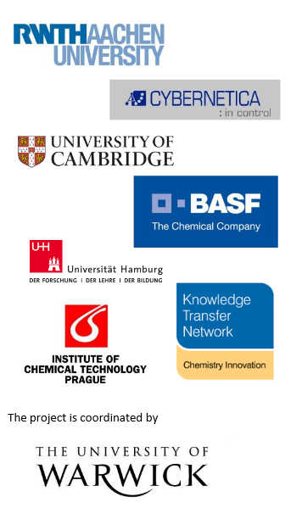
COOPOL objectives
Provide basis for widely applicable intensified chemical processes
  Short term approach: Process intensification of semi-batch polymerization processes
  Long term approach: Process intensification by robust and reproducible production of polymerization to smart-scale continuous processes
Develop and demonstrate new methods and tools for model based predictive control and optimization
Read more: http://www.coopol.eu/

Slide 4
COOPOL structure
WP1: Project Management
WP2:
Experiments for data generation
WP3:
Analytical protocol & Observability
Sensor fusion
Soft sensors
WP6:
Implementation and demonstration for smart-scale and semi-batch
WP4:
Development of kinetic model incorporating polymer structure properties for semi-batch and smart scale continuous processes
WP5:
Development & testing of control strategies for model based solutions; NMPC
WP7: Dissemination

Slide 5

COOPOL case study:
Process intensification of Continuous Emulsion Polymerization.
Smart-Scale Tubular Reactor.

Slide 6
Smart-Scale Reactor Setup

Slide 7
Smart-Scale Reactor Setup

Slide 8
Results
Increase in space time yield of about an order of magnitude
Almost plug flow behavior
Resonably high energy dissipation by optimized combination of static mixers, secondary flow phenomena and pulsed feed flow.
Low pressure drop
High specific heat area

Slide 9
COOPOL case study:
Process intensification through optimization based control.
Pilot plant demonstration.

Slide 10


Pilot plant reactor (2m³)
Dosing
initator
Dosing
Monomer
Energy balance

Slide 11
Model based control: Development phases
Reactor modelling
Model identification
On-line estimator design
Control application design
Commissioning

Slide 12
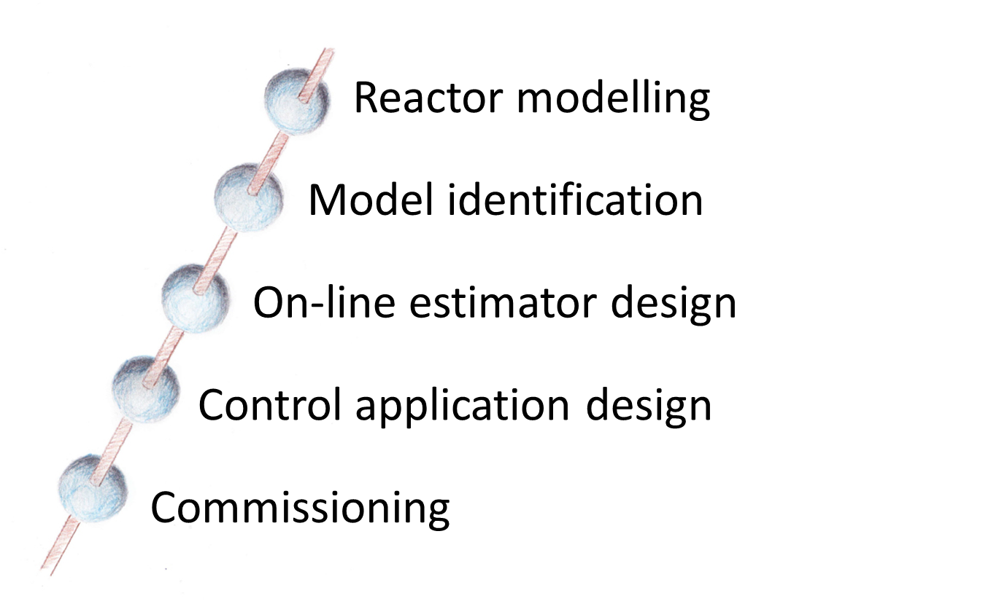
Model based control: Development phases
Collect technical documentation
Develop system specifications
Establish IT infrastructure
Preparations at the plant
CENIT software installation and initial testing
Modelling of specific reactor
Off-line model identification and validation
Design and implementation of on-line estimator
Design and implementation of NMPC
Remote testing in ‘open loop’
Factory Acceptance Test (FAT)
Commissioning at the plant
Remote monitoring
Site Acceptance Test (SAT)
Regular maintenance

Slide 13
Model and application overview
Semi-batch seeded emulsion copolymerization with 4 monomers
  2 hydrophilic
  2 hydrophobic
Model
  Developed by VSCHT, re-implemented and adapted for control by Cybernetica
  Mass balances for reactants
  Energy balances for reactor and jacket
  Simplified phase conditions
    Hydrophilic monomers only in water phase
    Hydrophobic monomers in monomer droplets and particle phase
    Equilibria with constant partition coefficients
    Heuristic expressions for phase transfer rates
  Mass balances for feed system
  Batch sequence
Application:
Model validation
  Kinetic parameters from literature data
  Some kinetic parameters are fitted to lab data (COOPOL)
  Final adaptation done with pilot plant data
The Kalman-filter is configured
  Ensure unbiased temperature predictions
The application is developed
  Batch sequence is programmed
  Three control levels are defined and implemented
  All necessary interfaces are programmed
The application is tested in simulations and at pilot plant in Ludwigshafen

Slide 14
Model validation

Slide 15
Control structure
Intuitive
Objectives &
constraints
Controller
Model with product quality
Monomer
Monomer
Monomer
Monomer
hot
hot
hot
hot
cold
cold
cold
cold
Operating conditions
States – Monomers conv.
Model parameters (kp, kk)
Disturbances
Sampling
rate ~20s
Setpoints for
Base-layer control
Soft sensor
Semi Batch Process + DCS
Measurements
Disturbances
Monomer
hot
hot
hot
hot
cold
cold
cold
cold
Temperatures
Feeds
Pressure
Model with product quality
Notes:
The results of the project fall into three different categories
First achievement is a BASF-tailored extension of the engineering platform in close cooperation with our software supplier Cybernetica
In the future, we can now deploy such an online optimizing quality controller on a standard PC-server hardware, which is connected to the batch process via a standardized OPC interface, provided by all modern DCS systems
The solution requires two distinct modules with different purposes
First we need a soft-sensor module, which estimates the current operating conditions of the process from process measurements and a detailed process model. This task includes especially adjusting critical model parameters to ensure consistency with the process behavior observed over the recent past.
The calculated results are then employed by the controller model, which derives optimal set-point profiles by predicting the future process behavior via the same detailed process model.
What is optimal in this respect is defined by inputs from the user – in terms of intuitive economic objectives, such as minimize cycle time or maximize feed and by process constraints such as maximum allowable vessel pressure, minimum cooling temperature and so on
By repeatedly executing the soft sensor and the controller module, which is now possible at a cycle time of 20s, we ensure robustness to model mismatches, drifting operating conditions as well as unmeasured disturbances

Slide 16
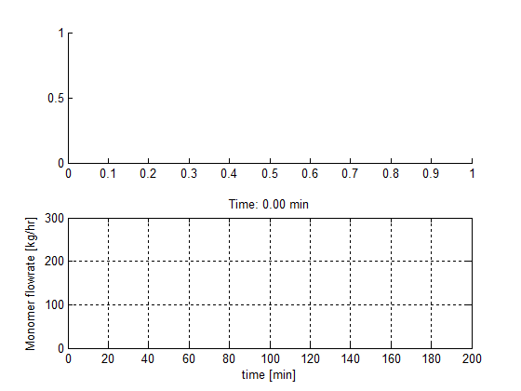
Batch optimization experiment
Batch time reduced 10 % while maintaining product quality
Dissemination event – Frankfurt

Slide 17
Results
Optimization based reactor control has been demonstrated for a 4-monomer emulsion co-polymerization system
Basic principles enabling process intensification are shown:
  Faster heating phase
  Maximization of feed rates (within limits)
  Terminal product quality specifications are met
A 10 % reduction in batch time is demonstrated
The technology will be commercially available this year!

Slide 18
Exploitation and impact:
The work is done, let’s start working.

Slide 19
Impact
Technical
Process intensification by production of specialty chemicals in smart-scale reactor(s) → Efficient operation
Production of tailored product by model based methods → Customer demand drives the process operation
Intensified semi-batch polymerization processes → maximized asset capacity, exploiting (unwanted) operational conditions e.g., fouling, seasonal variations etc.

Slide 20
Impact
Economic/Social
Complete exploitation of process potential → Process intensification results in 10-20% enhanced production capacity
Reproducible product for every batch → in-spec product properties batch after batch without being influenced by raw-material minor grade change or seasonal operational variations

Slide 21
Impact
Economic/Social
Reduced analytics, lower analysis costs → lower number of sampling hence reduction in number of samples preparation, transportation and analysis work
Production through intensified smart-scale process close to customer → reduced transportation costs hence lower carbon print
Process intensification by model based methods leads to self-optimization plants → lesser stress for operational personal hence improving human productivity

Slide 22
Impact
Environmental
Optimum utilization of resources such as process heating/cooling → lower energy consumption
Optimum use of production assets → Batch time optimized by model based methods depending on quality

Slide 23
Plant control is not one man’s work;
Thank you to the
COOPOL team and

Slide 24
