Slide 1
SPIRE PPP in Horizon 2020 – What Impact ?
Impact Workshop of the SPIRE PPP
Brussels, 22nd April 2015
Clara de la Torre
DG Research and Innovation
Director for Key Enabling Technologies

Slide 2
President Juncker's Agenda and the cPPPs
A New Boost for Jobs, Growth and Investment
A Connected Digital Single Market
A Resilient Energy Union with a Forward-Looking Climate Change Policy
A Deeper and Fairer Internal Market with a Strengthened Industrial Base
A Deeper and Fairer Economic and Monetary Union
A Reasonable and Balanced Free Trade Agreement with the U.S.
An Area of Justice and Fundamental Rights Based on Mutual Trust
Towards a New Policy on Migration
A Stronger Global Actor
A Union of Democratic Change
Five priority areas are addressed by the cPPPs

Slide 3
Why Public-Private Partnerships in Horizon 2020?
  R&D investments are essential for generating growth and high quality jobs
  EU business under-invests in R&D compared to other world regions
  Increasing international competition for leadership in strategic technologies
  Partnerships create stable frameworks for joint R&I investments in industrial domains
  To facilitate prioritisation of R&I in line with the European R&I policy and industry needs
  To leverage research and innovation efforts

Slide 4
Outcomes of "contractual" PPPs in FP7: FoF, EeB and GV
    A quick response in defining the strategy
      Multi-Annual Roadmaps
    Better success rates & shorter time-to-grant
    3 PPPs launched 366 projects with 4409 participations
    Increased participation of industry: 57% (30% in FP7)
      SMEs: 25% of the total participation. The participation of SMEs in FP7 Cooperation was ~17%.
More innovation related activities
      including demonstration & take-up of technology
    The full EC contribution was provided: € 1.6 billion
      -> combined investment: € 2.4 billion
Notes:
4
What have we achieved with the contractual PPPs in FP7?
A quick response towards more strategic work programmes via roadmapping
A higher implementation efficiency (e.g. shorter time-to-grants)
366 projects with 4409 participations in the 3 PPPs over 4 years.
Higher industrial participation (including SMEs, which had, in average, 1 in each 4 participations)
Increased activities to stimulate innovation (demo-targeted and take-up projects)

Slide 5
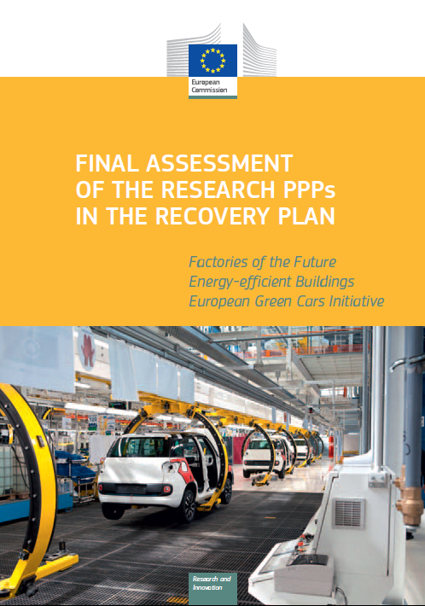
Findings of the PPPs Final Assessment
  PPP model in FP7:
  Inclusive
  75% of participations were non-members of Associations & received 70% of EC funding
  Making use of FP rules
  ensuring excellence, transparency, fairness & accessibility
  Projects end closer to market
  Targeting the complete innovation cycles
  Reversed the declining funding trend to the respective industrial areas
http://bookshop.europa.eu/en/
final-assessment-of-the-research-ppps-in-the-european-economic-recovery-plan-pbKI0213270/

Slide 6
PPPs in Horizon 2020
Institutionalised PPPs | Contractual PPPs
Innovative Medicines (IMI) Clean Sky Single European Sky ATM Research (SESAR) Fuel Cells and Hydrogen (FCH) Electronic Components and Systems (ECSEL - old ARTEMIS + ENIAC) New: Bio-based Industries (BBI) Shift2Rail | Factory of the Future (FoF) Energy-efficient Buildings (EeB) Green Vehicles (EGVI) Future internet (5G) New: Sustainable Process Industry (SPIRE) Robotics Photonics High Performance Computing Big Data
* All announced in the Communication on PPPs in H2020 (July 2013) except Big Data.

Slide 7
Contractual Public Private Partnerships in Horizon 2020 | EU indicative funding 2014-2020 (M€)
Factories of the Future (FoF) | 1150
Energy-efficient Buildings (EeB) | 600
European Green Vehicles Initiative (EGVI) | 750
Sustainable Process Industry | 900
Advanced 5G network infrastructure for the Future Internet (5G) | 700
High Performance Computing (HPC) | 700
Robotics | 700
Big Data | 534
Photonics TOTAL: | 700 6734
Industry has committed to complement these amounts with private investment in the order of 3 to 10 times the level of public funding in addition to the in-kind contribution in the cPPP projects under Horizon 2020.

Slide 8
cPPP | Contribution to Economy
Factories of the Future (FoF) | Manufacturing: 16% of Europe’s GDP, 30 million jobs, twice as many in support activities such as logistics, 80% of the EU’s exports are manufactured
Energy-efficient Buildings (EeB) | Construction sector: 15 million jobs, 9.3 % of the non-financial business economy’s total value added
European Green Vehicles Initiative (EGVI) | 12 million direct jobs, over € 500 billion/year in turnover
Sustainable Process Industry (SPIRE) | 20% of the European manufacturing base, 450,000 companies providing 6.8 million jobs
Advanced 5G network infrastructure for the Future Internet (5G) | 40% of the worldwide market of nearly €200 billion in 2012 in terms of network infrastructure supply
High Performance Computing (HPC) | Europe is a world-leader in HPC applications that are key for our society
Robotics | Robotics is a key enabling industry for manufacturing
Photonics | Europe holds 18% of the global photonics market, € 66 billion share
Big Data | Big Data market is growing six times faster than the overall ICT market. The compound annual growth rate (2013-17) expected to reach the overall total of $50 billion.

Slide 9
  How were PPPs selected ? (Art. 25 in Horizon 2020)
Criteria in Horizon 2020 legislation
      European added value
      Importance of impacts
      Scale and long term nature of industry commitments
      Openess and transparency
Strategic importance
      For EU international leadership of the technologies
      For EU policy objectives under Europe 2020
Building on success under FP7
      Following evaluations and experience
      New initiatives (5 new cPPPs) given policy importance and industry commitment

Slide 10
Establishment of the contractual PPPs
Based on ETPs and taking into account policy documents the Commission identified possible areas for a contractual PPP
Stakeholders were invited to prepare a PPP proposal
The private sector organised stakeholder consultations, in an open and transparent way, covering the whole value chain
The private sector delivered the proposal to the Commission
The Commission checked compliance with H2020 criteria for the PPPs (art. 25) with the help of high-level external experts
Commission decision to launch the contractual PPP
Signing of the Contractual arrangement

Slide 11
The contractual PPP approach
What is the same as in normal Horizon 2020:
    The financial rules are those of Horizon 2020
    Final responsibility for the Work Programme stays with the European Commission and is subject to Comitology
    Implementation remains with the Commission: selection of proposals, grant preparation, review of progress and payments
What is different from normal Horizon 2020:
    Long-term commitment by Commission to support the field
    Long-term commitment by industry to invest, with a need to demonstrate its fulfilment (monitoring & KPIs)
    Roadmap-based strategy. Close interaction in the Partnership Board to prepare the content of the calls.

Slide 12
The contractual arrangement (1/3)
Main roles of the public and private sides:
    Private sector partners advise the Commission on R&I priorities for the Horizon 2020 work programmes
    Implementation via Commission WPs normal calls using Horizon 2020 Rules for Participation and subject to comitology
Content:
    Scope and Specific Objectives,
    Activities, investment and outputs,
    Governance and openness,
    Specific commitments of each side,
    Monitoring and Key Performance Indicators,
    Duration and review
    The Multi-annual roadmap is an Annex

Slide 13
The contractual arrangement (2/3)
  Key Performance Indicators (KPIs) at PPP implementation level:
    New systems and technologies developed in the relevant sectors
    Participation and benefits for SMEs
    Contribution to the reduction of energy use
    Contribution to the reduction in the use of material resources
    New high-skilled profiles and new curricula developed
    Private investment mobilised in relation to the PPP activities
    Contributions to new standards
  Key Performance Indicators (KPIs) at project impact level:
    Scale of reduction in energy, material resources and waste
    Project results taken-up for further investments
    Trainings for a higher quality workforce
    Patents and activities leading to standardisation
Notes:
We want to see impact not only at project level, but also at the level of the SPIRE initiative as a whole.
The Multi-Annual Roadmap, but also the Contractual Arrangement signed on 17 December last year between the European Union (represented by the Commission) and the private side (represented by A.SPIRE) lists some key performance indicators that will help us measure the success of the initiative.
Some are at the PPP level like the additional private investment mobilised, others are at project level like patents (see list above)
We would need to find a way together to monitor the progress of the SPIRE PPP projects and the SPIRE PPP initiative using those KPIs in order to maximize the impact of each SPIRE PPP project, exchange best-practices for exploitation and dissemination of results, exploit synergies between EU funds and other types of funds.
Indeed, the success of a cPPP in Horizon 2020 should be more than the sum of the success of its projects' successes.

Slide 14
The contractual arrangement (3/3)
Signature of the arrangements for 8 contractual PPPs on 17 December 2013 (except for DATA cPPP on 13 October 2014)
Public investment (Horizon 2020): €6,7 billion
Private commitments: to complement with private investment in the order of 3 to 10 times (leverage factor) the public investments

Slide 15
SPIRE call 2014 – 2015 overview
Call year | 2014 | 2015
Call Budget | 60.300.000 € | 75.170.000 €
Received proposals | 72 | 82
Above threshold | 17 | 23
Main List | 12 | 13
EC Funding Success rate | 64.012.655 € 17% | 72.700.000 € 16%

Slide 16
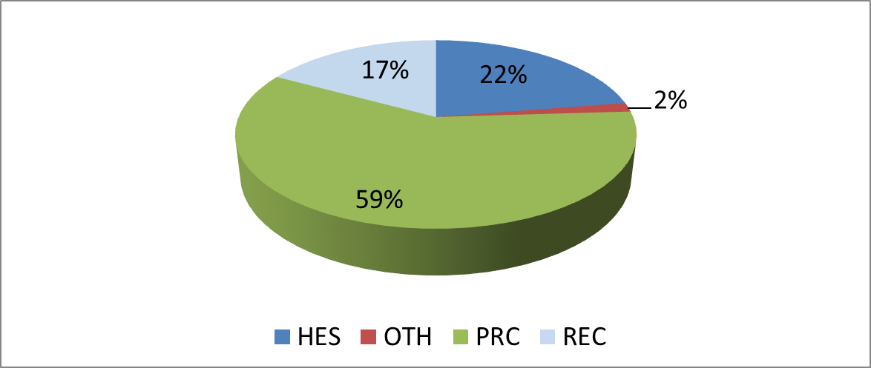
H2020-SPIRE-2014
Type of participants

Slide 17
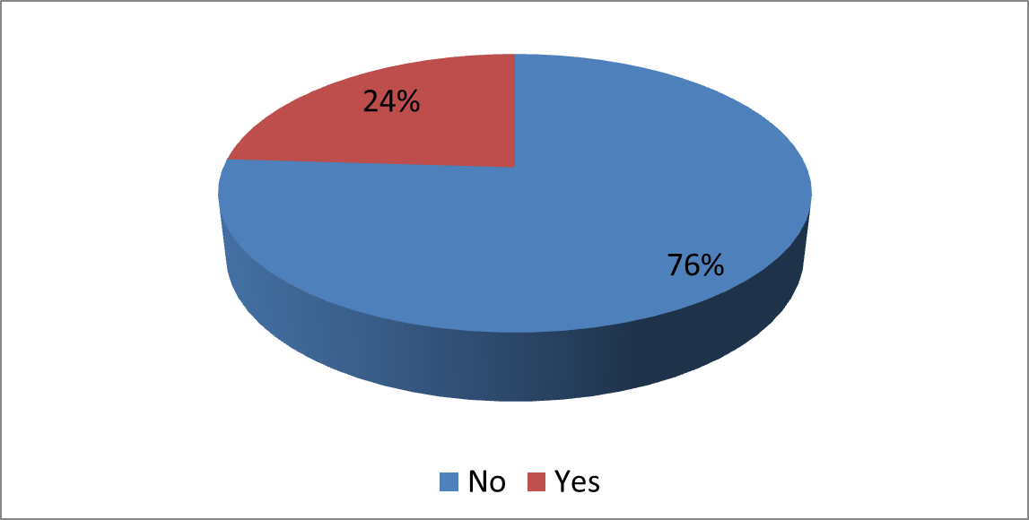
H2020-SPIRE-2014
SME participation

Slide 18
H2020-SPIRE-2015
Retained proposals - Consortium typology

Slide 19
H2020-SPIRE-2015
Retained proposals - SME participation ^{(*)}
 SME
 Not SME
(*) Based on participant declaration

Slide 20


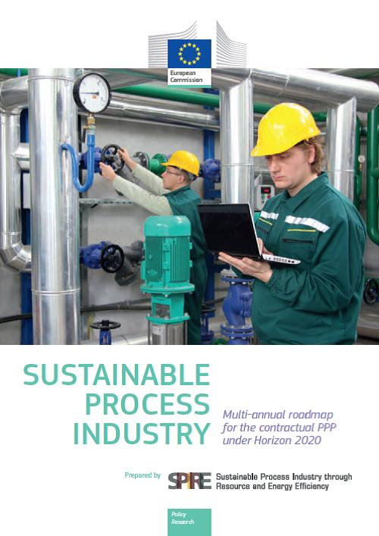



Slide 21
IMPACT
IS THE NAME OF THE GAME

Slide 22
Thank you for your attention
More information:
HORIZON 2020:
http://ec.europa.eu/research/participants/portal/desktop/en/home.html
Contractual Public-Private Partnerships in research and innovation:
http://ec.europa.eu/research/industrial_technologies/ppp-in-research_en.html

