Slide 2

CO₂ footprint reduction and resource efficiency
© jelwolf - Fotolia.com
Notes:
Europe produces 1/5 of the world’s chemical products and 5%-10% of the world’s petroleum output is dedicated to chemicals manufacturing.
I will not go into details on CO2 emissions from resource intensive chemical and process industries, I am sure your are all more or less familiar with the facts, however I would like to stress the opportunities for CO2 abatement and resource effciency!
As you all know, Resource intensive chemical and process industries contribute in numerous ways to CO2 emissions. Thus there are numerous ways and opportunities to rejunivate and to transform resource intensive chemical and process industries into eco-efficient high-tech solution providers

Slide 3


Numerous opportunities!
© luna - Fotolia
Notes:
Societal challenges, RTD and innovation offer opportunities to rejuvenate and transform the resource intensive
chemical and process industries into eco-efficient high-tech solution providers, by switching
to bio-based feedstock: Less fossil fuels less carbon dioxide emissions
Improving efficiency of processes: Less use of energy less less carbon dioxide emissions
by recycling waste materials : Closing the loop
by looking at industry as an integrated system (industrial symbiosis): synergy effects, what is spill for one could be a resource for another
R4R ceases the opportunities and will rejuvenate and transform the resource intensive chemical and process industries into eco-efficient high-tech solution providers

Slide 4




What is R4R? – the facts
Notes:
Three years project with 19 partners from 7 different countries funded by the European Union within the Seventh Framework program

Slide 5
What is R4R?
Analysis of Innovation Systems and research agenda’s of regional clusters
Initiatives to improve integration: definition of a Joint Action Plan
Measures towards the implementation of the Joint Action Plan
2013 2014 2015
Notes:
1) analyzing and
benchmarking successful regional technology innovation systems (TIS) within six complementary regions that
target three specific technology domains (alternative feedstock, resource efficient processes and recycling); 2)
based on this analyses improving synergies between regions through aligned regional, national and European
Joint Action Plans and innovation roadmaps; 3) promoting internationalization, with a strong focus on SMEs,
through an international cluster platform on resource efficient regions, embedded in the SusChem ETP; 4)
disseminating a toolset and experience on technology innovation system analyses (TIS), to European regions
in cluster platform.

Slide 6
What is R4R? –Needs and challenges
Bio-based and alternative feedstock for chemicals
Resource efficiency in process industries (water, energy, feedstock)
Recycling and waste management
CO₂ footprint decrease
Opportunites
Notes:
R4R will be the major community to share the best innovation practices and address the following
needs and challenges

Slide 7
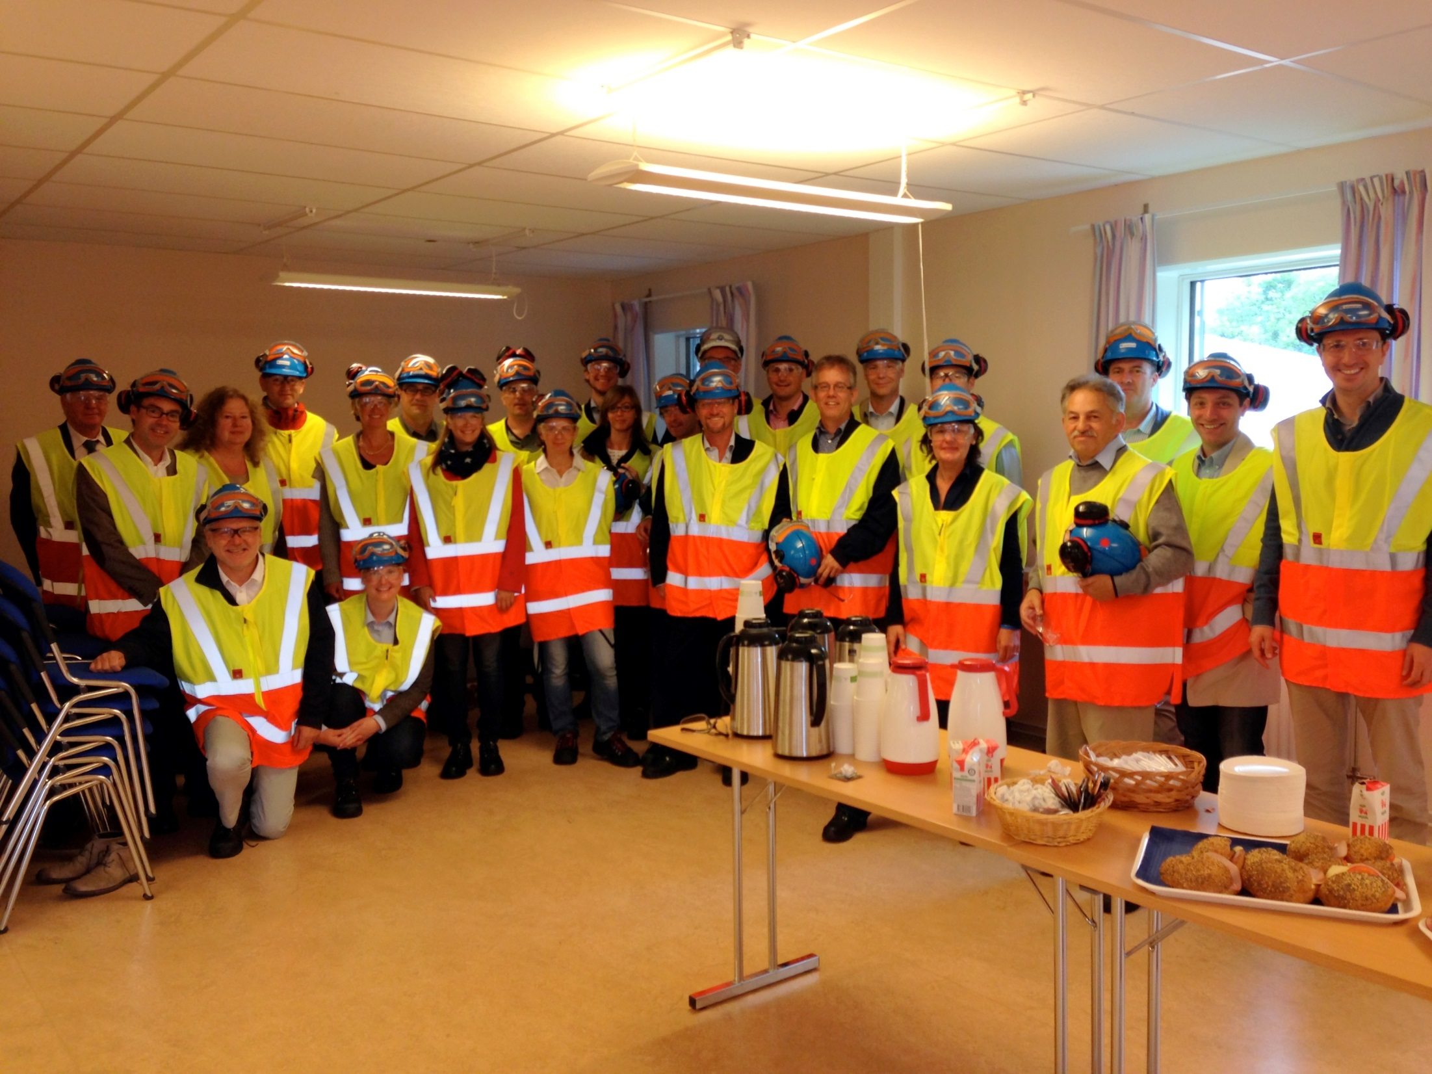

Slide 8
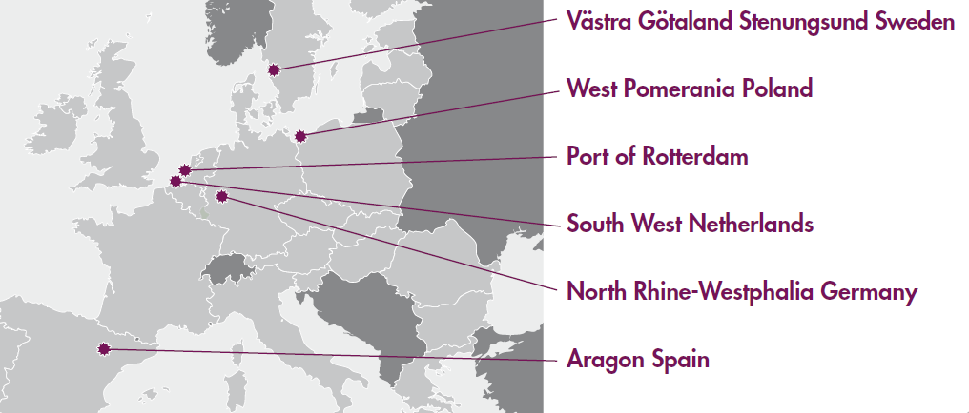
Who are we? – the regions
Cefic and PNO
Notes:
Six complementary EU regions, each with their own local expert and public-private research communities are joining forces. For three years, cooperation, collaboration and development of their research and innovation efforts will aim at improving resource efficiency and eco-innovation in industry.
Plus European partners

Slide 9









Project Partners

Slide 10









Project Partners

Slide 11
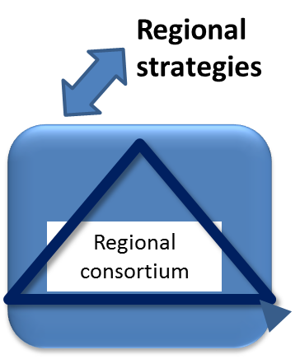
Ideator process
to catalyze the process from idea/innovation to project and achieving sustainability goals by European triple helix collaboration and industrial synergies
→ Joint Action Plan
EU strategies
H2020
Ideas
Innovation
Challenges
.
.
.
Ideator
process
Solutions to regional challenges
Improved resource efficiency methodology
Cross Europe triple helix collaboration
Transfer of “best practice technology”
European
Triple helix project
Regional
Mentoring
→ Implementation measure

Slide 12
Current Status
Regional Analyses completed
Initial idea generation completed
  33 development idea pitches have been developed so far to tackle resource efficiency
  Idea generation continues
Now taking ideas to EU-wide level with cross-regional interfaces

Slide 13
Next Steps
Complete Joint Action Plan
  Define and catalyze the path forward with ideas and possible developments
Explore options to further develop ideas into solutions
  Initiate Horizon2020 projects
  Inter-regional developments
  Regional knowledge transfer
Put measures in place to enable implementation and long-term sustainability of the approach

Slide 14
Thank you for your attention!
Anna Sager
SP Technical Research Institute of Sweden
Coordinator of R4R
Contact:
Anna.sager@sp.se
+46 10 516 58 37

