Slide 1



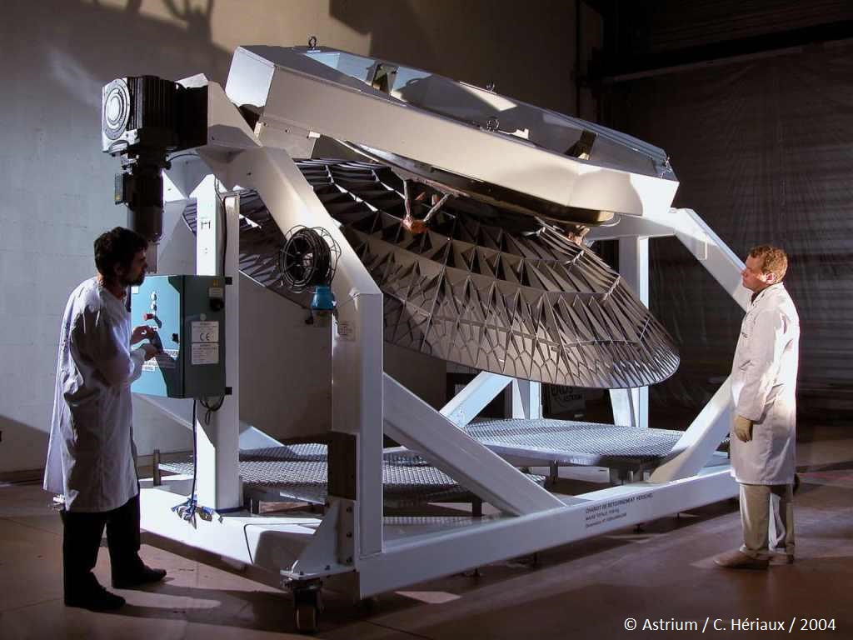

EIB financing for companies investing in KETs
An InnovFin Advisory perspective
Piermario Di Pietro
Innovation Finance Advisory, EIB
Workshop on Impact of the SPIRE cPPP
21 – 22 April 2015, Brussels, Belgium
Innovative Financial Instruments and Advisory Services
Shiva Dustdar
EIB RDI Advisory Services
Berlin, 1 July 2014
European Investment Bank

Slide 2
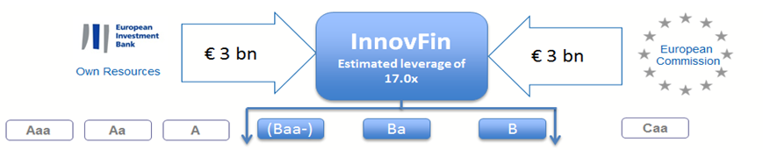

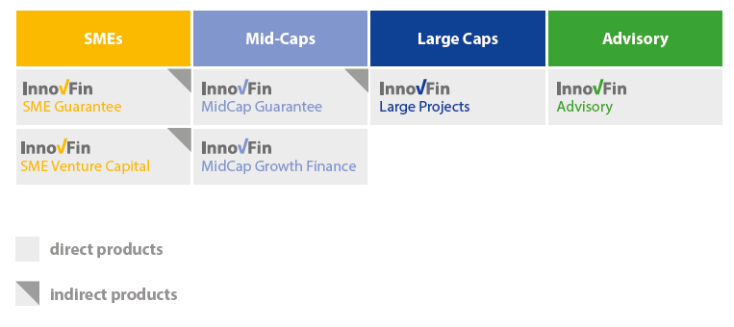


Current structure of InnovFin financial and advisory products
Equity/Debt
(the EC provides a
First loss Piece)
SMEs
Mid-Caps
Large Caps
Advisory
SME Guarantee
MidCap Guarantee
Large Projects
Advisory
SME Venture Capital
MidCap Growth Fin.
22 April 2015
Innovation Finance Advisory | European Investment Bank
2

Slide 3
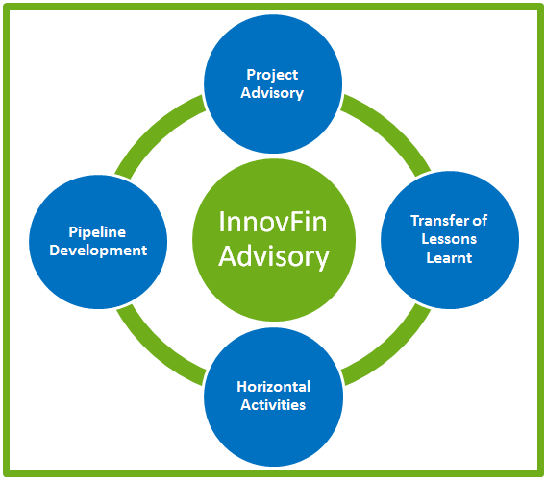
Innovation Finance Advisory helps to improve access-to-finance conditions
Project Advisory
Improve the bankability and the investment readiness of companies/projects needing funding to make significant R&I investments
Clients include R&I driven companies (midcaps or larger), public-private consortia, Joint Technology Initiatives, PPPs, R&D clusters, EC and EU Member States
Business model
Debt capacity analysis
Capital structure
Funding strategy
Classic or innovative (public) financial instruments
Funding sources and their eligibility criteria
  Governance
  Stakeholder engagement
Horizontal Activities
Prepare studies on increasing effectiveness of financial instruments to address specific sectors/R&I projects’ needs
Develop “business case” for new financing mechanisms to support specific R&I policy objectives
22 April 2015
Innovation Finance Advisory | European Investment Bank
3

Slide 4
Evolution of InnovFin products
SMEs
Mid-Caps
Large Caps
Thematic Finance
Advisory
SME Guarantee
MidCap Guarantee
Large Projects
FDP
Advisory
SME Venture Capital
MidCap Growth Fin.
IDFF
SMEs and small Mid-Caps
< 500 Employees
Mid-Caps
< 3,000 Employees
Large Caps
Typically > 3,000 Employees
Intermediated
SME/Mid-Cap Financing
Intermediated and/or direct Corporate lending
Direct Corporate Lending
22 April 2015
Innovation Finance Advisory | European Investment Bank
4

Slide 5
Study on access-to-finance conditions for companies investing in KETs
Despite the significant budget (Euro 6.7 billion grants) dedicated to KETs under Horizon 2020 and other measures taken, many KETs companies struggle to raise financing due to:
  High R&D risks;
  Significant capital requirements typical of KETs innovation activities;
  Uncertain commercial prospects
Innovation Finance Advisory scope of work:
  Survey on KETs investment plans and access-to-finance conditions with relevant sample companies and financial institutions investing in KETs;
  Identification of the key constraints facing KETs R&D activities from early stages research to commercialisation for a select group of KETs;
  LPA (Light-Project-Advisory) pilot project to assist companies on access-to-finance and potentially draw lessons for study.
22 April 2015
Innovation Finance Advisory | European Investment Bank
5

Slide 6
Survey on access-to-finance conditions for companies investing in KETs
As part of the survey we are conducting, we would be interested to meet companies to hear about their access-to-finance experiences, current or past
We would be interested to meet companies with minimum yearly revenues of Euro 5 million
Contact: Piermario Di Pietro (p.dipietro@eib.org)
22 April 2015
Innovation Finance Advisory | European Investment Bank
6

