Slide 1
SYNFLOW - A Success Story
Walter Leitner
Center for Molecular Transformation @RWTH Aachen
(Dr. Stefan Palkovits, Cora Schings)
DECHEMA
(Dr. Alexis Bazzanella)

Slide 2
Chemical and Pharmaceutical Industry
Importance of the chemical and pharmaceutical industry in Europe
European Chemical Industry | Employment | 1,19 Million direct jobs*
 | Chemicals sales | 558 billion €** 17.8% world market share
European Pharmaceutical Industry | Employment | 700.000 direct jobs***
 | Pharmaceuticals sales | 160 billion € *** 26.7% of world sales
* Eurostat 2012
** Cefic Chemdata International 2013
*** European Federation of Pharmaceutical Industries, Key-data 2012

Slide 3
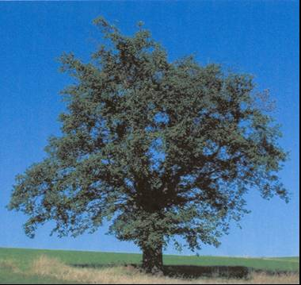
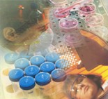
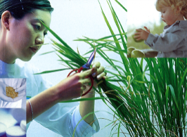



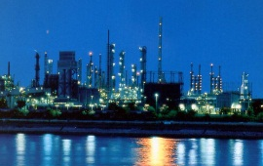
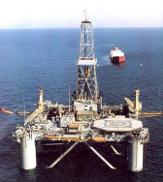
The Material Supply Chain: A ChemisTree
> 10⁵ products
health
new or improved
products
function
nutrition
care
~ 10² intermediats
sustainable synthetic pathways and processes
~ 10¹ basic chemicals
alternative carbon
ressources
10⁰ petroleum

Slide 4
The Green Chemistry Challenge
Petrochemistry
Basic Chemicals
Fine Chemistry
Pharaceuticals
kg waste/kg product
E- Factor = m(waste)/m(product) (R. Sheldon, 1993)
R. Sheldon, Green Chemistry, 2007, 9, 1273-1283

Slide 5
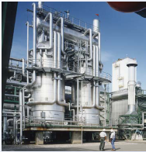
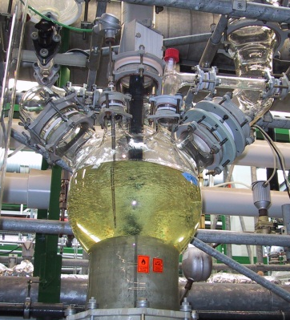
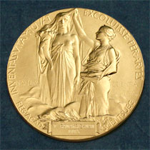
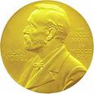
Catalysis: A Key Technology
>90% of new chemical processes
13 billion $ catalyst market
>1,000 billion $ value generation
15-20% of the total economy
2001: Asymmetric Catalysis (Sharpless, Knowles, Noyori)
2005: Olefin Metathesis (Chauvin, Grubbs, Schrock)
2007: Surface Science (Ertl)
2010: Pd-Catalyzed C-C Coupling (Heck, Negishi, Suzuki)

Slide 6
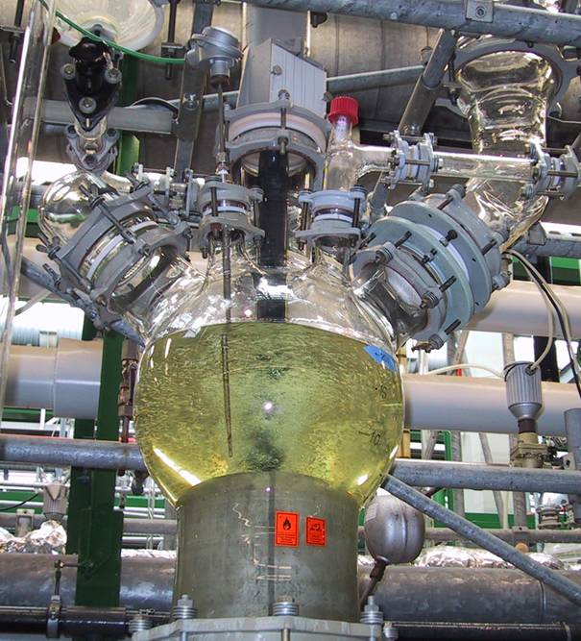
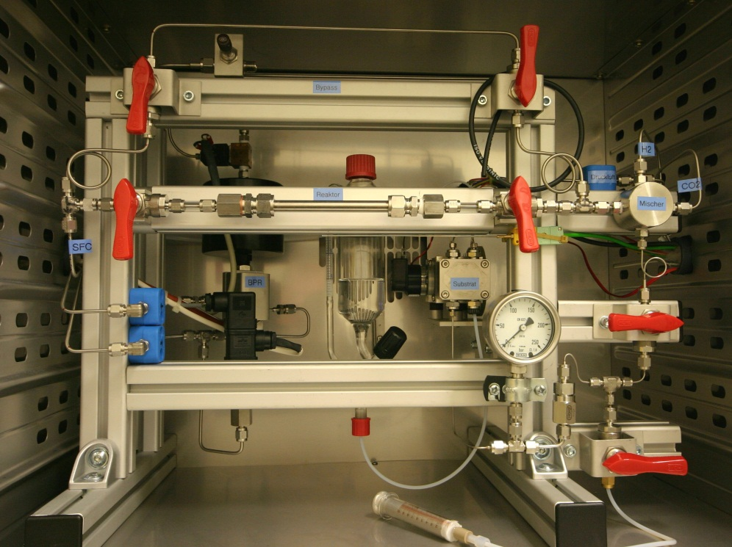
The SYNFLOW Concept
batch-wise
large volume
high E-factors
many unit operations
low space time yields
labour intensive
continuous-flow
small and flexible
no VOC, no waste
integrated process
high space time yield
largely automated
molecular
AND
engineering
sciences

Slide 7
The SYNFLOW Consortium
20 partners from 8 European countries
Coordination: CMT@RWTH Aachen
Management: Dechema
16,6 Mio € budget / 11 Mio € EU funding
September 1, 2010 – August 31, 2014

Slide 8
Research Programme: Work Packages & Case Studies
Integrated & Interdisciplinary Approach
Directed to new methodologies
Robust and generic processes
Based on industrial case studies
Aimed at demonstration (kg/d)

Slide 9
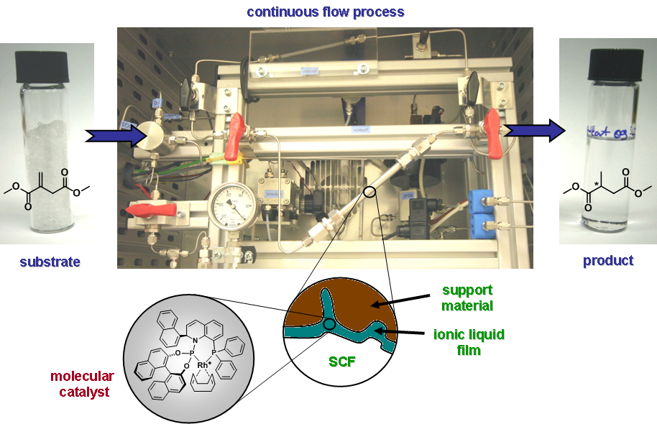
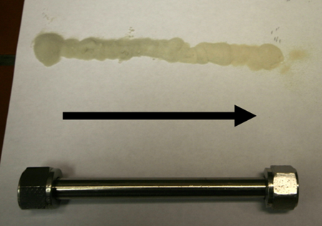
scCO₂
scCO₂
H₂
Supported
Ionic
Liquid
Phase
U. Hintermair, G. Franciò, W. Leitner,
Chem. Eur. J. 2013, 19, 4538 – 4547.
Notes:
ONE example for the approaches taken,
Exemplified for asymmetric hydrogenation as „case study“ because of ist broad utility in pharma !
Start with FLOW SCHEME, scCO2 combines DISTILLATION and EXTRACTION (Destraction, Zosel) => SUBSTRATES / PRODUCTS for Pharma!
NO organic solvent, PURE product without any further purification directly obtained.
CATALYST retained in SILP material: complex is IN SOLUTION, but material is free flowing POWDER !
Molecular structure and environment (IL, support) sontrol the performance! Further optimization possible!
STY = Reactor of 1 L volume (MASSKRUG !!) can produce 0.3 x 24 x 365 = 2628 kg product, i.e. ca 1 t of product per year !

Slide 10
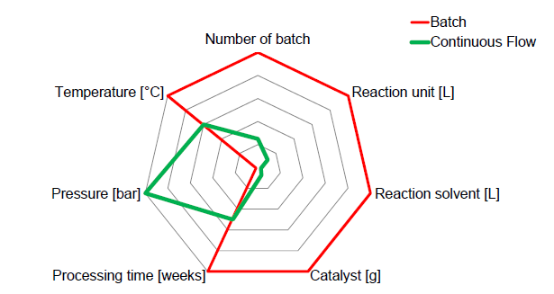
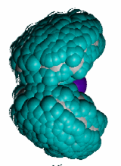
scCO₂
scCO₂
H₂
Supported
Ionic
Liquid
Phase
Notes:
ONE example for the approaches taken,
Exemplified for asymmetric hydrogenation as „case study“ because of ist broad utility in pharma !
Start with FLOW SCHEME, scCO2 combines DISTILLATION and EXTRACTION (Destraction, Zosel) => SUBSTRATES / PRODUCTS for Pharma!
NO organic solvent, PURE product without any further purification directly obtained.
CATALYST retained in SILP material: complex is IN SOLUTION, but material is free flowing POWDER !
Molecular structure and environment (IL, support) sontrol the performance! Further optimization possible!
STY = Reactor of 1 L volume (MASSKRUG !!) can produce 0.3 x 24 x 365 = 2628 kg product, i.e. ca 1 t of product per year !

Slide 11
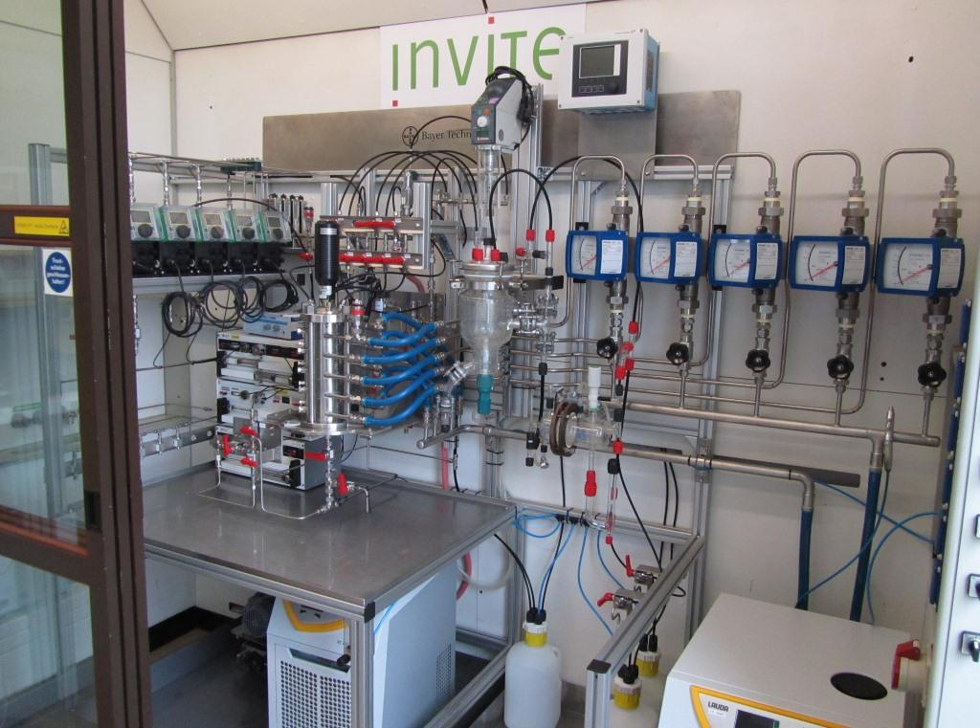
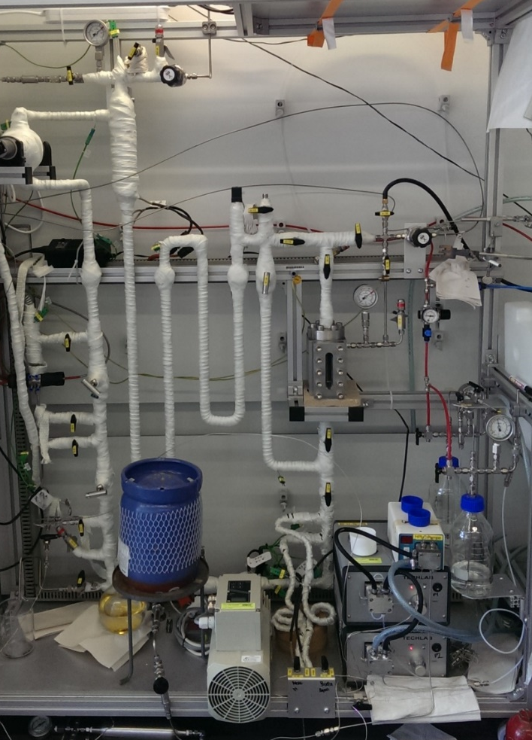
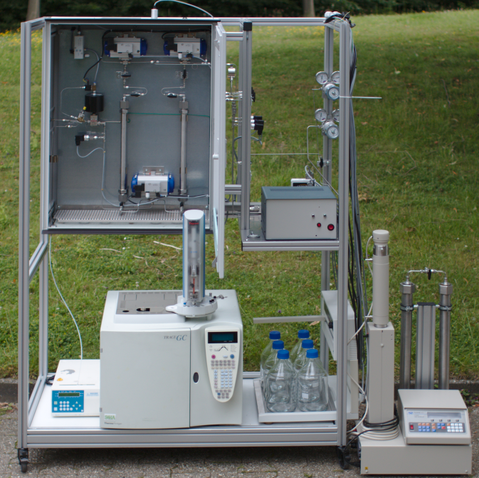
The SYNFLOW Deliverables: Demonstrators
Olefin Telomerization
(Evonik/Erlangen)
Hydrogenation
(AZ/RWTH Aachen)
Buchwald-Hartwig
(AZ/BTS/Invite)

Slide 12
The SYNFLOW Deliverables: Key Criteria
Effective catalyst
Product quality
Downstream processing
Energy & Solvents
Timelines for scale-up
Flexibility / Scope
Commercialisation of new catalyst
for Buchwald Hartwig amination
Reduced metal contamination
Patents on new reactor
technologies
Energy: -15%, up to -50%
E-factor: reduced up to 10x
Reduced by 25%
Drug development projects
up to 100 Mios €

Slide 13
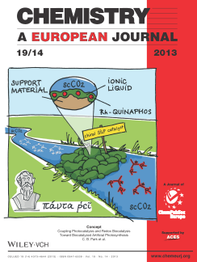
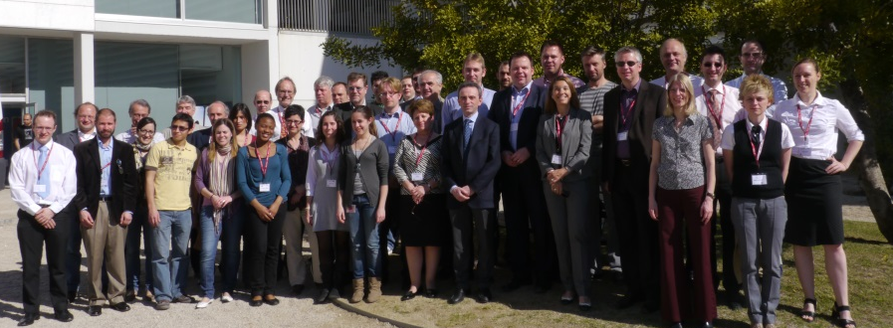
The SYNFLOW Legacy
26 publications in peer-reviewed journals
12 keynotes at international conferences
9 Postdocs / 36 PhD students
Consortium Meeting, Tarragona, April 2011

Slide 14
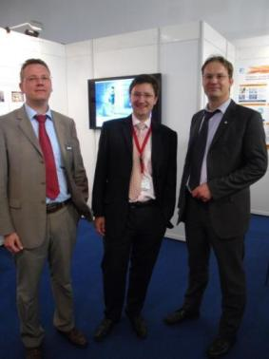
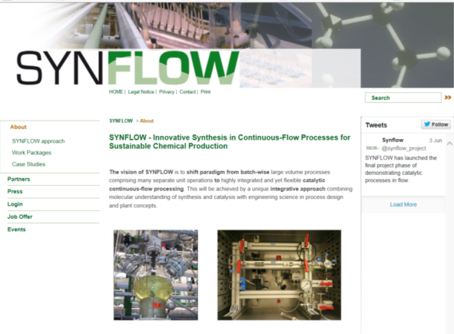
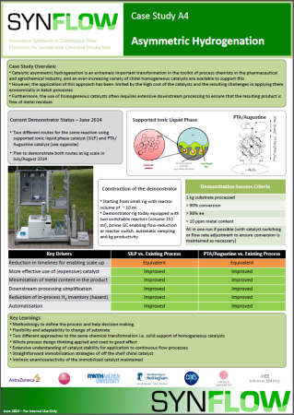
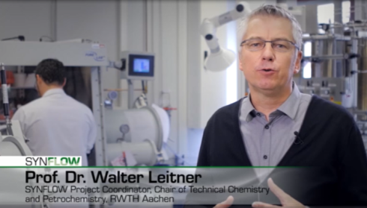
SYNFLOW dissemination activities
ACHEMA 2012
Joint Exhibition Booth
Website: www.synflow.eu
Twitter: @synflow_project
SYNFLOW
video
Conference Sessions
Green solvents 2012
CHISA 2012
15th International Congress on Catalysis
SYNFLOW
case studies

Slide 15
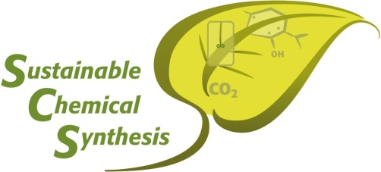
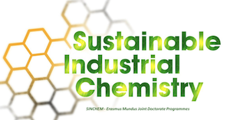


The SYNFLOW Legacy
NRW / Ziel 2
Marie-Curie ITN
Marie-Curie ITN
Synflow
F3 Factory
PolyCat

Slide 16
The SYNFLOW Legacy: Where to go next?
> improving known synthetic methods
=> novel synthetic pathways
> small and flexible units
=> novel operating windows
> automated reactors
=> self-optimizing / adaptable reactors
> pharmaceutical industry
=> cross-sectorial impact

Slide 17
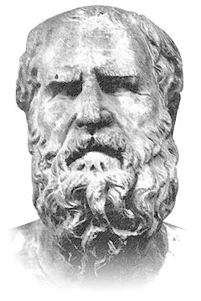
THANK YOU !!
πάντα ῥεῖ
panta rhei
„all flows“
Ἡράκλειτος
Heraclitus
ca 535 - 475 AD

