Slide 1
H2020 – WASTE 1-2014 CABRISS
INTRODUCING SPIRE 2014 PROJECTS
June 29, 2015 - Brussels

Slide 2
Main project features
CABRISS: IMPLEMENTATION OF A CIRCULAR ECONOMY BASED ON RECYCLED, REUSED AND RECOVERED INDIUM, SILICON AND SILVER MATERIALS FOR PHOTOVOLTAIC AND OTHER APPLICATIONS
HORIZON 2020 CALL
Waste: A Resource to Recycle, Reuse and Recover Raw Materials
WASTE-1-2014: Moving towards a circular economy through industrial symbiosis
TYPE OF ACTION: Innovation actions
Project key features
Project duration: 36 months
Budget: 9,281,682.25€
EC Contribution: 7,844,564.54€
Coordinator: CEA (French Alternative Energies and Atomic Energy Commission)
Contacts: luc.federzoni@cea.fr david.pelletier@cea.fr

Slide 3
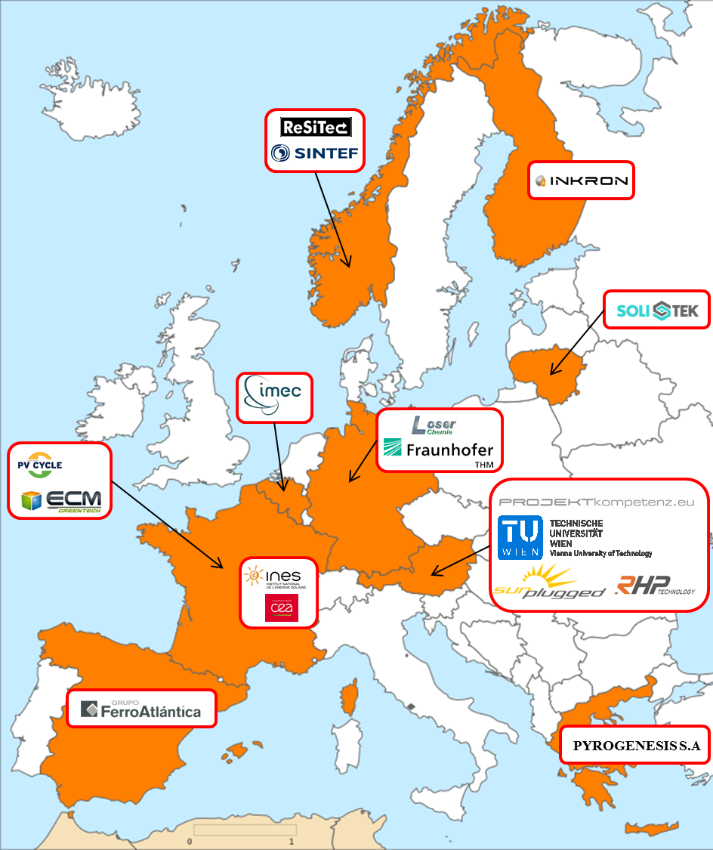
Main project features
CONSORTIUM
16 partners from 9 countries
6 SMEs and 5 Industries
5 RTO
TIMELINE
Official starting date: June 1st, 2015
Kickoff meeting July 7th-8th, July 2015

Slide 4
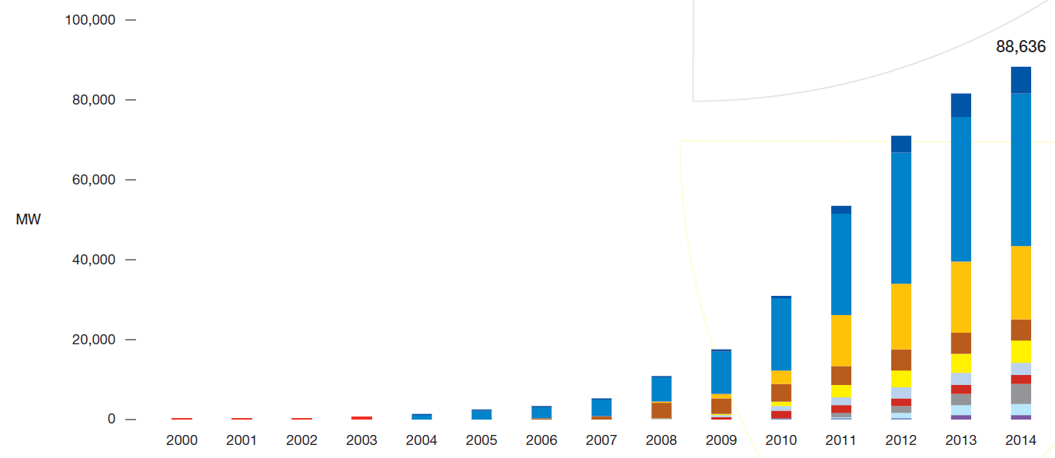
CABRISS Genesis
An important amount of photovoltaic waste
Long term challenge: the total PV products disseminated throughout Europe represent now roughly 8 million tons of future PV waste.
Short term challenge: deal with the waste coming from installation breakage and production scrap. As an example, in 2012, the 17.7 GW installed capacity in Europe has generated around 27000 tons of waste from installation breakage (estimated rate 2%) and production scrap (estimated rate 1-2%).
EU solar cumulative installed capacity
Source: Global Market Outlook. For Solar Power 2015-2019. SolarPower Europe.
Annual tonnage of EU PV waste (end of life modules only) until 2020 i.e. at the time where the CABRISS project’s outcomes will be available.
The European legislation is pushing towards the development of green solution that tackle the issue of PV waste. The recast WEEE Directive 2012/19/EU provides a legislative framework for extended producer responsibility of PV modules at European scale.

Slide 5
CABRISS Objectives
CABRISS aims at pioneering a circular economy dedicated to handle the critical situation of recycling the important amount of photovoltaic waste and benefiting also to electronics, metallurgy and glass industries.
Five main objectives :
Developing industrial symbiosis by providing raw materials such as glass or silver pastes as feedstock for other industries (e.g. Glass, electronics or metallurgy).
Collecting up to 90% of the PV waste throughout Europe compared to the 40% rate in 2013.
Retrieving up to 90% of the high value raw materials from the PV cells and panels: Silicon, Indium and Silver.
Manufacturing PV cells and panels from the recycled raw materials achieving lower cost (25% less) and at least the same performances (i.e. cells efficiency yield) as the conventional processes thanks to the implementation of a solar cell processing roadmap, which uses Si waste for the high throughput, cost-effective manufacturing of hybrid Si based solar cell.
Involving the EU citizens and industry into such a sustainable and financially viable new economy. Namely, EU PV manufacturing industry will be given a new momentum allowing them to reach 50% of the EU market by 2020 (vs 24% in 2013).

Slide 6
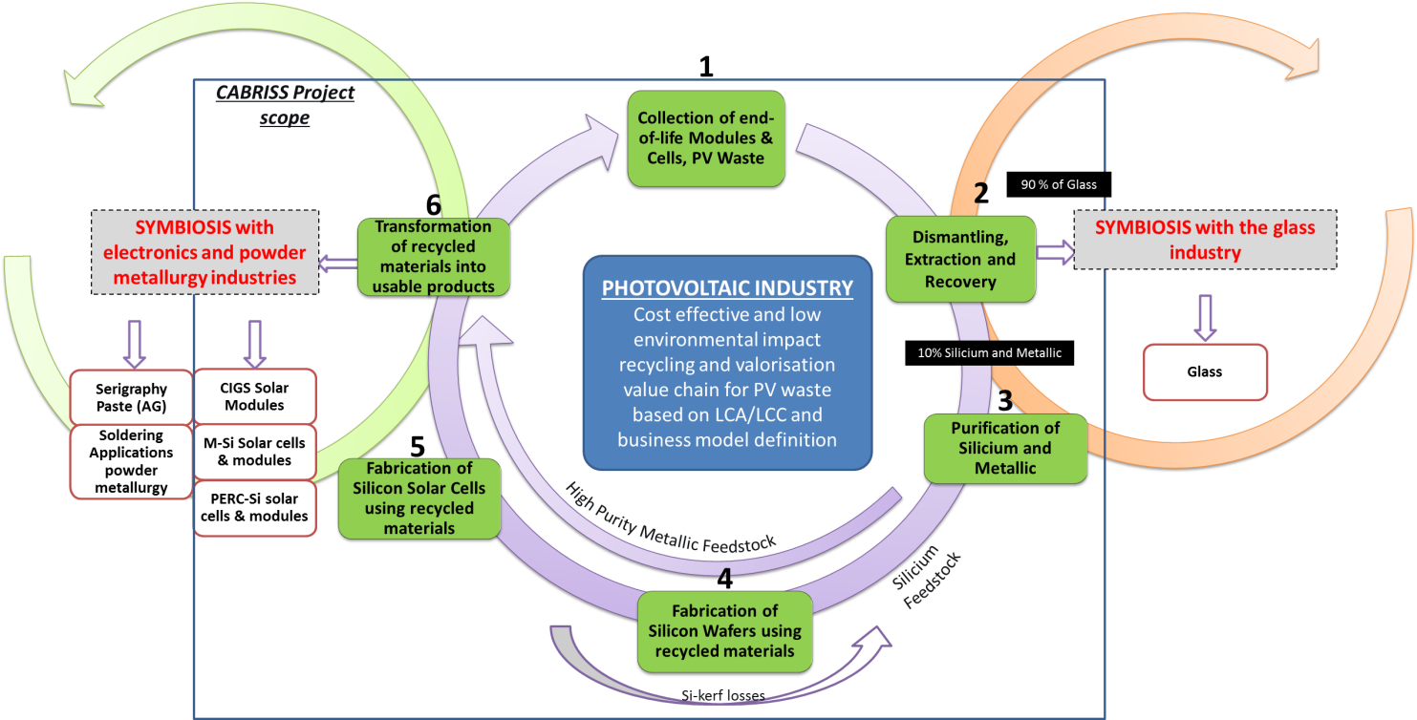
CABRISS project strategic concept

Slide 7
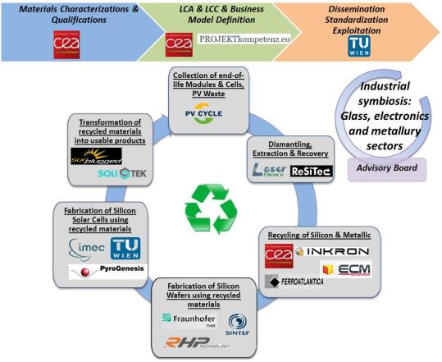
CABRISS Value chain

Slide 8
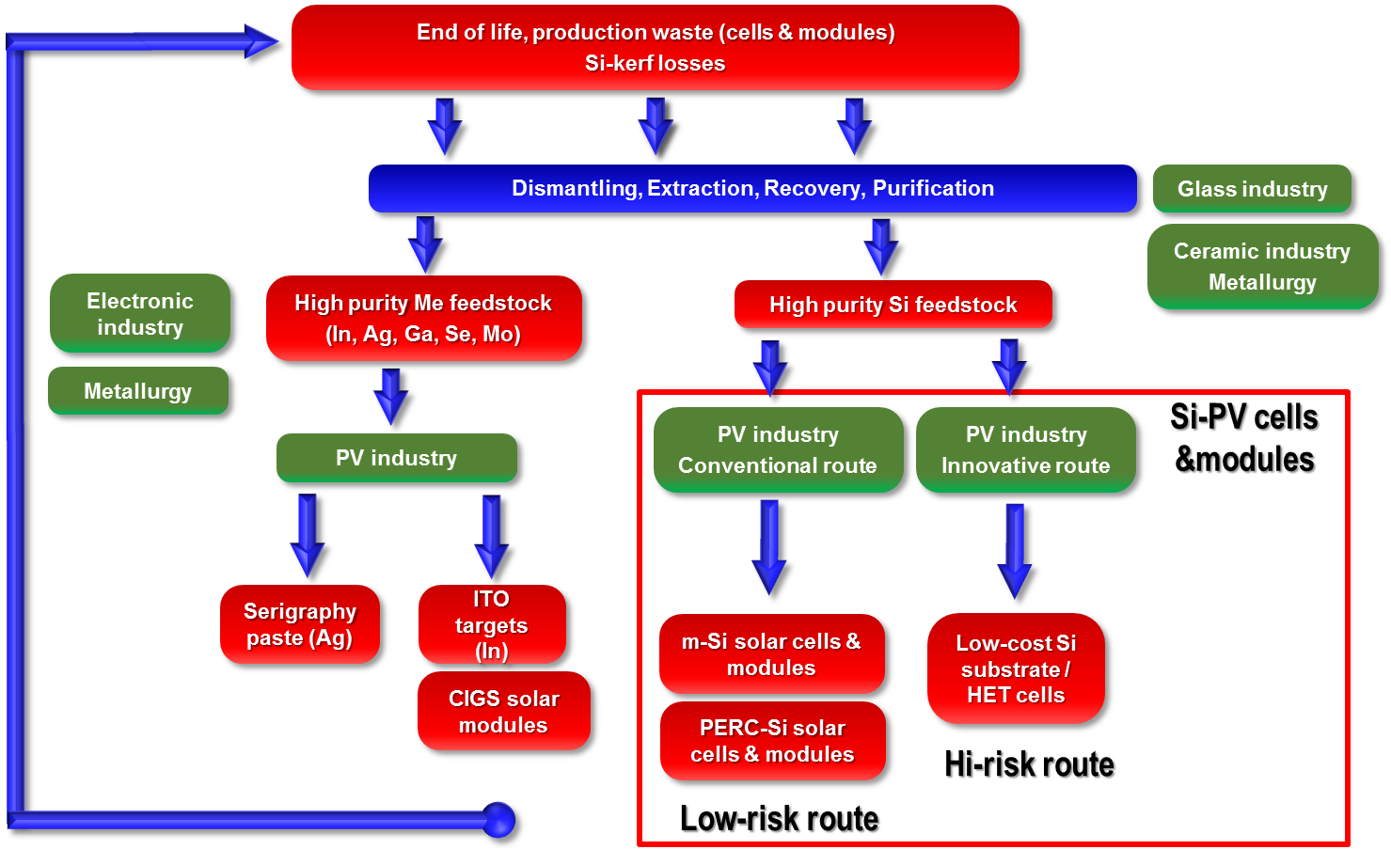
Exploitation expectative

Slide 9
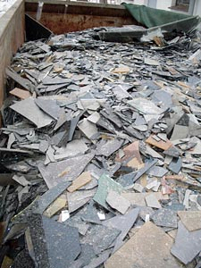
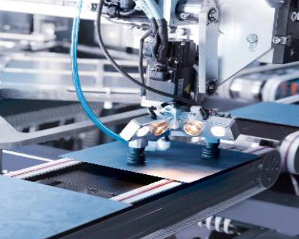
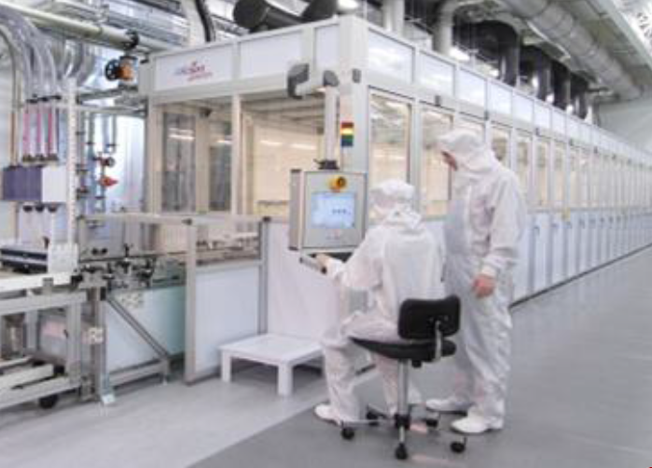
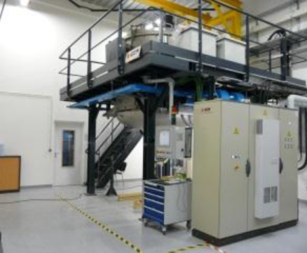
Study cases/pilots foreseen
Works in CABRISS are based on industrial scale process lines all along the value chain:
Collecting/dismantling: selected tens of tons of PV waste will be dismantle to constitute raw materials feedstock’s to recycle
Industrial demonstration will be done for the conventional route for PV industry: solar silicon purification, crystallization, wafering, cells processing, modules processing. Demonstration with the production of:
several ingots (G5 size – 450kg)
hundred of cells
tens of modules, different technologies
Demonstration at the largest possible scale will be done for the PV innovative route (kerfless route production of cells):
available
available
pilot after CABRISS

Slide 10
Validations
10 tons of PV panels will be dismantled and recycled during the project CABRISS
Life Cycle Assessment:
The following metrics will be used in CABRISS project:
The average emission of greenhouse gases per 1kWh of electricity produced (gCO_{2eq}/kW) and in total (tCO_{2eq}).
The primary energy required to produce 1Wp of solar panel (GJ/W_{p}).
The energy pay-back time (EBPT) in years.
Life Cycle Costing: The overall cost of new processes will be monitored. The target is to develop new routes with lower costs
The global process flow of CABRISS will be validated through verification by the EU Environmental Technology Verification Pilot (ETV) program and support the implementation of the roadmap of the SPIRE PPP.
Needs and opportunities for close loop introduction in the PV sector will be assessed by involving the European PV clusters and the industrial User Group for exploitation on other markets and develop transdisciplinarity between different sectors.

Slide 11
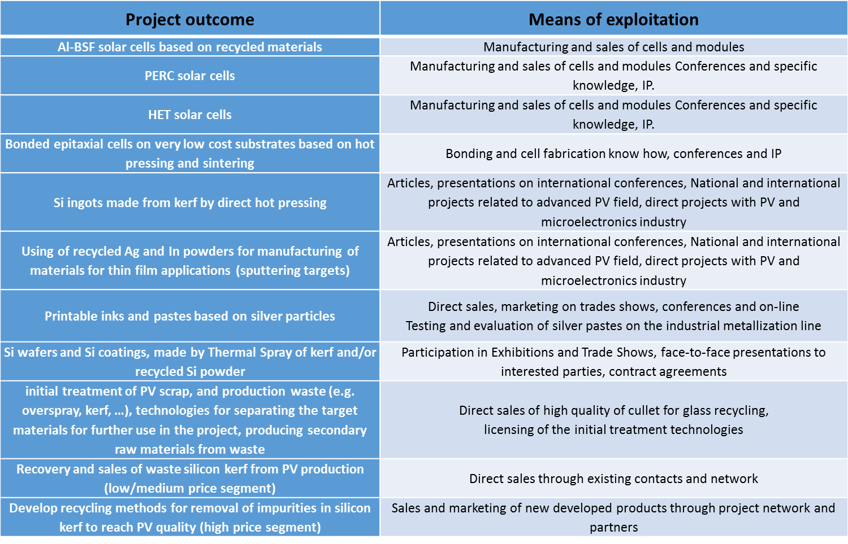
Exploitation expectative

Slide 12
Conclusion
Historical opportunity to develop a circular economy for the photovoltaic benefiting also for the electronics, metallurgy and glass industries.
Greater chances of success with close interactions outside the consortium:
Two open workshops will be organized within CABRISS
Call for discussion/collaboration to extend potential exploitation domains
Ask for a strong synergy with the SPIRE network
May we welcome a SPIRE representative in the CABRISS Advisory Board?
Opportunity to organize a European Workshop on EU projects (H2020, LIFE+,…) dealing with recycling ?

