Slide 1
Integrated Control and Sensing for Sustainable Operation of Flexible Intensified Processes
Prof. Dr. Sebastian Engell
TU Dortmund
June 29, 2015

Slide 2
The Partners in the Consortium
Process industry
Research institutes & academia
Supplier for instrumentation & SMEs
Università degli Studi di Cagliari
Notes:
We have seven large companies of the chemical industry. We have three research institutes and two universities. And, we have a supplier for instrumentation and two Small and Medium-Sized Enterprises. There are partners from Germany, France, Belgium, Italy, and the Netherlands. Before explaining what we are going to do in the CONSENS project, I would like to present some ideas on

Slide 3
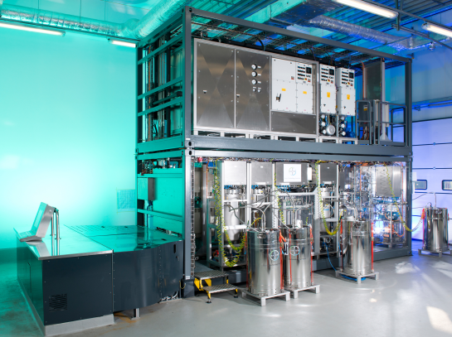
Mission
Advance the production of high-value products that meet high quality demands in flexible intensified continuous plants by introducing novel online sensors & closed-loop control methods.
Characteristics
Benefits
Miniaturized equipment
Product uniformity
Intensified heat & mass transfer
Sustainability
Fast adaption to market demand
Possibly modular setup
Innovative products
Containerized modular plant from F³ Factory project

Slide 4
Motivation
Compared to batch processes, there are significant benefits of flexible intensified continuous processes in many cases.
Specific challenges:
Small dimensions → fast sensors & closed-loop control needed
Higher quality levels → more accurate sensors needed
Complex phenomena →PAT and model-based control necessary
Innovative products → fast design, engineering and optimization
Fouling and clogging → needs special attention
Integrated PAT-based Process Control copes with these challenges:
Fast and accurate online sensing of key product and process parameters
PAT and model based closed-loop control and online optimization
Tools for design, monitoring, and optimization of the process and of its control system

Slide 5
Approach
Sustainable processes
Competitive prices
High quality products
Flexibility
Cross-sectorial dissemination & exploitation
Integrated validation in flexible intensified continuous plants
Develop new technologies for Integrated Process Control
Online Sensors
Closed-loop Control
Software Tools

Slide 6
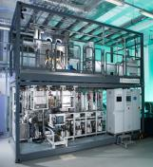
Case Studies & Novel Technologies
 | Intensified synthesis of organic compounds | Intensified production of high-viscous polymers | Continuous formulation of complex liquids
Setup | Tubular reactor | Kneader reactor | Static mixers
Benefit | Reaction without cooling | Uniform product | Homogeneity
Critical | Product purity | Rheology | Rheology
Issues | Clogging, varying feed | Difficult to control | Disruptions / waste
Novel sensors | online NMR sensor online fouling sensor | online rheology sensor for polymer melts | online rheology sensor with air-bubble detection
Novel control | Self-adapting optimizing control Plant-wide control |  | Data-driven control Plant-wide control
Tools | Sensor failure detection, performance monitoring, design evaluation

Slide 7
Novel sensing technologies
 | Online rheology sensors | Online fouling sensor | Online NMR sensor
Process parameter | Viscosity vs. shear rate, non-Newtonian fluids, polymer melts | Thickness of fouling layer in a tubular reactor | Compositions and ratios of substances
Features | Inline, non-invasive, measure across pipe, multi-phase-use, fast | Inline, non-invasive, possibly space-resolved | At-line, fast, accurate, possibly calibration free, high linearity
Principle | Ultrasound (across pipe) | Ultrasound (along pipe) | MR-NMR spectroscopy (permanent magnet)
S
N

Slide 8
Novel Control Technologies & Tools
Technology | Features
Model-based closed-loop control | Using simple rigorous models with online adaptation of parameters Iterative optimization Plant-wide control
Data-based closed-loop control | Data-based models for complex phenomena Closed-loop control based upon these models
Tool for sensor failure detection | Internal model is trained using process data Online correction of false sensor data
Tool for data-mining | Using “data cubes” which combine process, control, and design data Identifies long-term deviations Enables process optimization
Tool for design evaluation | Evaluation of the integrated control system in an early design stage Using realistic production scenarios

Slide 9
Integrated Validation of Technologies
Design Evaluation
Monitoring
Sensor failures / performance
PAT based adaptive control
Rigorous and data-based control
Plant-wide control
Advanced PAT:
composition / rheology / fouling
+ sensors available on the market
Process (flexible, intensified, continuous)
Notes:
In the validation phase, we want to apply the technologies to the processes in conjunction. This means, that the measured values of the developed sensors and other sensors will be used in the developed control technologies and in the monitoring tools in order to operate the process fully automated at its optimum. Before doing so, the methodology for design evaluation will be applied to the overall integrated system.

Slide 10
Example for integrated validation: Intensified synthesis of organic compounds
Control
Monitoring
Sensors
Online performance monitoring
Other sensors
Model-based control
Online state & parameter estimation
Sensor failure detection & correction
Fouling Sensor
NMR
A1
Dos.
Dos.
Mixing
A2
Dos.
Reactor section 1
Reactor section 2
B
Dos.

Slide 11
Conclusions
CONSENS focuses on flexible intensified continuous processes.
Novel online-sensors, advanced control methods and monitoring tools are developed and integrated to enable to exploit the benefits of these processes.
The sensing and control technologies can also be used for conventional processes.
Cross-sectorial dissemination and exploitation will widen the impact of CONSENS on the process industries.

Slide 12
Coordinator: Manuel Pereira Remelhe
Email: manuel.remelhe@bayer.com

