Slide 1

iCspec
Crowne Plaza Brussels
In-line Cascade laser spectrometer for process control
Rainer Strzoda, Siemens AG

Slide 2
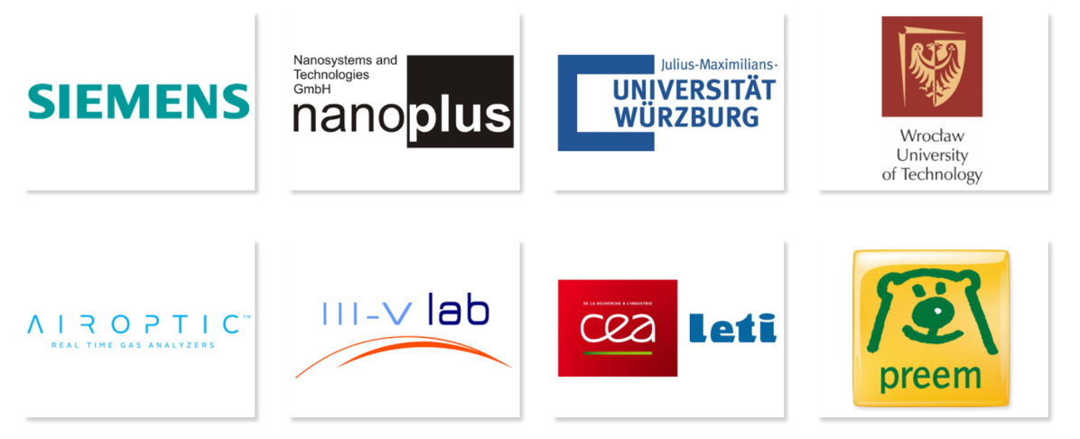
Project Fact Sheet
SPIRE-1-2014, Integrated Process Control
Consortium, 8 Partners, coordinated by Siemens
4 Countries: France, Germany, Poland, Schweden
Project duration: April 2015- March 2018
Budget: 9.3 M€ total, 5.6 M€ funding

Slide 3
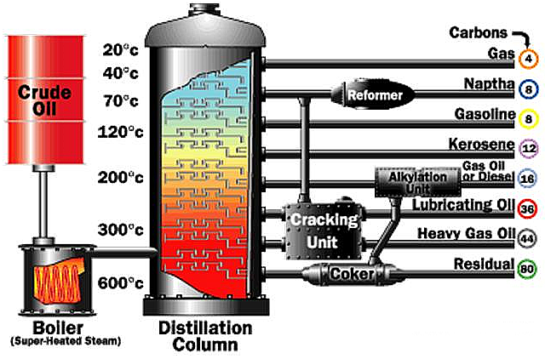
Objectives
  Project goal
  Development of laser based gas analyzers for fast in-line
  multi-component monitoring of gas compositions in a process stream
1st Target application
  In-line multi-component monitoring of hydrocarbons
  in a process stream of a refinery
  Benefits
  Fast in-line multi-species chemical composition measurements for process analytics
  Compact, robust and maintenance-free analyzer
  Replacement of extractive systems with a delayed response of several minutes
  Significant cost savings from the total-cost-of-ownership and improved process efficiency
GC
TDLS
iCspec
Multi-species
Extractive
Single species
Robust
In-line
Multi-species
In-line
Accuracy
FTIR
~ 10 Gases
Extractive
NDIR
~ 4 Gases
Overall costs

Slide 4

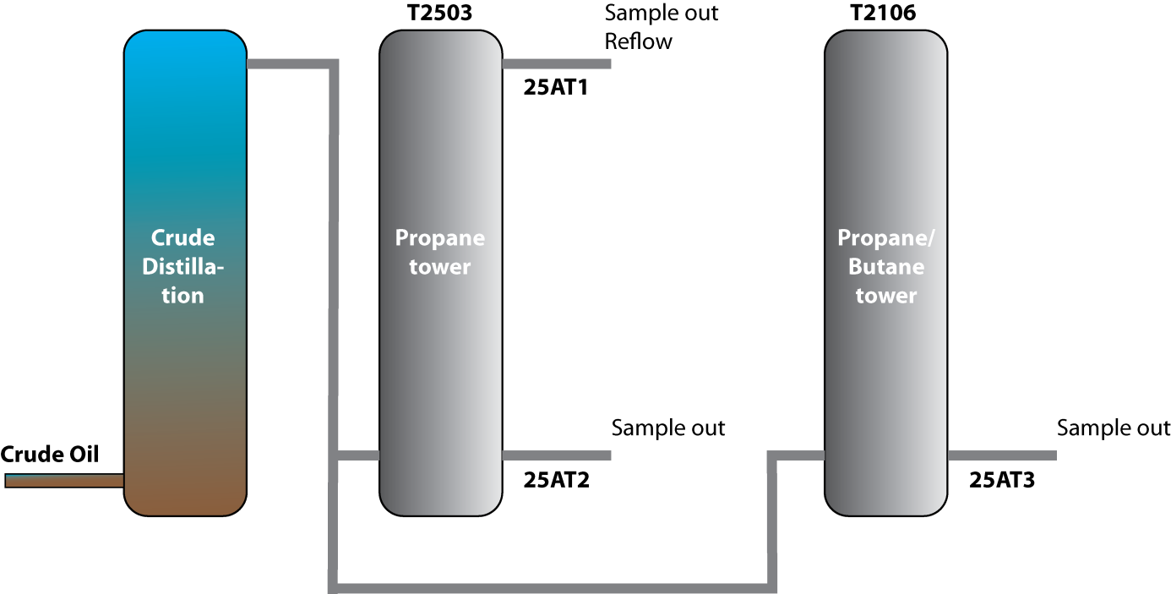
Pilot application
Preem refinery in Gothenburg
Target application close-up at PREEM refinery
  The separation of liquefied Petroleum gas
  from crude oil distillation: C₁ – C₅ hydrocarbons
  Extractive monitoring of hydrocarbons by GCs
    requires calibration gas
    requires sophisticated sample handling system
    introduces a sample delay of >4 minutes
    requires 60 l/h of sample gas vented to the flare
Specified gas mixtures in % of the PREEM application of the crude oil plant in Sweden
 |  | Sampling point
 | Compound | #1 25AT3 T-2106 | #2 25AT2 T-2503 Bot | #3 25AT1 T-2503 Ref
C₁ | Methane | 0,1 | 0,3 | 0,0
C₂ | Ethane | 0,5 | 4,0 | 0,5
C₃ | Propane | 33,0 | 49,7 | 98,5
C₄ | Iso-Butane | 40,0 | 22,0 | 0,7
C₄ | Normal-Butane | 24,3 | 22,0 | 0,3
C₅ | Iso-Pentane | 1,4 | 1,4 | 0,0
C₅ | Normal-Pentane | 0,6 | 0,6 | 0,0
C₆ |  | 0,1 | 0,0 | 0,0
~ 1000 ppm H₂O
#3
#2
#1

Slide 5
Key technologies
Required key technologies
  The development of fast laser based in-line measurement systems in the Mid-Infrared fingerprint region comprises:
    The integration of mid-IR laser sources
    Drive schemes and measurement procedures
    Advanced signal processing and data evaluation
MIR fingerprint region of HC
QCL – Quantum Cascade Laser Array
32 individual QCLs

Slide 6
Cooperation within iCspec
III-V Lab / mirSense
Distributed by III-V Lab / mirSense
Performance test
CEA Leti
Deduction of impact on process control regarding
production efficiency
Safety
Ecology
Cost reduction
Nanoplus
Airoptic

