Slide 1
Introducing SPIRE 2014 Projects
Brussels, June 29th, 2015
Introduction of the MEASURE project
Dr. Dana Kralisch, Friedrich-Schiller-University Jena

Slide 2
MEASURE Objectives
Addressing critical issues in Life Cycle Sustainability Assessment.
Identification of gaps in the available tools and methods in case of cross-sectorial cooperation.
Recommendation of best-suited LCSA evaluation tools
For different industrial sectors,
For cross-sectorial supply chain [data] management.
Enhance the comparability between the outcome of European SPIRE projects:
Recommendations for life-cycle based sustainable process design,
Identification of future research and standardisation needs.

Slide 3
Implementation Plan
Overview on current state of
sustainability assessment methods used in industry by joint online survey of STYLE, MEASURE and SAMT
In-depth survey concerning open issues in LCSA in case of cross-sectorial cooperation adressing experts by MEASURE
Multi-criteria decision analysis of the complex informations gathered with respect to the project objectives
Roadmap towards harmonised cross-sectorial life cycle sustainability assessment along the value chain
Analysis of the existing knowledge in literature
Expert interviews
1st workshop in May 2015 in Mechelen
Short course during the LCM 2015 conference, Bordeaux
2nd workshop in October 2015, London
Public dissemination event in March 2016 in Berlin

Slide 4
Joint Online Survey with STYLE and SAMT
Led and coordinated by STYLE
Launched on 24 Feb 2015 and closed end-March 2015
122 participants from chemistry, minerals, consumer goods, steel& automotive, waste…
The majority of responses are from:
Europe (96%) (Q4)
Germany: 22; UK: 18; Belgium: 16; Spain: 11; France: 10

Slide 5
Tools Used in Industry
Motivations for application of sustainability tools (Q40):
Software solutions used (Q41):
SimaPro > GaBi > Umberto > Instant LCA
Some tools are proposed to be added (Q42):
LiDS-wheel, EcoFly, Siscan tebodin, Bilan produit, Quantis Suit 2.0
>50% (of 30 answers) rely on existing tools, whereas ~25% are actively participating in developing such (Q45)

Slide 6
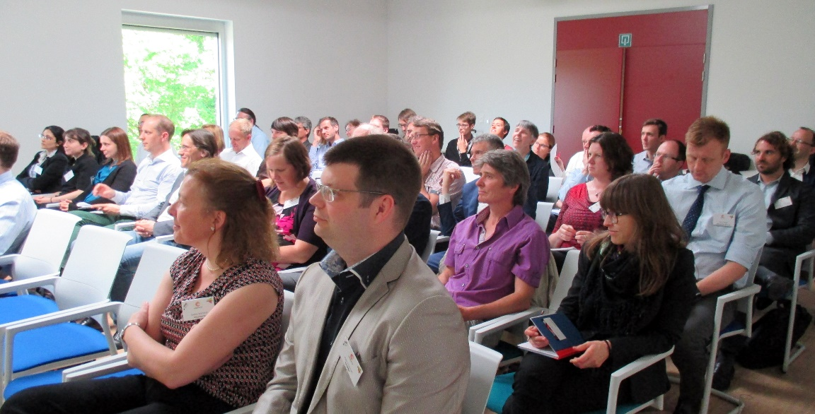
Key Topics of 1st MEASURE Workshop in May 2015
A Critical points:
Due to interfaces between sectors and along supply chains in European process industries
Resulting issues associated with data management.
B Challenges related with the forecasting of sustainability in SPIRE projects:
Evaluation from R&D to full scale production using the right tools.
Connectivity with existing engineering tools.
C Methodological choices with respect to:
Impact assessment methods and tools,
Uncertainty analysis,
Allocation and reuse.
D Current state of social LCA and footprinting methods.

Slide 7
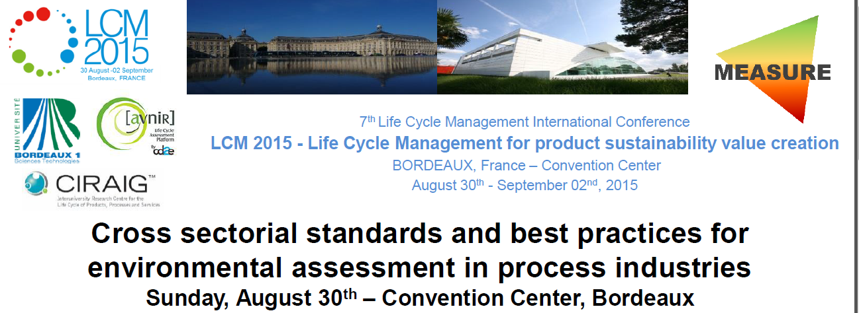
Short Course at LCM International Conference

Slide 8
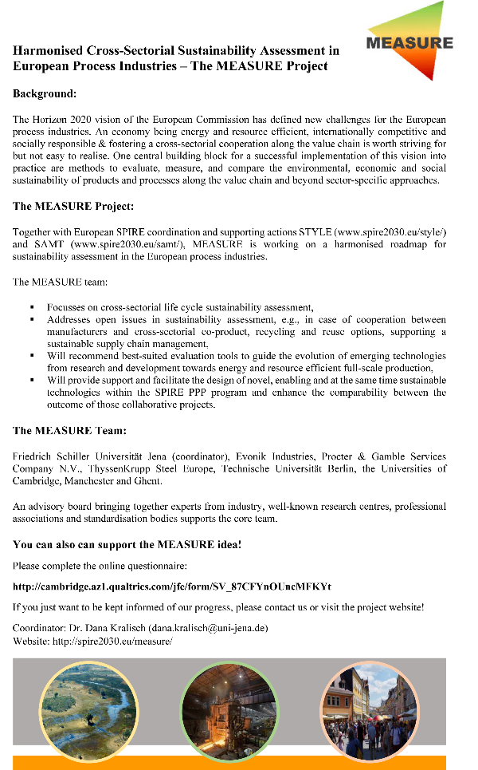
Online Survey → MEASURE Specific Topics
Online survey concerning open issues in LCSA in case of cross-sectorial cooperation in European process industries
Link: http://cambridge.az1.qualtrics.com/jfe/
form/SV_87CFYnOUncMFKYt

Slide 9
The MEASURE Team
Friedrich-Schiller-University Jena
Dana Kralisch
Peter Weyell
Evonik Industries
Elmar Rother
Aurelie Manent
Procter & Gamble Services Company
N.V.
Diederik Schowanek
Geert Vanhoof
ThyssenKrupp Steel Europe
Lisa Mohr
University of Cambridge
Alexei Lapkin
University of Manchester
Adisa Azapagic
Martyn Jones
Harish Jeswani
Technische Universität Berlin
Matthias Finkbeiner
Nikolay Minkov
University of Ghent
Jo Dewulf
Steven De Meester
Wouter De Soete
Sophie Sfez
The CSA MEASURE receives funding from the European Community's framework programme for research and innovation H2020 [H2020/20014-2020] under grant agreement no. 636816.

