Slide 1
MefCO₂ - Methanol fuel from CO₂
Synthesis of methanol from captured carbon dioxide using surplus electricity
June 2015

Slide 2
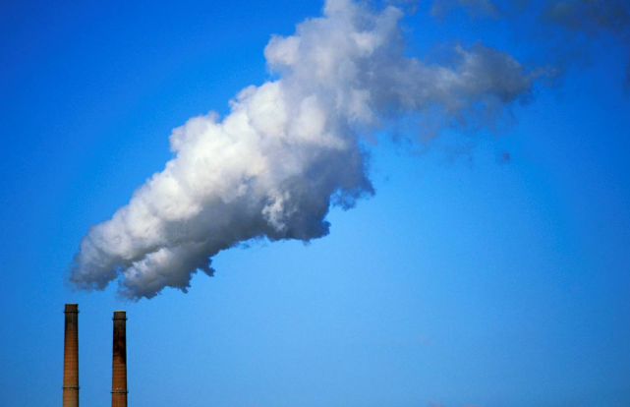
GHG emissions must be reduced by 50 to 80% by 2050 to avoid dramatic consequences of global warming
Notes:
MefCO2 proposal - Section 2

Slide 3
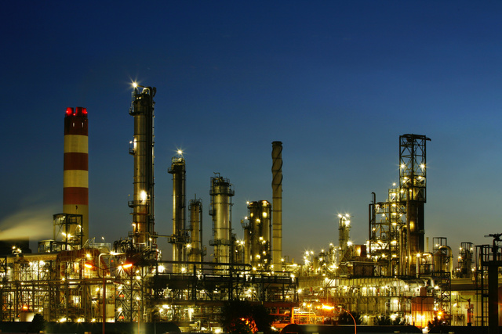
CO_{2 …} a key valuable element to be used for the sustainable future of the chemical industry
Notes:
http://www.oil-gasportal.com/co2-valorization-technologies/

Slide 4
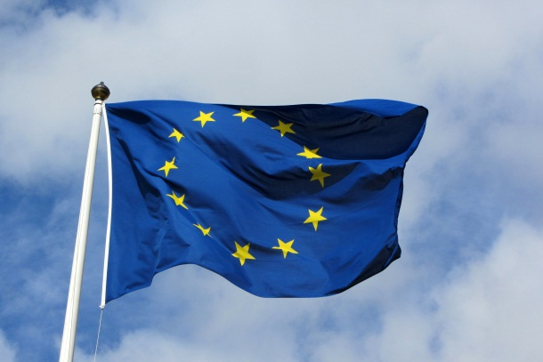
Europe has the know-how, the ability and the ambition to lead the world in developing these technologies
Notes:
http://ec.europa.eu/clima/policies/lowcarbon/
http://ec.europa.eu/eip/raw-materials/en/system/files/ged/90%20spire-roadmap_september_2013_pbp_02.pdf

Slide 5
MefCO₂ - Synthesis of methanol from captured carbon dioxide using surplus electricity
Notes:
MefCO2 proposal - Section 2

Slide 6
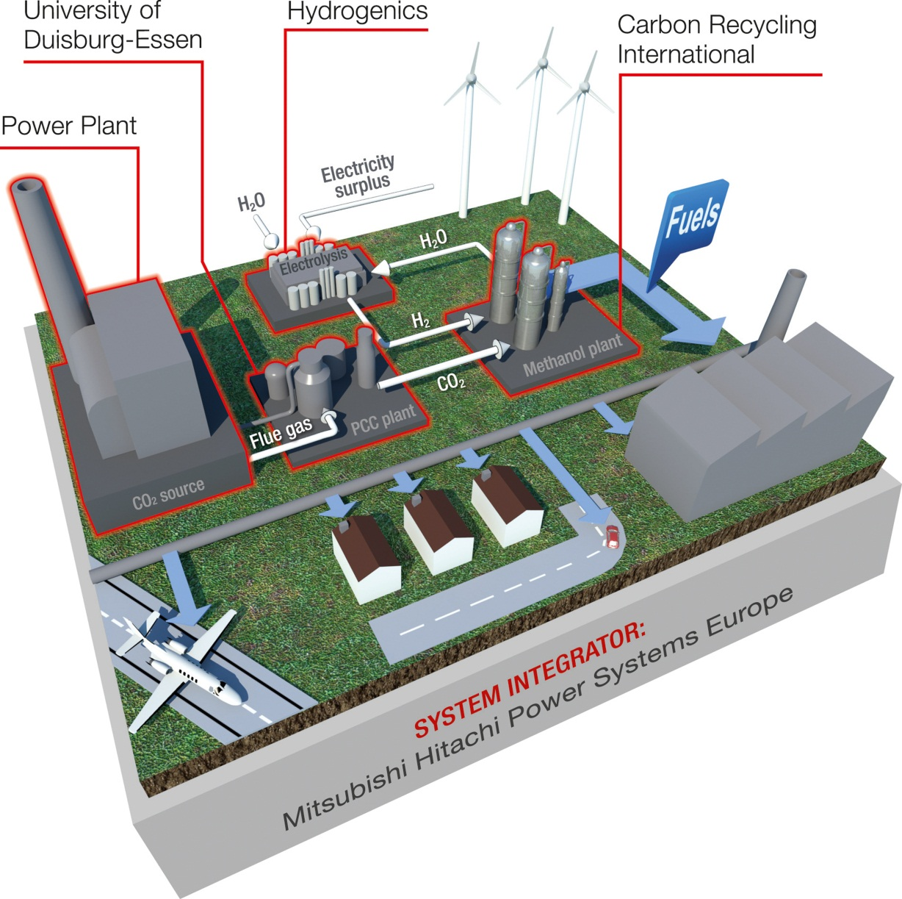
Water electrolysis
Carbon capture plant
Methanol process
Power plant
Notes:
MHPSE’s Communication department

Slide 7
i-deals (Spain) → Coordination, dissemination & exploitation
National Institute of Chemistry Slovenia (Slovenia) → Catalysis and reaction engineering
Mitsubishi Hitachi Power Systems Europe (Germany) → System integrator
Subcontractor: STEAG (Germany) → Power plant owner
Cardiff Catalysis Institute (UK) → Research in catalyst synthesis
Carbon Recycling International (Iceland) → CO₂ to methanol technology developer
DIME - University of Genoa (Italy) → Thermo-economic analysis and process optimisation
Hydrogenics Europe (Belgium) → Electrolyser technology developer
University of Duisburg Essen (Germany) → CO₂ capture technology provider
Notes:
MefCO2 proposal - Section 2

