Slide 1
Robust and affordable process control technologies for improving standards and optimising industrial operations Pau Puigdollers Project Coordinator

Slide 2
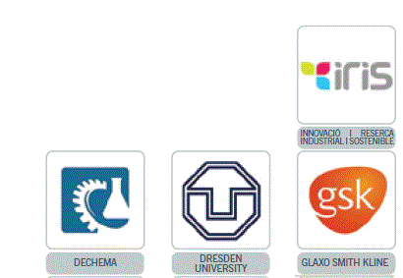
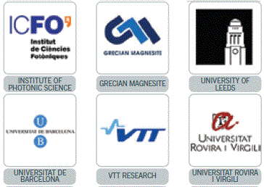
Quick overview
Topic: SPIRE 1 – Integrated Process Control
Grant Agreement no. 637232
Start date: 1st January 2015
End date: 31st December 2018
Participants: 16 partners, 8 EU countries
SME led project that also includes a technology start up, process industries, academia and institutes.

Slide 3
PROPAT: Making the process analytical technology (PAT) initiative a reality for the European process industries through integrated process control.
PAT enables:
• a process to be monitored for real time release of the process, cutting down on the amount of testing downstream and optimising quality in real-time.
• quality cost reduction by moving quality control closer to the production line (in-line, on-line, at-line) and away from the post-manufacturing quality labs.
• Quality by Design- allowing a process to be optimised to obtain greater efficiencies and higher end quality through knowledge of the fundamental scientific principles behind a process and continuous control of a process.

Slide 4
What are the challenges of PAT adoption in the industry?
• High costs of analysers
• Lack of a flexible platform for the integration of different analysers into existing plants
• PAT generates large volumes of data that need to be managed
ProPAT’s flexible PAT integration and data management platform will remove the barriers to practical PAT adoption in the industry.

Slide 5
What is ProPAT?
An affordable platform to facilitate Process Analytical Technology implementation for achieving more efficient and sustainable production processes.
Key objectives
To develop an INTEGRATED PROCESS CONTROL PLATFORM based on novel low cost real time on-line sensors and a versatile Global Control System Platform that acquires and processes the data
To perform PAT and QbD implementation case studies in order to evaluate their impacts and demonstrate their advantages.
To develop models for individual sensors and methods for analysing multisensory inputs

Slide 6
Specific outputs
Expected outcomes:
Novel MEMS-based SWIR compact spectrometer
Novel “lens-free” microscope particle size analyzer
Latest smart sensors
Latest chemometric tools
Global control platform
Installed and validated in real production facilities

Slide 7
A more efficient process results in:
Greater production capacity
Easier and more predictable processing
Less waste generated
Cost savings
Integrated process control is fundamental for a sustainable and efficient European process industry

Slide 8
Expected impacts
Implementation of PAT in the European process industry
To ensure a more efficient control of processes through on-line measurement and modelling critical quality attributes
Increased resource and energy efficiency in plant operations in the short to medium term
ProPAT will contribute to the creation of a CEN Workshop Agreement as a best practice document.
Cross-sectorial technology transfer: Demonstration activities across 4 different process industries will ensure the cross sectorial technology transfer.

Slide 9
Beyond ProPAT boundaries
The planned dissemination and exploitation activities will also ensure the technology developments reach other potentially interested sectors
ProPAT is open to collaboration with similar projects and platforms to ensure a larger impact of the project results.
The creation of a PAT standardization platform will allow the results of ProPAT to be uptaken by industries around Europe and beyond.

Slide 10
www.pro-pat.eu
Thank you!

