Slide 1
RECOBA:
Cross-sectorial REal-time sensing, advanced COntrol and optimisation of BAtch processes saving energy and raw materials
Libor Šeda, BASF SE
libor.seda@basf.com
29.6.2015, Introduction to SPIRE projects; Brussels, Belgium

Slide 2
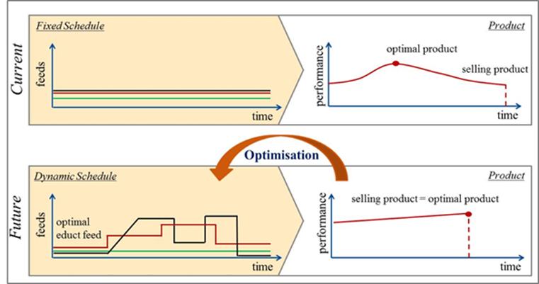
What is the RECOBA project about?
Increase the efficiency (product quality, energy, raw materials, costs) of the considered example batch processes.
Prove that online optimisation and control methods can be used in cross-sectorial applications and thus encourage other EU process industries for implementation of online model predictive control for their processes.

Slide 3
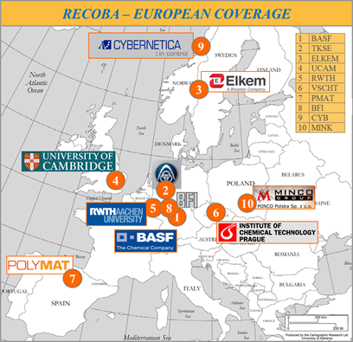
Who are the project partners?
Consortium
3 industries
BASF SE, Germany
ThyssenKrupp Steel Europe AG, Germany
ELKEM AS Technology, Norway
5 research institutes/universities
VDEh-Betriebsforschungsinstitut GmbH, Germany
POLYMAT, University of the Basque Country UPV/EHU, Spain
University of Cambridge, United Kingdom
RWTH Aachen University, Germany
University of Chemistry and Technology Prague, Czech Republic
2 SMEs
Cybernetica AS, Norway
Minkon Sp. z o.o., Poland

Slide 4
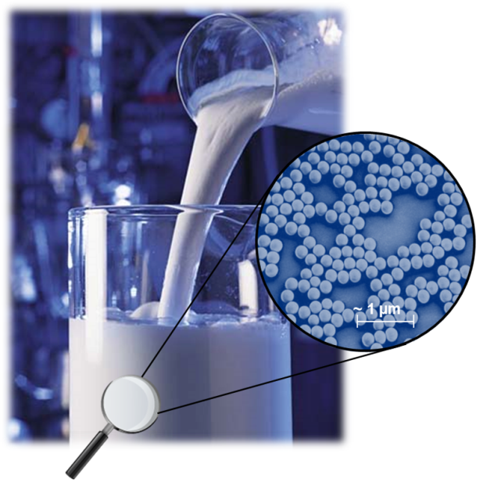
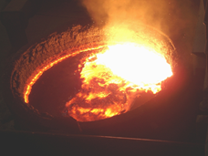
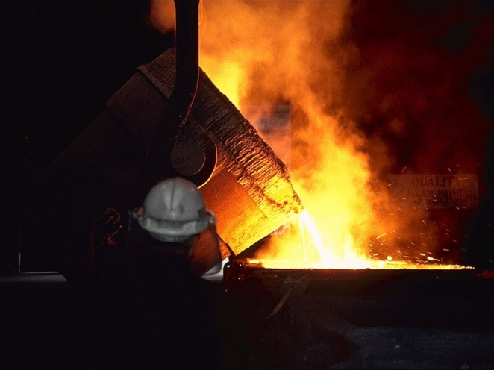
What are the considered example processes?
Polymerisation process (BASF)
Semi-batch emulsion copolymerization
Liquid steelmaking process (TKSE)
Silicon refining process (ELKEM)

Slide 5
Summary
Scientific technical goals
Innovative sensor techniques (Raman spectroscopy, TEM, temperature fibre optic sensors, etc.) will be implemented.
Innovative process models will be developed.
Control and optimisation methods will be faster and more reliable.
Technological impact
Products have higher and consistent quality (big + also for customers).
Economic impact
Higher energy and resource efficiency will be achieved.
Environmental impact
Carbon footprint will be reduced.

Slide 6
Project coordination:
Libor Šeda, BASF SE
libor.seda@basf.com
http://www.spire2030.eu/recoba/

