Slide 1
Introducing SAMT project
Hanna Pihkola, VTT
Introducing SPIRE 2014 projects
29 June 2015, Brussels

Slide 2
Aim of the SAMT project
To review and make recommendations about the most potential methods for evaluating sustainability in the process industry, focusing on energy and resource efficiency
To collect, evaluate and communicate the experiences of industrial actors from cement, oil, metal, water, waste and chemical industry
To promote cross-sectorial learning and uptake of best practices by
  Conducting case studies
  Organizing workshops and
  Identifying needs for future R&D and standardization

Slide 3









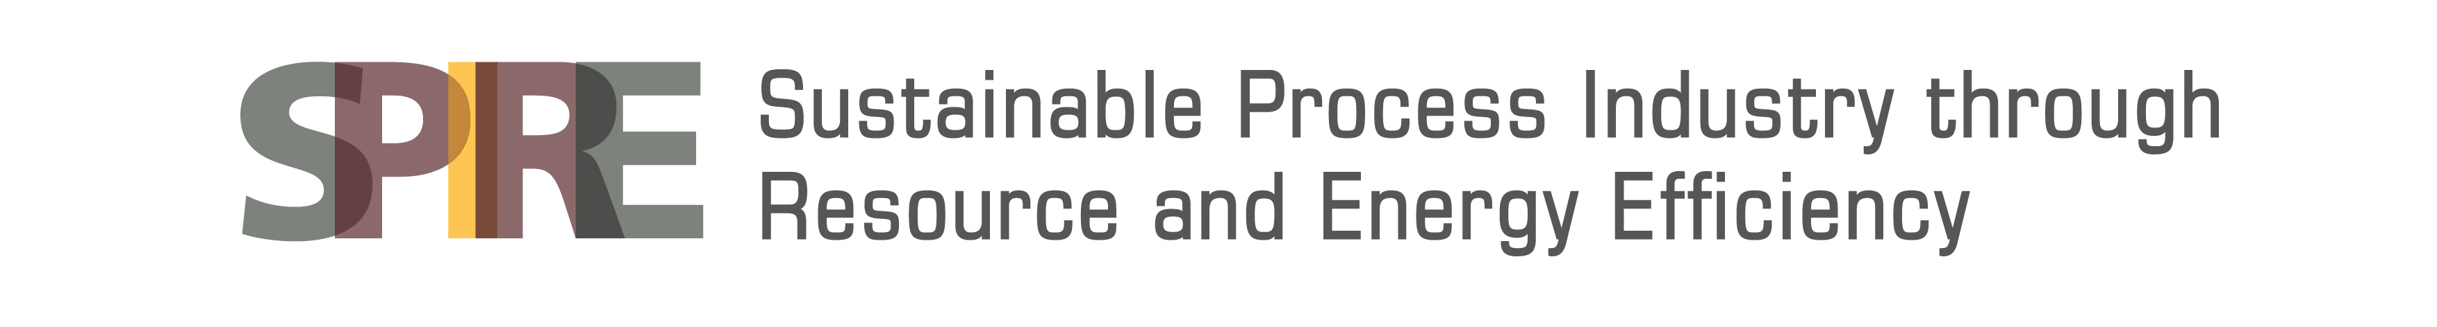

A cross-sectorial team working together to identify best practices for evaluating resource and energy efficiency
SAMT is coordination and support action
Project consortium consists of three research institutes, six companies and one standardization body
Cooperating with SPIRE sister projects STYLE and MEASURE

Slide 4

Main tasks & Outcome
On-going
REVIEW OF ASSESSMENT METHODS AND TOOLS
REVIEW OF STANDARDS
INTERVIEWS WITH INDUSTRY EXPERTS
WP1
Describes
the state of the art
in theory and practice
EVALUATION CRITERIA FOR THE ASSESSMENT METHODS AND TOOLS
OPEN WORKSHOP 1 – 02 JUNE 2015
Starting
EVALUATION, CLASSIFICIATION AND TESTING OF THE METHODS
WP2
Evaluates the ability of the
methods to support
decision-making and assess
energy and resource efficiency
CASE STUDY
CASE STUDY
CASE STUDY
BEST PRACTICE FOR EVALUATING RESOURCE AND ENERGY EFFICIENCY
OPEN WORKSHOP 2 – 17 FEBRUARY 2016
2016
RECOMMENDATIONS AND FUTURE RESEARCH NEEDS
WP3
Focuses on cross-sectorial
applicability and provides
recommendations for
future development needs
and implementation
STRATEGY FOR IMPLEMENTATION
ROADMAP FOR DISSEMINATION
RECOMMENDATIONS FOR CROSS-SECTORIAL ASSESSMENT
INPUT FOR FUTURE STANDARDIZATION
OPEN WORKSHOP 3 – OCTOBER 2016

Slide 5
First results are available on the
SAMT website
D1.1 Overview of existing sustainability assessment methods and tools and of relevant standards (Saurat, Ritthoff & Smith 2015)
Search resulted to 52 methods and 38 tools
Methods and tools were clustered and reviewed
The amount of found methods and tools was a surprise
  The list is not yet exhaustive
  It seems that only a very small number of methods and tools is applied in the process industries. In addition, companies have developed their own methods and tools for internal use.
There is a gap of horizontal standards (sector independent), addressing sustainability in general
See:
www.spire2030.eu/samt

Slide 6
Definitions applied
Method: set of instructions describing how to calculate a set of indicators. Methods include official standards.
Tool: artefact that assists with the implementation of a method. A tool is usually software but it could also be, for example, a paper-based check-list.
Indicator: a quantitative or qualitative proxy that informs on performance, result, impact, etc. without actually directly measuring it.
Need for harmonization?

Slide 7
Review by clusters
Focus on clusters with potential for cross-sectorial applications
Method and tool clusters | Comments
Life cycle methods | LCA, subsets or derivatives of LCA, and life cycle methods beyond environmental assessment
Hybrid methods | Fusion of existing methods (the limit between methods becomes blurred) in order to increase the scope of each individual method.
Integrated methods | Juxtaposition of well-delimited methods (“Russian dolls” construct) to support decision making. Usually includes a weighting scheme to aggregate sub-indicators into one or a small number of indicators.
Full LCA tools | Implementation of ISO-conform LCA and possibly other life cycle methods
Simplified LCA tools | Implementation of streamlined LCA and possibly other life cycle methods
Integrated tools | Interestingly, available integrated tools do not implement the integrated methods described above but provide their own combinations of methods

Slide 8
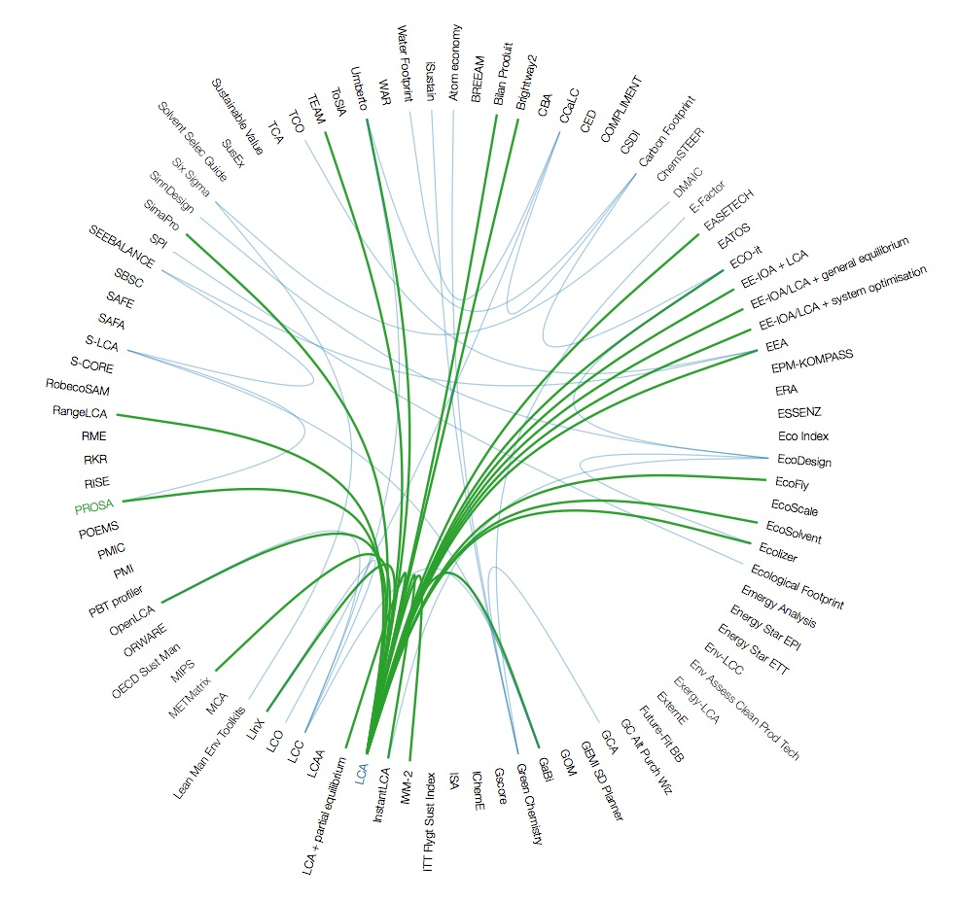
Overview: Which tools implement which methods?
Interactive visualisations available at www.spire2030.eu/samt

Slide 9
Next steps in the project
Analyzing the outcome of the interviews and the findings from the first workshop
Preparing the evaluation criteria
Next deliverable available in August:
  D1.2 Description of current industry practice and definition of the evaluation criteria
Evaluation of the selected methods and tools
Preparing for the industrial case studies that start in November
  3 cases planned to test the selected methods and tools in practice and to focus on cross-sectorial aspects and cooperation between different industry sectors

Slide 10
SAMT open workshops
1st workshop, June 2nd 2015 in Wuppertal, Germany
  Overview of methods and tools used in the process industries, including the practice of application
2nd workshop, 17th February 2016, Bilbao, Spain
  Findings and learnings from the industry specific case studies
3rd workshop, October 2016
  Identification of best practices, cross-sectorial guidance and
  recommendations for future actions
Invitations will be available through the SPIRE info channels
Joint event with MEASURE & STYLE?

Slide 11
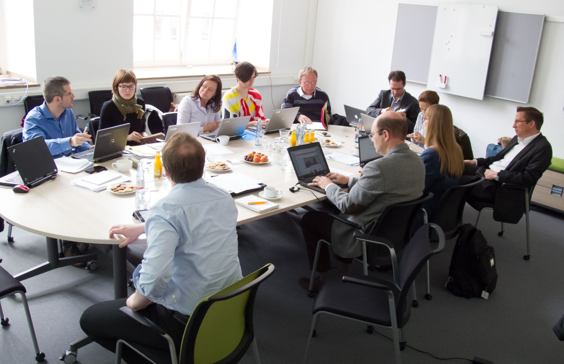
Thank you! Any questions?
SAMT project team at work in Wuppertal on June
Photo by Michael Ritthoff
Contacts:
hanna.pihkola@vtt.fi
tiina.pajula@vtt.fi
www.spire2030.eu/samt

