Slide 1
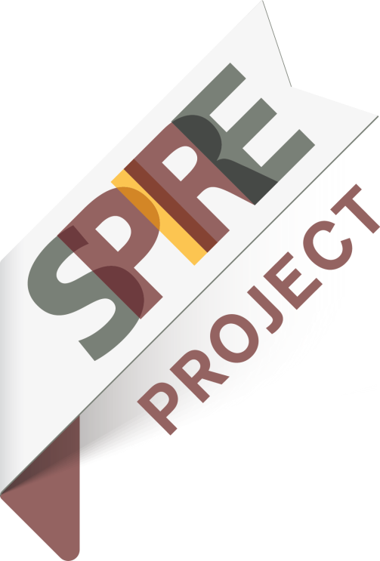

Introducing SPIRE-2014 projects
29th June 2015-Brussels
TASIO
H2020-EE-2014-1-PPP
GA 637189

Slide 2

Title: Waste Heat Recovery for Power Valorisation with Organic Rankine Cycle Technology in Energy Intensive Industries
Acronym: TASIO
H2020-EE-2014-1-PPP GA 637189
Participants:
TECNALIA RESEARCH & INNOVATION (Spain)
TURBODEN SrL (Italy)
D´APPOLONIA SPA (Italy)
CENTRO SVILUPPO MATERIALI SPA (Italy)
GEONARDO ENVIRONMENTAL TECHNOLOGIES LTD. (Hungary)
GERDAU ACEROS ESPECIALES EUROPA S.L. (Spain)
HOLCIM ROMANIA S.A. (Romania)
VIDRALA S.A. (Spain)
01st Dec. 2014- 31st May 2018 (42 months)
2

Slide 3
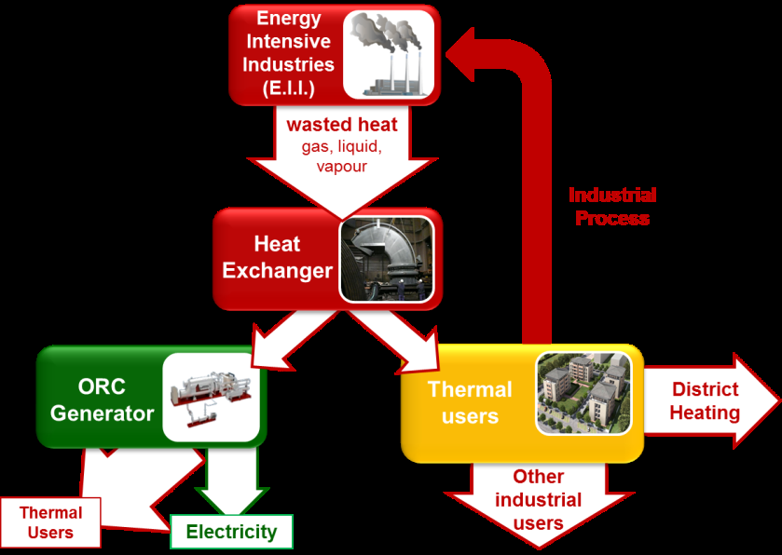
Waste Heat Recovery System (WHRS): a system of components installed to recover thermal energy from a heat source.
heat exchanger + heat carrier medium circuit + ORC unit+ cooling unit
Organic Rankine Cycle (ORC): closed thermodynamic cycle to convert heat into mechanical energy and eventually into electricity with a close circuit employing a working fluid different from water and metal (siloxane hydrocarbons, etc.).
The objective of TASIO is to eliminate the heat carrier medium circuit by developing an innovative solution of Direct Heat Exchange aimed at heat recovery for electricity generation through an ORC .
3

Slide 4
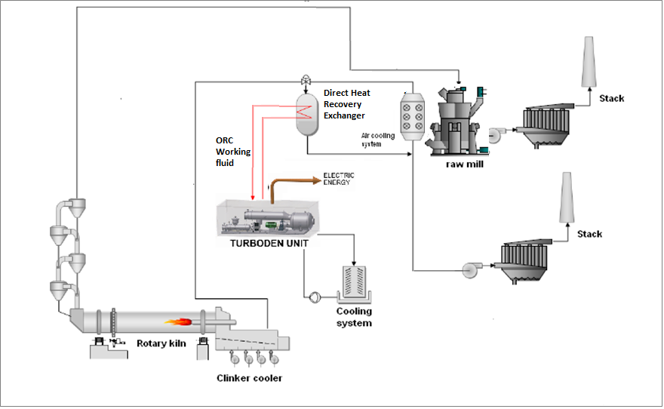
Main aspects. Tasks. Innovative aspects.
◌ Direct Heat Exchange solution suitable for cross sectorial applications in EI industries
◌ Foreseen increase in the efficiency of the process 15-20%
◌ Selection/development of innovative materials and coatings.
◌ Reduction of the overall costs while increasing efficiency of the ORC technology.
◌ Complete validation in real production conditions. DEMO site
◌ Pilot scale test of the WHR system to recover and transform the thermal energy of the flue gases of EII into mechanical energy for internal use (compressors).
4

Slide 5
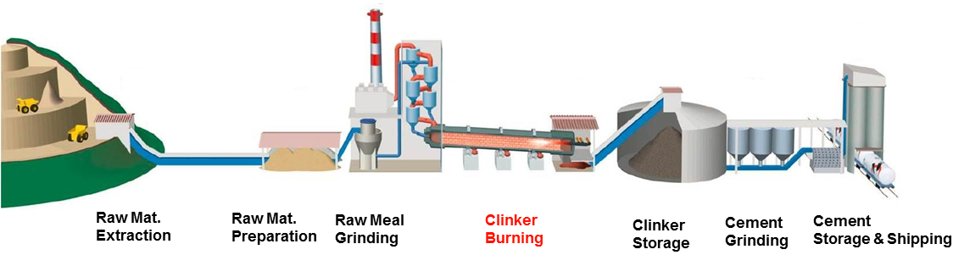
Expected outcomes. Results
☺ New Heat exchanger
☺ New Generation of ORC Turbogenerators
☺ Advanced Monitoring & Control System
☺ WHRS for Air Compressors Energy Supply
☺ System for Electrical energy production from the petrochemical sludge
☺ DEMO site
5

Slide 6
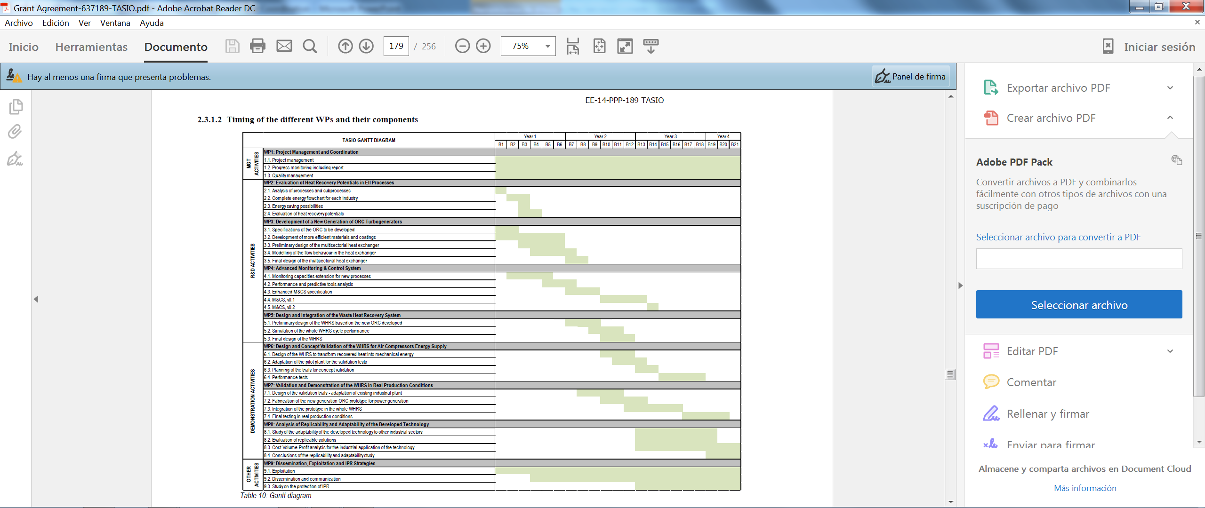
TASIO in 2015. First year summary. Clustering
☺ Sustainability. STYLE project
☺ Clean Manufacture cluster formed by AREUS, EMC2Factory, ENEPLAN and REFORM projects and managed by Rosemary Gault from Sheffield Univ.
☺ ☺ ☺ SPIRE community. A.SPIRE aisbl
Av. E. van Nieuwenhuyse, 4. B-1160 Brussels
www.spire2030.eu
6

Slide 7

Many thannks you for your attention
Pedro.egizabal@tecnalia.com

