Slide 1
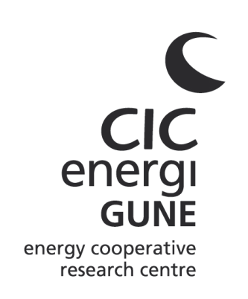

CIC energiGUNE
RESLAG
Turning waste from steel industry into valuable low cost feedstock for energy intensive industry
© CIC energiGUNE. 2015 All rights reserved
2015
Bruno D’Aguanno
CIC energiGUNE
bdaguanno@cicenergigune.com
Notes:
PORTADA

Slide 2
A short history of the project
Project idea
from an experienced research team
Exploitation of waste slag for applications
for the metal extraction, heat recovery, CSP and refractory sectors
Idea development
2012
Search and evaluation
of instruments to support the project activities
Regional calls, National calls,
H2020 calls, direct industrial contract
2013
Project definition
2014
Identification of supporting entities
Project partners, management
entities, consultant agencies, material suppliers, H2020 staff, supporting industrial organizations, supporting stakeholders, etc.
Project writing
and
submission
2015
Project realization
(if approved)

Slide 3
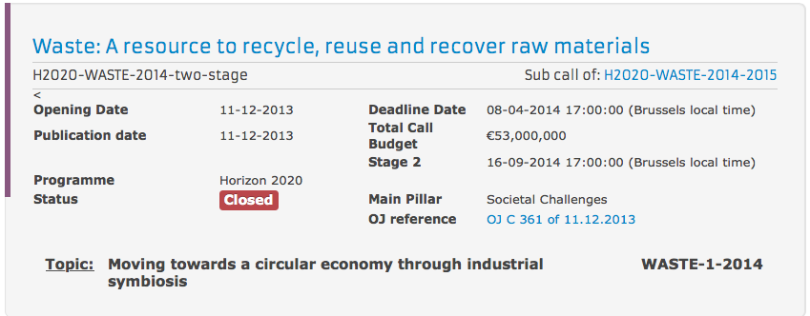
The instrument
After evaluating different options, CIC energiGUNE decided to chose the following instrument:
http://ec.europa.eu/research/participants/portal/desktop/en/opportunities/h2020/topics/2111-waste-1-2014.html

Slide 4
Challenges and scopes
CIC energiGUNE decided to focus on the following challenges and scopes highlighted in the WASTE-1-2014 call:
Specific challenge: Growing prosperity leads to the extraction and use of more resources and to the production of more waste. … This calls for eco-innovative solutions and resource-efficient products, processes and services, ….
Industrial symbiosis, whereby different actors derive mutual benefit from sharing utilities and waste materials, requires large-scale systemic innovation with the aim of turning waste from one industry into useful feedstock for another one.
Industrial symbiosis has been identified by the SPIRE PPP as one of the solutions to be addressed to achieve more efficient processing, resource and energy efficient systems for the process industry
Scope: Proposals should aim to demonstrate and analyse … innovative processes and services … that enable product and material reuse, recycling, recovery, … and reduce generation of waste along product chains in different production processes …

Slide 5
The project consortium
18 Partners
10 Research Insitutions | CIC energiGUNE | Spain
 | German Aerospace Center | Germany
 | IK4-Azterlan | Spain
 | ETH | Switzerland
 | Imperial College | United Kingdom
 | Friedrich Alexander University Erlangen-Nuremberg | Germany
 | Commissariat à l‘énergie atomique et aux énergies alternatives | France
 | Agenzia nazionale per le nuove tecnologie | Italy
 | Technical Research Centre of Finland | Finland
 | Fraunhofer Society, Resource Strategy and Recycling Technologies | Germany
5 Large Companies | ArcelorMittal | Spain
 | Optimum Cement | France
 | Tapojärvi company | Finland
 | Alstom Power Systems | France
 | Improequipe Ingeniería | Spain
2 SME | Life Cycle Engineering | Italy
 | Zabala Innovation Consulting | Spain
1 Association | Moroccan Agency for Solar Energy | Morocco
8 Countries | Spain, Germany, Switzerland, United Kingdom, France, Italy, Finland, Morocco

Slide 6
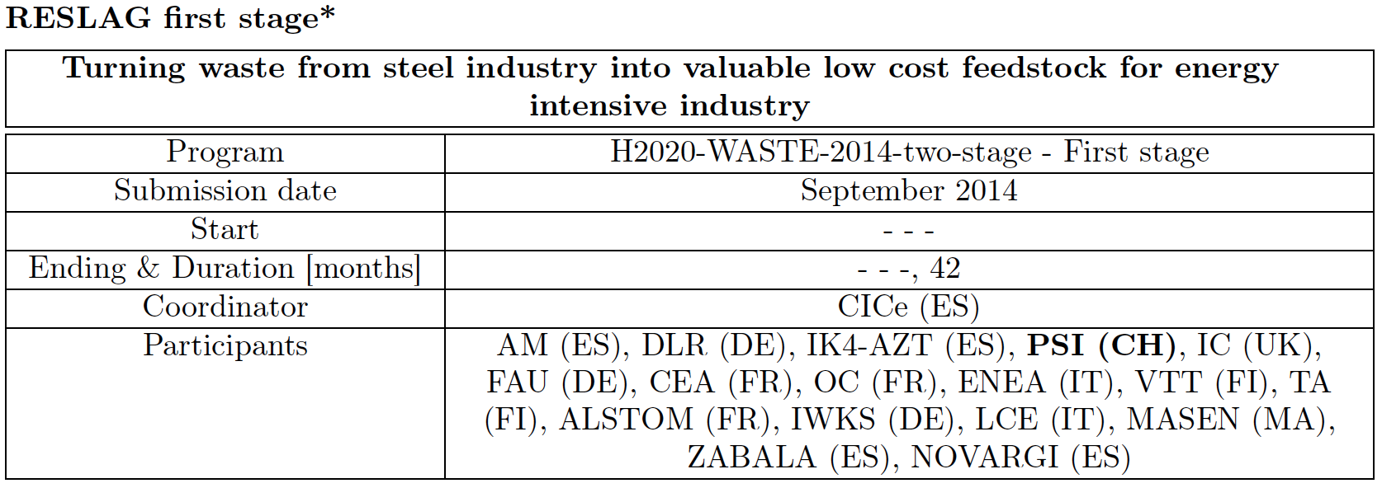
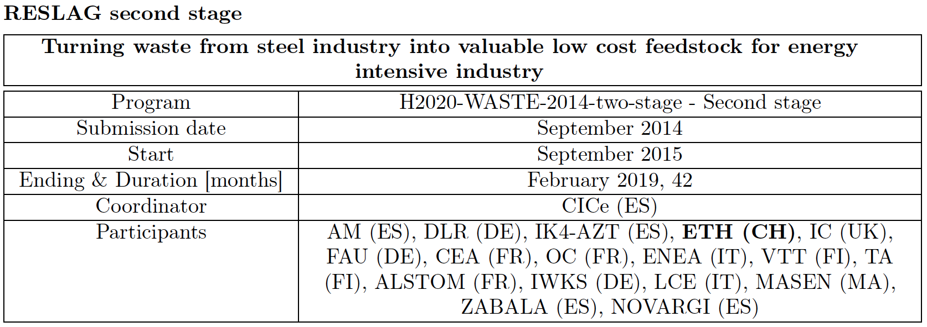
Project timing

Slide 7
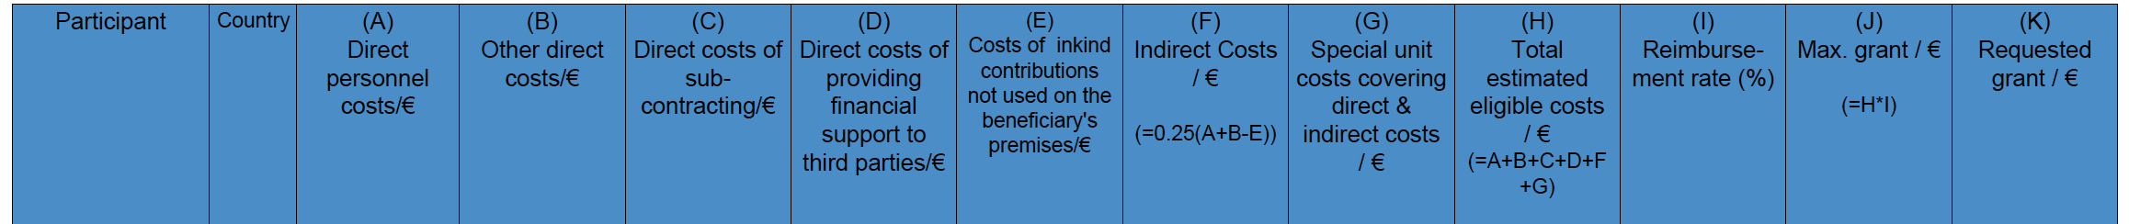
Project budget

Slide 8
Project aim and objectives
Main aim
Decrease of the environmental impact of landfill of steel slag by turning waste slag from the steel industry into useful feedstock for other industrial sectors leading to close loop processes
Objectives
Environment:
    Reduction of landfilled steel slag (25% of the total);
    Heat recovery and CO2 reduction;
    Primary raw material reduction.
Operative:
    Building and validation of 4 pilot system: (1) Non-ferrous high value metal extraction from slag; (2) Shaped pebbles for TES applications to recover heat in thermal energy intensive industries; (3) TES material to be used for CSP plants; (4) production of innovative refractory ceramic compounds.
Social, sectorial and policy :
To contribute to a close to zero waste Steel Sector;
To improve industry competitiveness in a wide number of sectors;
To give recommendations to the EU about the organizational RESLAG model.

Slide 9
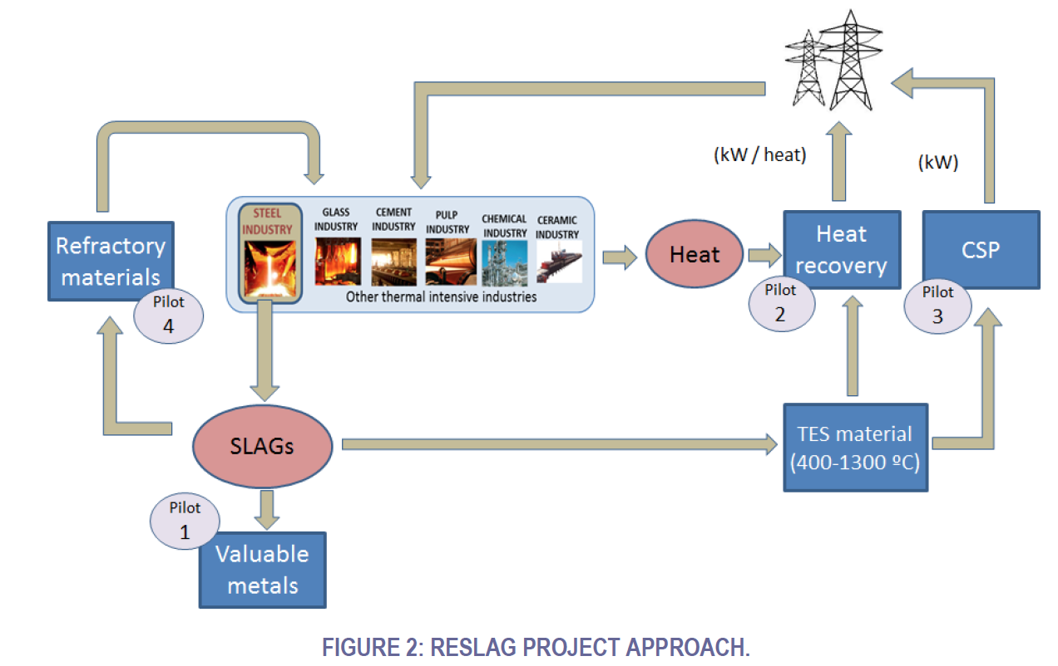
The project approach

Slide 10
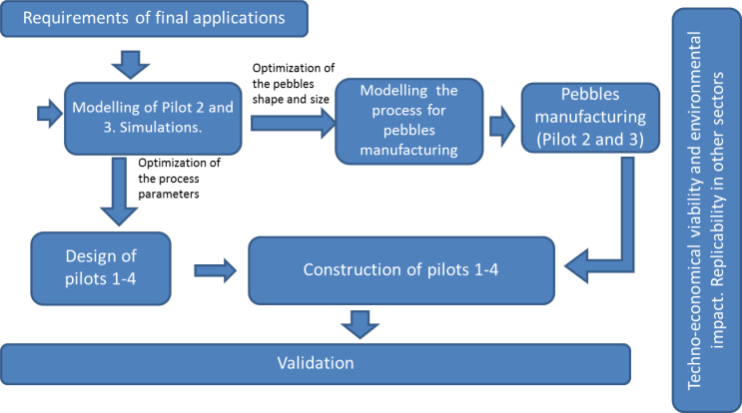
The project methodology
FIGURE 10: RESLAG OVERALL APPROACH AND METHODOLOGY

Slide 11
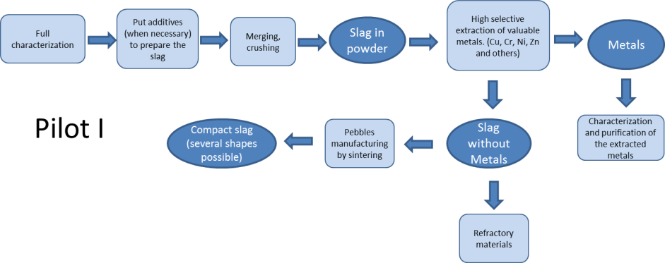
Pilot 1: Slag for valuable metal extraction
FIGURE 3: PILOT 1 FLOW CHART

Slide 12
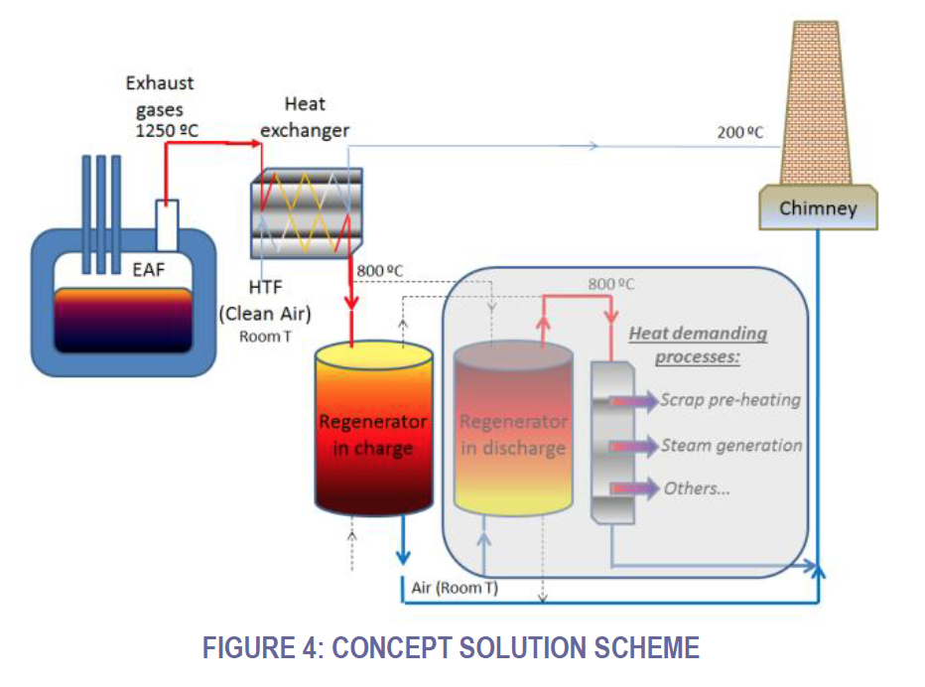
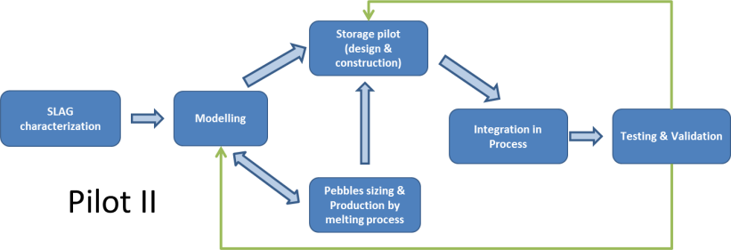
Pilot 2: Slag for waste heat recovery

Slide 13
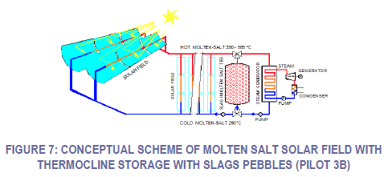
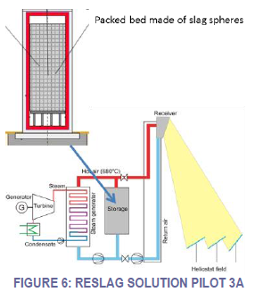
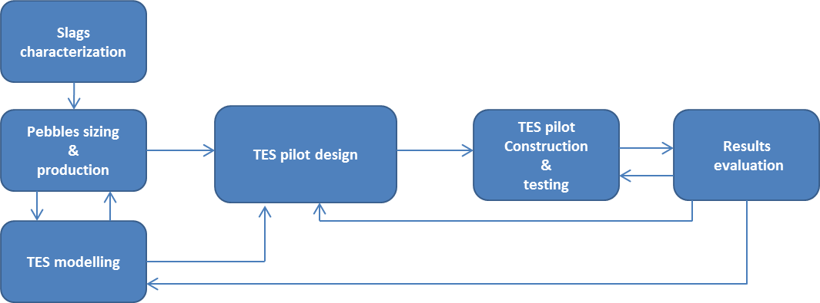
Pilot 3: Slag for heat storage in CSP plants
FIGURE 8: FLOW CHART OF ACTIVITIES FOR THE PILOT 3

Slide 14
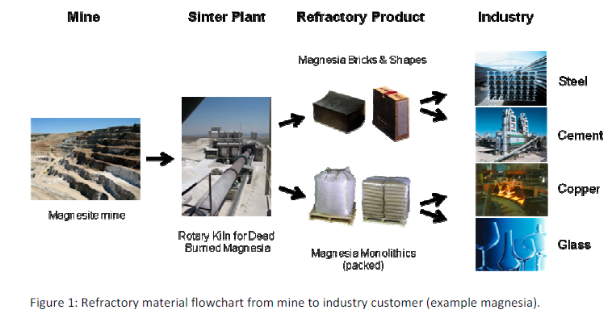
Pilot 4: Slag for innovative refractory ceramics
Slag will avoid the use of virgin raw material for refractories
Source: European Refractories Producers’ Federation
Slag will avoid energy consuming sintering/firing processes by using in-situ sintering of combustion chamber insulating linings
Energy intensity of different refractory product groups. Source:PRE product carbon footprint report © PRE/Cerame-Unie 2013
Courtesy of Pertti Lintunen, VTT

Slide 15
Conclusion: the path for a successful project
Project idea
from an experienced research team
Exploitation of waste slag for applications
for the metal extraction, heat recovery, CSP and refractory sectors
Idea development
2012
Search and evaluation
of instruments to support the project activities
Regional calls, National calls,
H2020 calls, direct industrial contract
2013
Project definition
2014
Identification of supporting entities
Project partners, management
entities, consultant agencies, material suppliers, H2020 staff, supporting industrial organizations, supporting stakeholders, etc.
Project writing
and
submission
2015
Project realization

Slide 16
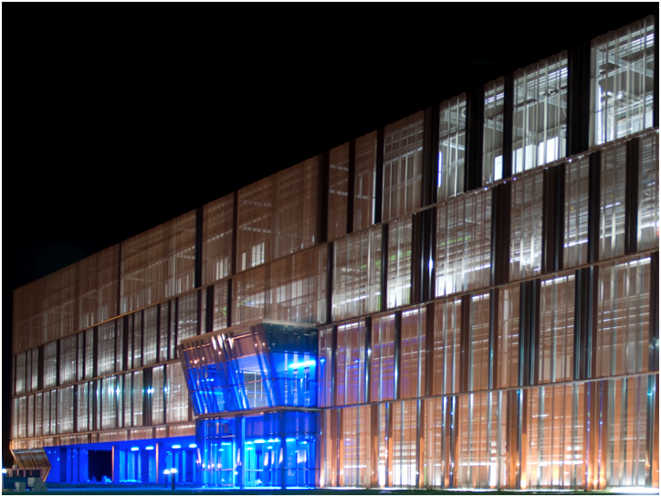

THANK YOU
CIC Energigune All rights reserved
Notes:
CONTRAPORTADA

