Slide 1
SteamBio
Flexible Superheated Steam Torrefaction and Grinding of Indigenous Biomass from Remote Rural Sources to Produce Stable Densified Feedstocks for Chemical and Energy Applications
Siegfried Egner
Fraunhofer Institute for Interfacial Engineering and Biotechnology IGB

Slide 2
Outline
The Consortium
Fossil vs. renewable biomass
Status quo
Our vision
SteamBio
Objectives
On-site operation
Downstream processing
The SteamBio Business
Supply chain

Slide 3
The Consortium
The research leading to these results receives funding from the European Union’s Research and Innovation Programme Horizon 2020 under Grant Agreement Nº 636865.

Slide 4
Outline
The Consortium
Fossil vs. renewable biomass
Status quo
Our vision
SteamBio
Objectives
On-site operation
Downstream processing
The SteamBio Business
Supply chain

Slide 5
Bioeconomy
Substitution of fossil carbon feedstock by renewable biomass
Lignocellulosic biomass is the biggest source of carbon
Alternative fuel for power plants
Green chemical building blocks

Slide 6
Status quo
Supply of fossil hydrocarbons via trans-European pipeline networks

Slide 7
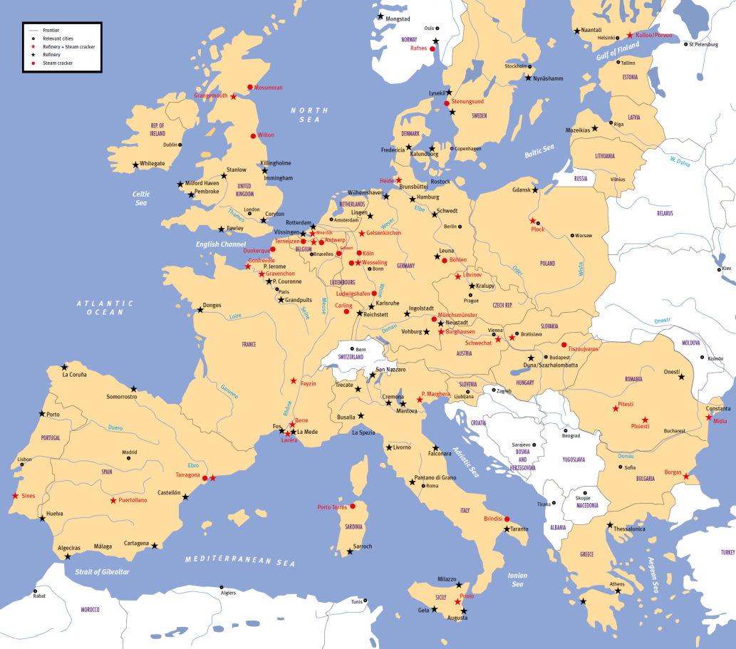
Major locations of petrochemical sites in Europe
Petrochemical industry is
heavily dependent on
fossil hydrocarbons
concentrated in
certain regions

Slide 8
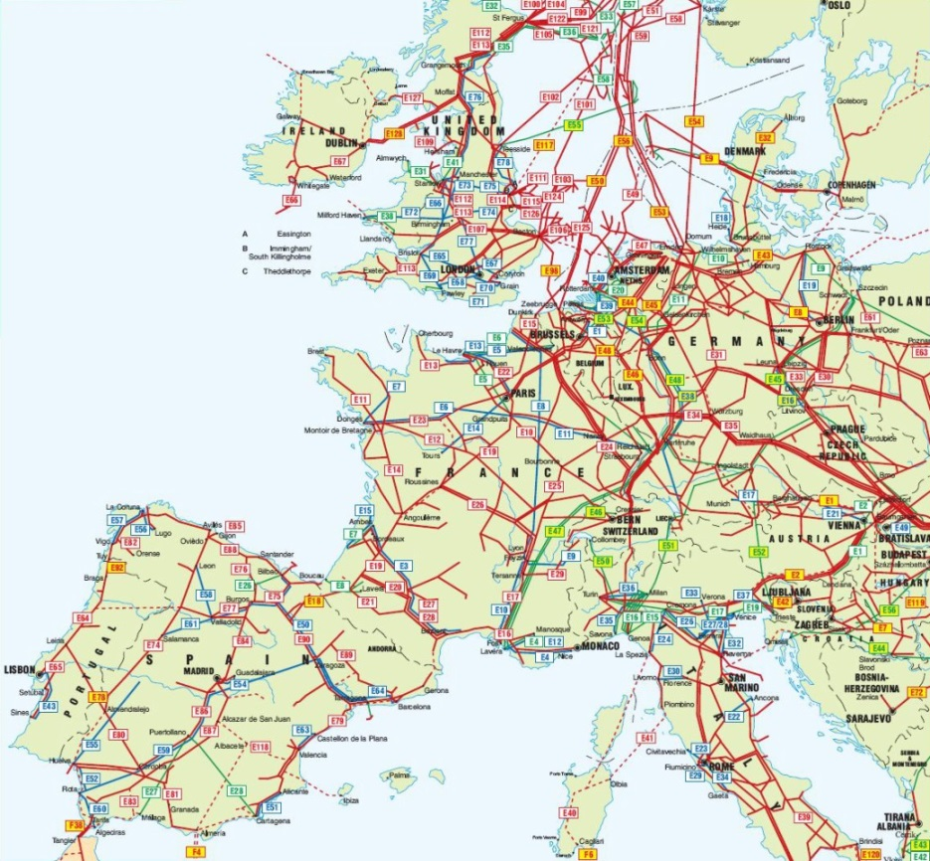
Status quo – Supply of oil and gas in Europe
Established supply of fossil hydrocarbons by trans-European oil and gas pipelines

Slide 9
Our vision
Supply of renewable hydrocarbons out of lignocellulose from forestry via trans-European transportation networks

Slide 10
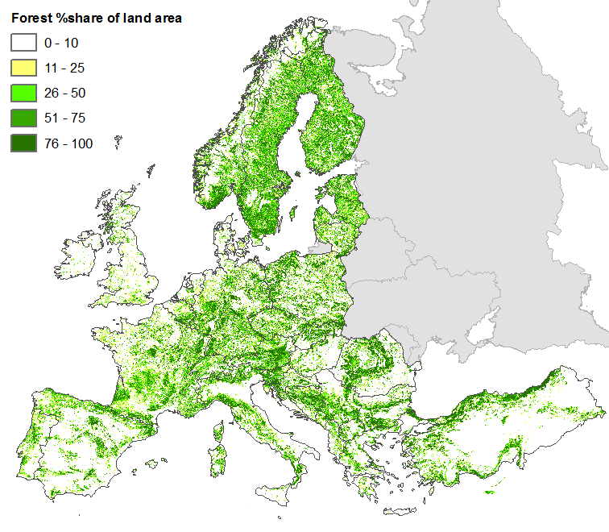
Sources of lignocellulosic biomass across Europe
Forest % share of land area
0 – 10
11 – 25
26 – 50
51 – 75
76 – 100

Slide 11
Mismatch between locations of source and demand
Forest % share of land area
Main forestry zones in remote areas
0 – 10
11 – 25
26 – 50
Urgent need of efficient trans-European delivery of biomass to chemical sites
51 – 75
76 – 100
Chemical sites

Slide 12
Challenges in handling lignocellulosic biomass
Solid material
Bulky feedstock with large particle size
High moisture content
No pipelining possible
Energy-intensive shredding for further use
Inefficient transportation
Minimization of transportation expenses by pretreatment of biomass
Our concept
SteamBio – Mobile advanced torrefaction process

Slide 13
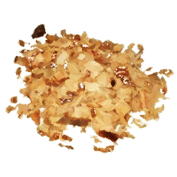
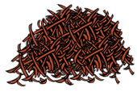
SteamBio – Superheated steam torrefaction of lignocellulosic biomass
Process “A“
Process “B“
Process “C“
solids
liquids
gas
Residues / Pruning / Thinning / Chips

Slide 14
Outline
The Consortium
Fossil vs. renewable biomass
Status quo
Our vision
SteamBio
Objectives
On-site operation
Downstream processing
The SteamBio Business
Supply chain

Slide 15
SteamBio – Objectives
Definition of optimum SHS processing parameters for assorted agro-forestry residues
Facilitation of transportation and storage of the torrefied outputs
Develop and build of mobile SteamBio system on a trailer as a scalable demonstrator unit
Process six different biomass materials with confirmation of stability of the output for over 12 month
Demonstration of the SteamBio process at over five different locations
Validate the technical and economic viability of the integrated process
Confirm the full life economic, environmental and social sustainability of the entire approach

Slide 16
SteamBio – Enabling technologies
On-site operation
Superheated steam (SHS) processing
Combined milling in SHS atmosphere
Pre- and post-handling systems (coveying, filling, loading, packaging, etc.)
Volatiles fractionation (e.g. selective condensation)
Downstream processing
Organosolv-process
High-vacuum and flash distillation
Liquid-liquid extraction

Slide 17
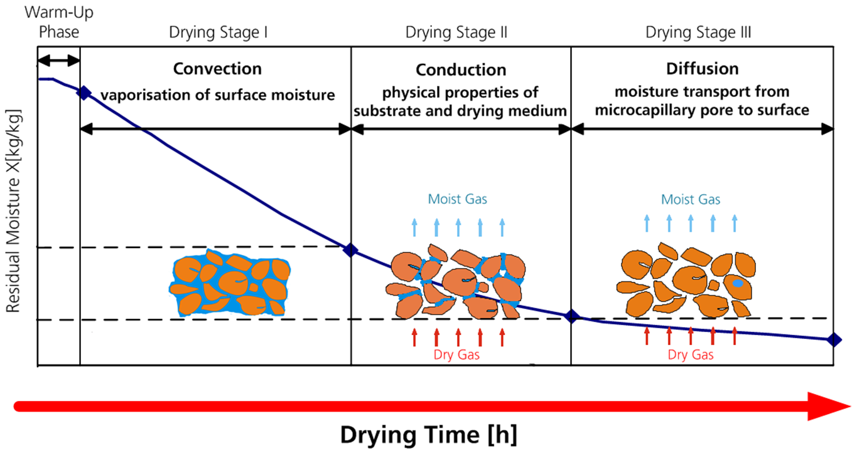
SHS processing so far just used for drying
Superior heat transfer properties compared to hot air
Reduced processing time and lower specific energy consumption
No oxidative reactions and avoiding the risk of fire or explosions
Allowing recovery of energy and volatile compounds

Slide 18
The SteamBio SHS torrefaction process
SHS processing extended operation
Increase in energy density of the solid biomass
Decrease in volumetric density of the solid biomass
Reduction in power consumption required for grinding
Improved transport and storage stability

Slide 19
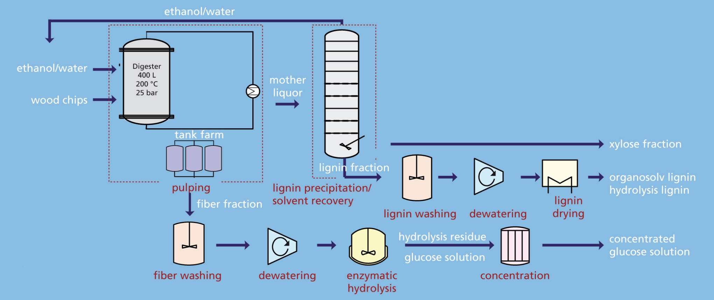
Downstream processing – Solid handling
E.g. organosolv-process

Slide 20
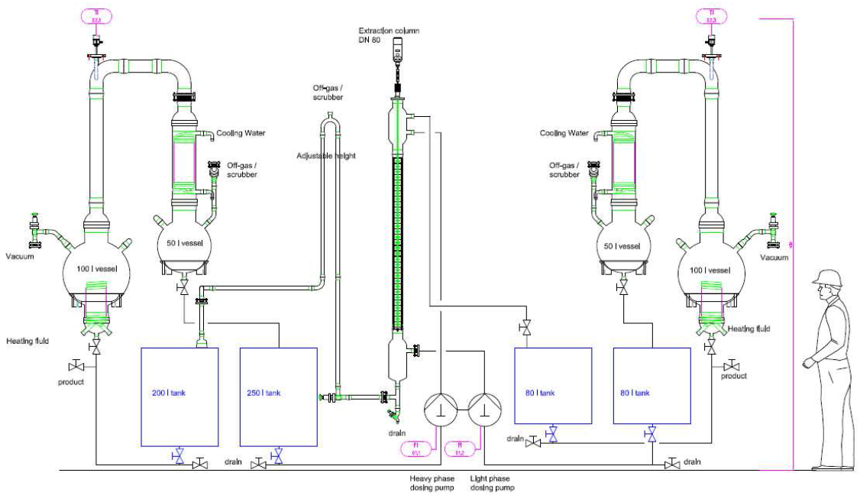
Downstream processing – Liquid (condensable) handling
E.g. extraction column with distillation recovery

Slide 21
Outline
The Consortium
Fossil vs. renewable biomass
Status quo
Our vision
SteamBio
Objectives
On-site operation
Downstream processing
The SteamBio Business
Supply chain

Slide 22
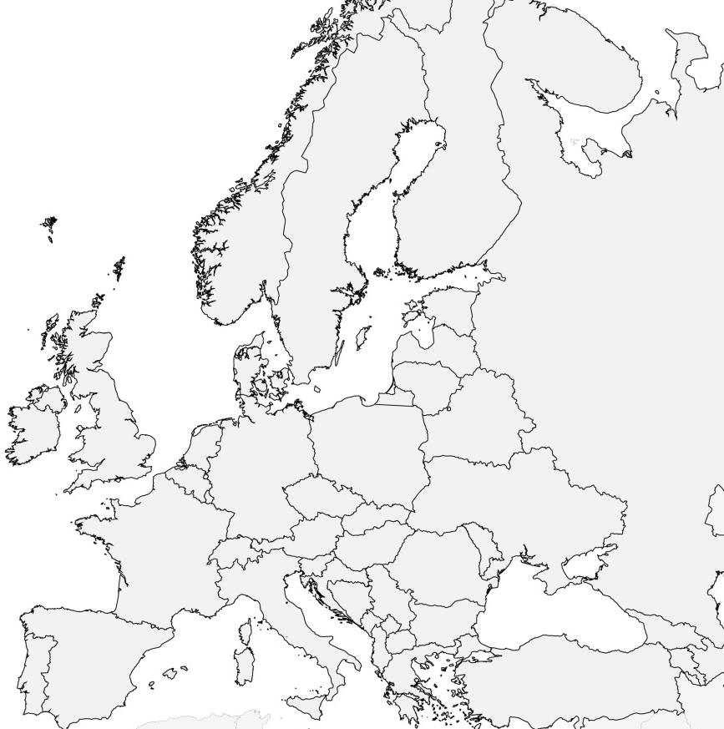
Supply chain level 1 – Local pretreatment
N
Local forestry
districts
FIN
10¹ km
S
Mobile SteamBio-service of pretreatment

Slide 23
Supply chain level 2 – Short distance transportation
N
N
Mobile SteamBio-service of pretreatment
FIN
FIN
10² km
S
Shipping
terminals
S

Slide 24
Supply chain level 3 – Trans-European transportation
N
Shipping
terminals
FIN
10³ km
Chemical process
sites
S

Slide 25
Thanks for Your Attention!
Coordination and Contact:
Siegfried Egner , Dipl.-Ing.
Fraunhofer Institute for Interfacial Engineering and Biotechnology IGB
Department of Physical Process Technology
Nobelstrasse 12, 70569 Stuttgart, Germany
Phone +49 711 970-3643 | Fax +49 711 970-3997
siegfried.egner@igb.fraunhofer.de
www.igb.fraunhofer.de

